Slide 1
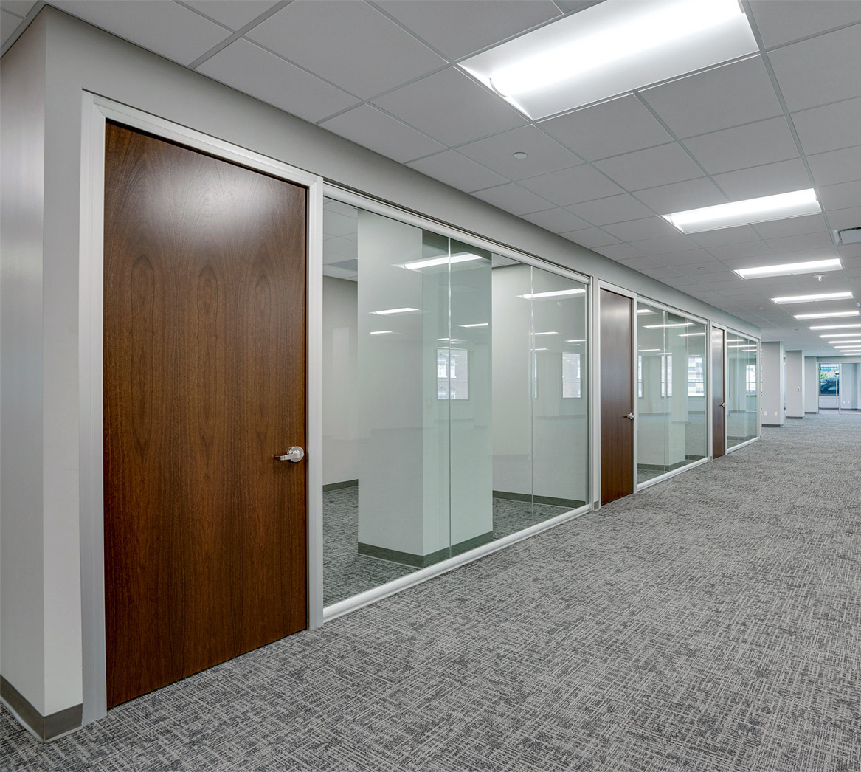

NxtWall’s Winning Combination -
Flexible, Sustainable, Affordable,
and Fast!
www.nxtwall.com

Slide 2
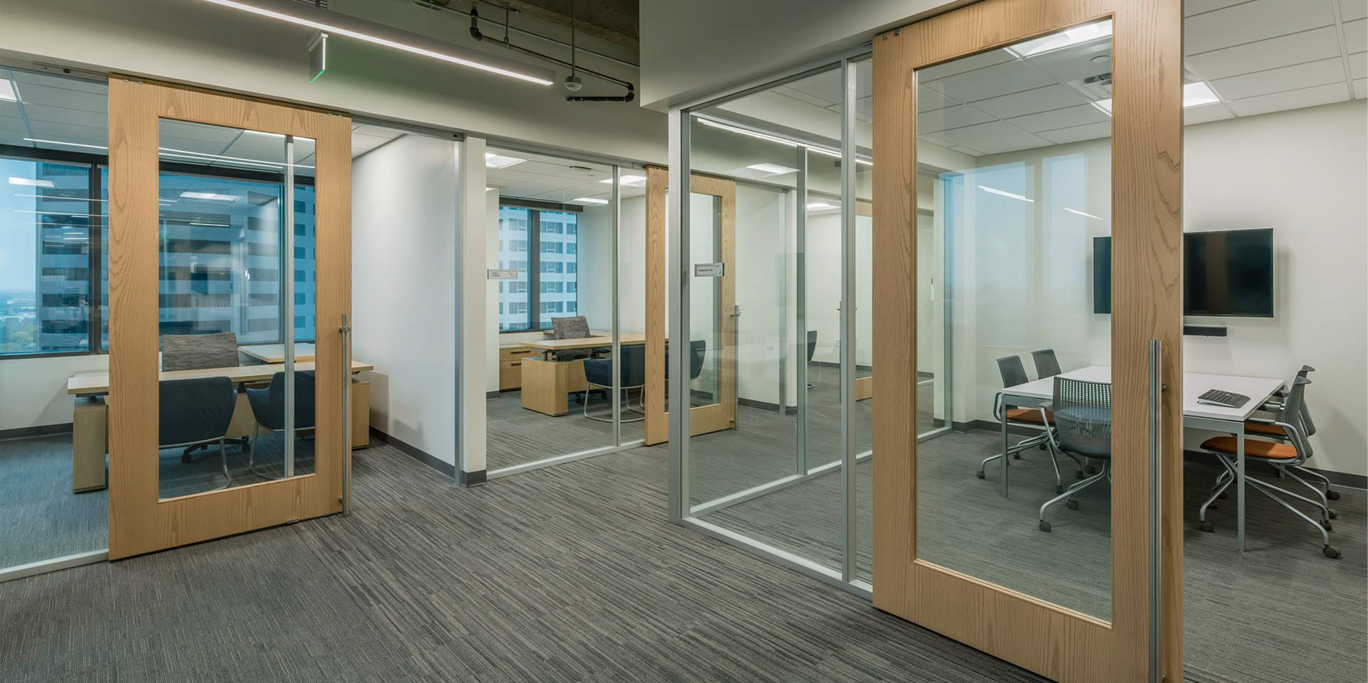
Who is
?
• Architectural Wall/Partition company focused on offering great aesthetics with flexible design options that are sustainable and up to 100% recyclable.
• Made in the USA
• Installations in 48 states and 8 countries
• Headquarters and corporate showroom located in Kalamazoo, MI
• Privately Owned
Flex Series

Slide 3
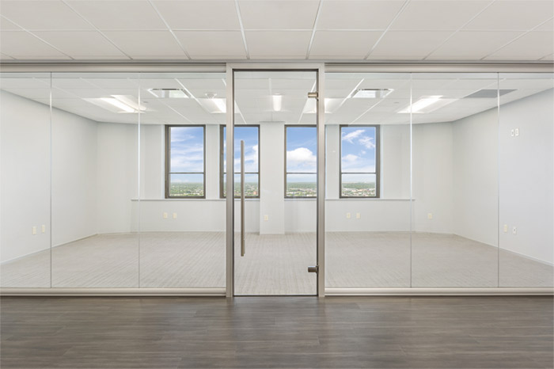
What is
?
• Demountable Wall Systems
• Stick Built
• Field-Fit
• Component-Based
• Endless Product Integration
• Non-Progressive
• Non-Unitized
• Utilize Local Labor and Regional Suppliers
View Series

Slide 4
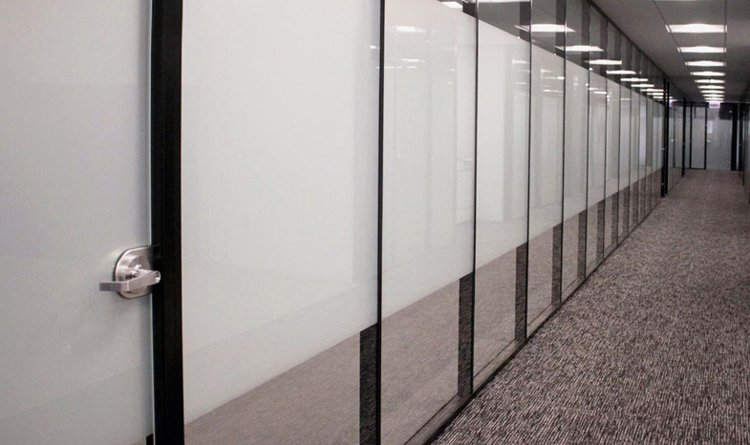
When
?
• Focused on Mid-Market Pricing
• Speed of Construction
• Challenging Environments
• Maximum Flexibility
• Sustainability/LEED
• Tax Savings
• Social Distancing
• Free Standing or Floor-to-Ceiling
• When Future Changes are Inevitable and competitive pricing is important!
Flex Series

Slide 5
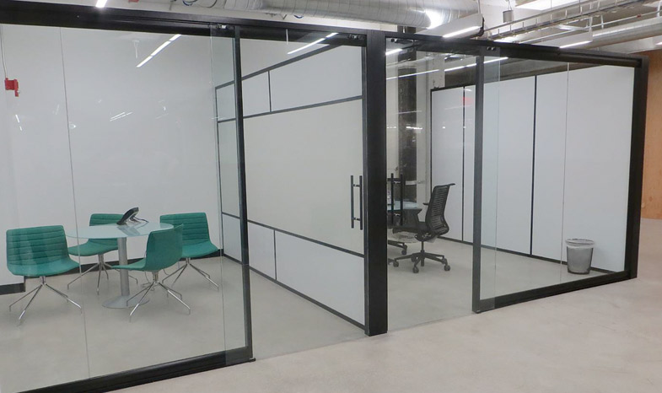
Why
?
• Proposal within 3 Business Days
• 3-5 Week Lead Time on Standard Products
• Free Design Service
• Experienced & Knowledgeable Staff
• Marketing Support & Resources
• Continuous Process and Product Development
• Exceptional Value, Attention to Detail, and One-of-a-Kind Service
View Series (with Flex Series Sidewalls)

Slide 6

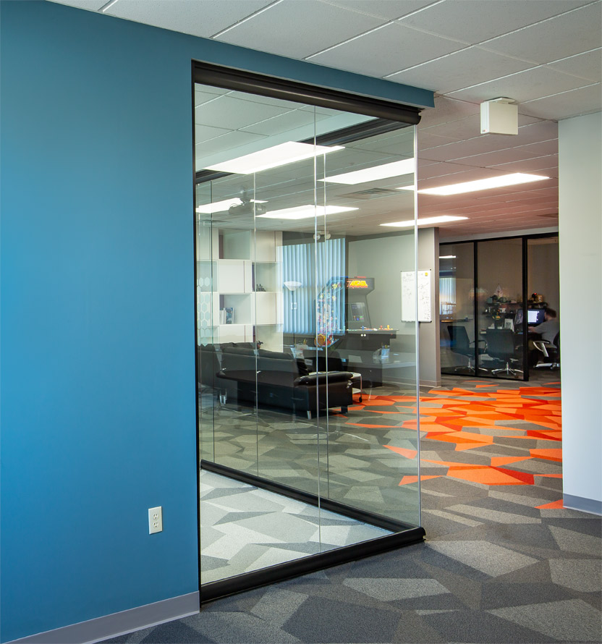
Sustainable
• Up to 100% Recycled, reusable, and reconfigurable – keeping drywall and debris out of our landfills
• Eco-friendly finishes available
• Regional materials as needed
• Supports worker comfort, safety, and health
Meet the needs of today’s ever-changing world without compromising the future.
View Series

Slide 7
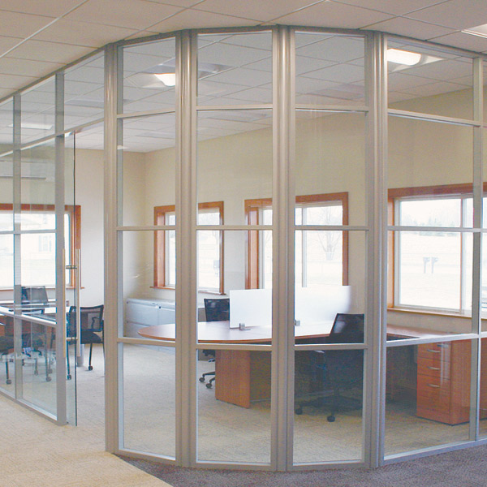
Flexible
• Ability to accommodate any design layout.
• Unlimited wall panel material choices.
• Ease of panel replacement save time and money on reconfigurations.
• Integrates with existing construction or even existing wall systems.
• Scalable to fit your budget and building needs.
• Eliminate the risk of incorrect field measurements and panel sizes by using our field fit components.
• Modular power options available, can be installed at multiple locations and heights.
Flex Series

Slide 8
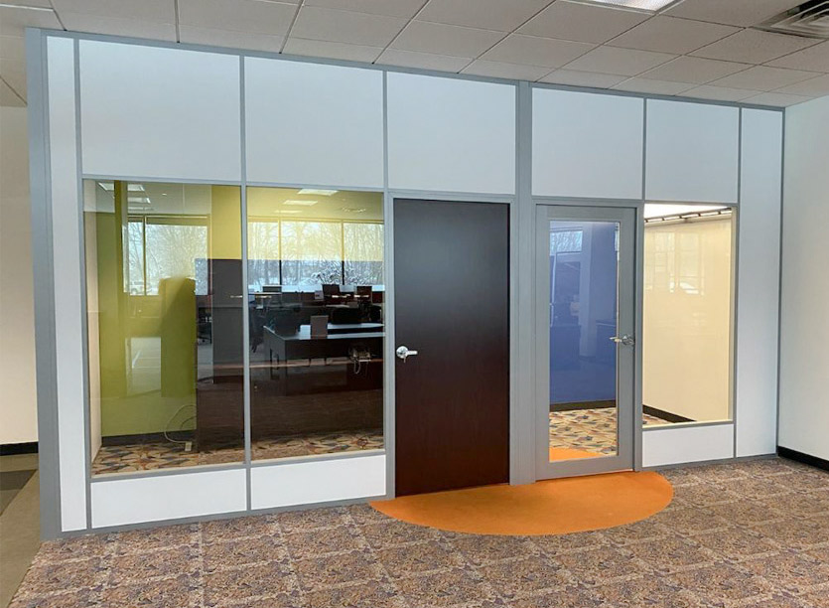

Speed
• Fastest lead times in the demountable wall industry with a 3-5 week standard lead time
• Fast and easy to reconfigure
• A single trade can install NxtWall from start to finish
• Quotes/Proposal within 3 Business Days
• Use NxtWall’s Quick Ship program when you need a solution fast!
NxtWall’s Demountable Wall Quick Ship program allows
orders using stock finishes, doors, door hardware, wall board,
and glass to be shipped complete and ready to install – in as
little as 7 days!

Slide 9
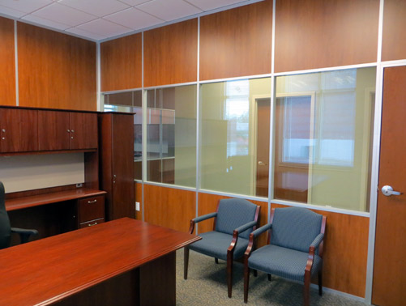
FLEX Wall Series
Endless Solids & Glass
3” Thick Wall
Floor to Ceiling/Freestanding
Solid Panels can be any ½” material
Easily Incorporate Glass and Solids
Single or Double pane Glass
Universal Swing Doors
Barn and Pocket Door Options
Great Acoustical Performance
  Solid Panel STC 42
  Glass Panel up to STC 41
Integrated White Board, Tackable Surface, Fabric, Back Painted Glass, Blinds, etc.
Accepts all Power/Data (Plug & Play or Conventional)
Accepts surface-mounted hanging of Storage and Media
Portable/reusable

Slide 10
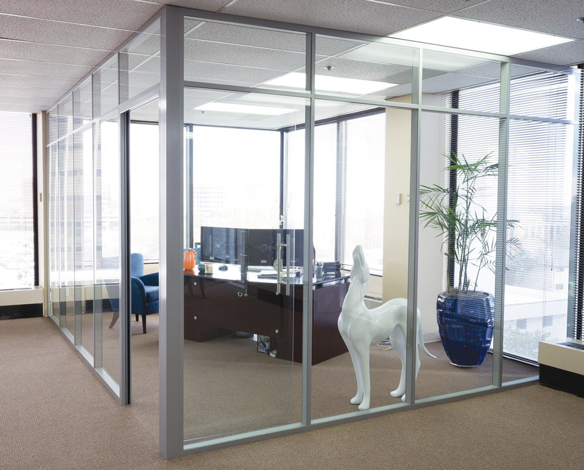
Connected to Grid
Horizontal Mullion
Glass Slab Door with 15” Bar Pull and Self-Closing Hinges
Dog from “Friends”
Flex Series

Slide 11
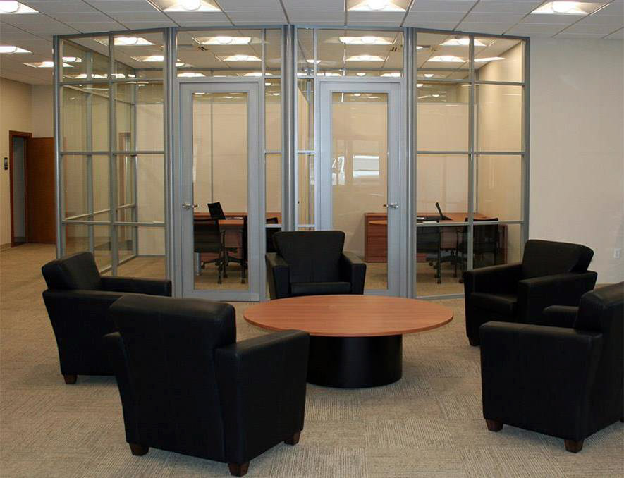
Multiple Segments
Radius Posts for Curved Walls
NxtWall Aluminum Framed Doors
Flex Series

Slide 12
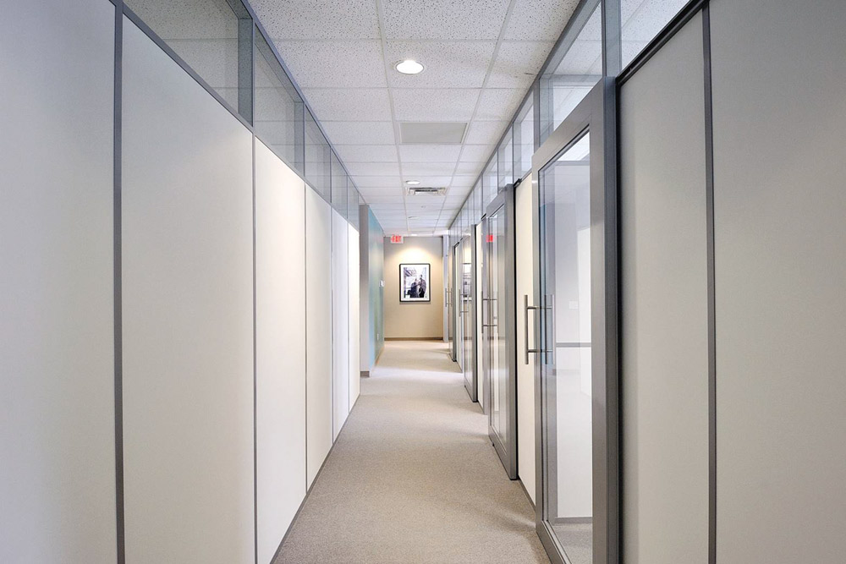
NxtWall (C-Rail)
Barn Door System
Clerestory Glass
Vinyl Wrapped Gypsum Panel
NxtWall “Full Lite” Barn Door
Flex Series

Slide 13
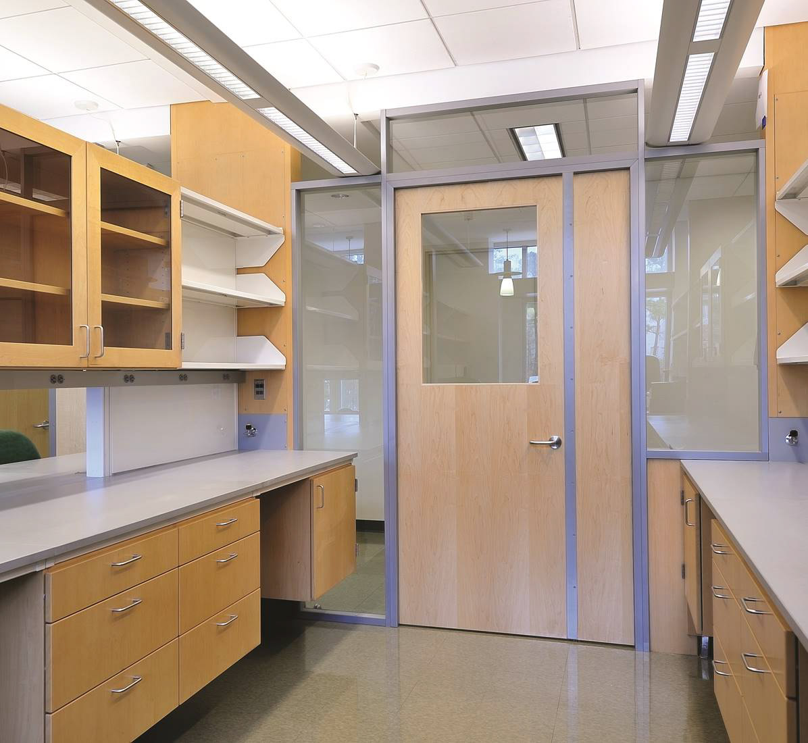
Lighting and Casework were installed prior to the NxtWall. The installer was required to build around them. This was not the original plan and occurred on the fly.
Custom made door with a passive astragal that can be opened when large lab carts are utilized.
Flex Series

Slide 14
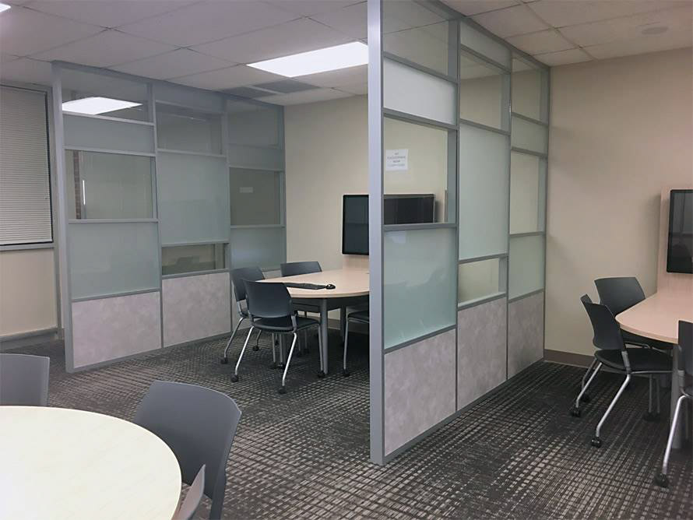
Flex Series used as a space divider- utilizing segmentation of Clear Glass, Frosted Glass, and Vinyl Wrapped Gypsum Panels. Great way to provide social distancing.
Flex Series

Slide 15
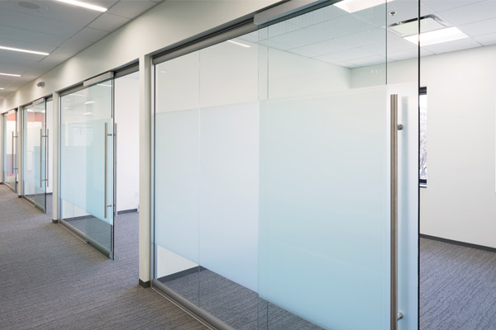
VIEW Wall Series
Center Mounted Glass
Center Mounted Single Pane Glass 3/8” to 1/2”
Floor to Ceiling/Freestanding
Integrated Sliding Doors
Universal Swing Doors
Designed as a stand alone Storefront
Compliments the Flex Series for a total office solution
Adaptable/Flexible enough for uneven floors
Completely portable and reusable

Slide 16
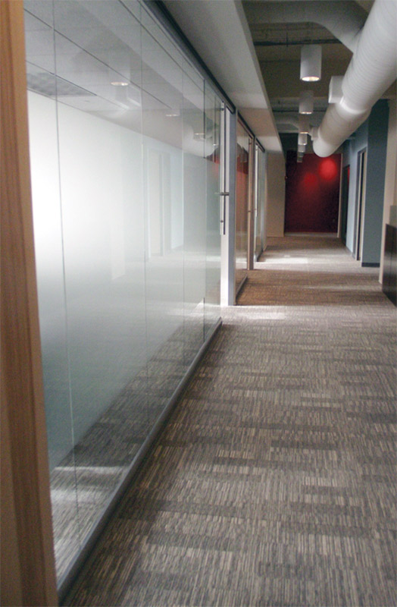
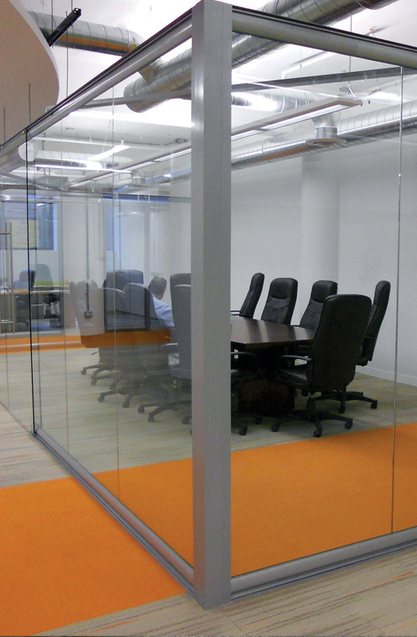
Connected to Bulkhead
Locking Ladder Pull that Locks into the Ceiling
Cross Bracing Added
Additional Support connected to the Deck to carry weight of the Door
Customer Applied Frosted Film
Freestanding Installation
View Series
View Series

Slide 17
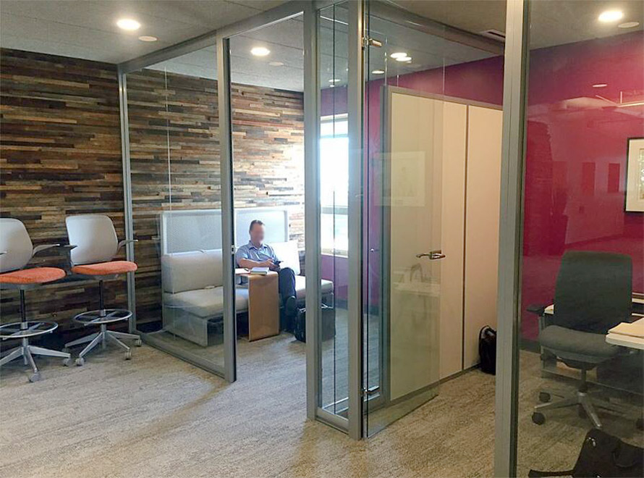
Full Height Glass Slab Doors
Flex Series Dividing Wall
T-Type Wing Back Connected to the Flex Series
View Series

Slide 18
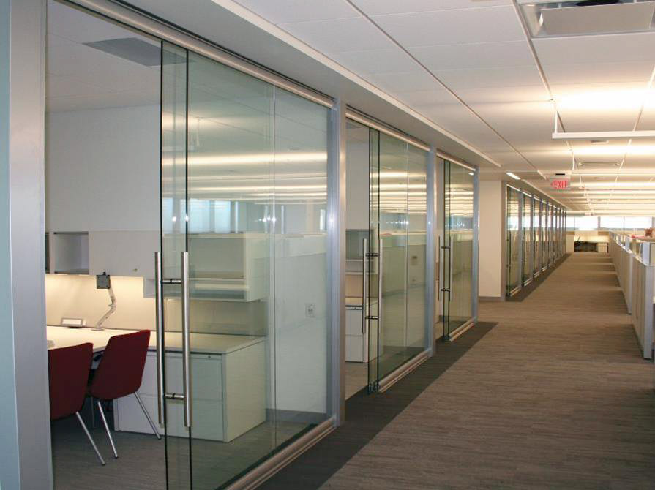
Special End Cap Detail installed on the Drywall Dividing Wall
36” Non-Locking Door Pulls
View Series

Slide 19
SOUND TRANSMISSION CLASS (STC) RATINGS
WALLS:
DOORS:
(FLEX SERIES)
Install Type: STC Rating:
1/4” Single Pane Glass…………………………………..…………………..31
Fabric on Tackboard with Rock Wool Insulation………………….31
MDF Laminate with Rock Wool Insulation…………………………..36
1/4” Double Pane Glass………………………………………………………38
1/4” Single Pane Glass + 3/8” Single Pane Glass………………….41
Vinyl Wrapped Gypsum with Insulation………………………………42
(VIEW SERIES)
Install Type: STC Rating:
3/8” Glass……………………………………………………………………………34
1/2” Glass …………………………………………………………………………..36
(SWING DOORS)
Install Type: STC Rating:
Aluminum Framed Door……………………………………………………..19
-with Drop Seal.……………………………………………………………23
3/8” Glass Door…………………………………………………………………..19
-with Drop Seal……………………………………………………………22
Solid Core Wood Door…………………………………………………………19 -with Drop Seal……………………………………………………………27
(SLIDING DOORS)
Install Type: STC Rating:
Aluminum Framed Door or 3/8” Glass Door……………………….09
-with Vinyl Wipes.……………………………………………………….16
-with Vinyl Wipes and Drop Seal…………………………………25

Slide 20
The
Advantage
Work Flow: Clean efficient process • One Trade group • Low impact on operations.
Sustainability: Recycle • Reuse • LEED • Daylight harvesting with use of glass walls.
Price: Blended price per lineal foot competitive with GC/Trades.
Architectural: Glass and solid walls with an array of finish options fits unique shapes.
Permits: Some municipalities may not require a permit to install furniture.
Quick lead times: 3-5 Week Standard Lead Times.
Flexibility: As requirements change, NxtWall can adapt.
Long Term savings: Reuse/Re-purpose strategy.
Tax Advantages: Qualifies as Furniture for accelerated depreciation.
Speed: Fastest standard lead time in the industry • No delays as with typical gypsum board construction • Eliminate debris, sanding, finishing and painting.
Experience: NxtWall has the expertise, experience and the capability to provide a
successful project on time and on budget.

Slide 21

NxtWall’s winning combination -
Flexible, Sustainable, Affordable, and Fast!
KEY CONTACTS
Jerry Sweet
Tim Gunter
Matt Sweet
Petra Jodelis
President
Lead Designer
Project Manager
Marketing
jsweet@nxtwall.com
tgunter@nxtwall.com
msweet@nxtwall.com
pjodelis@nxtwall.com
269-488-2752
www.nxtwall.com

Slide 22
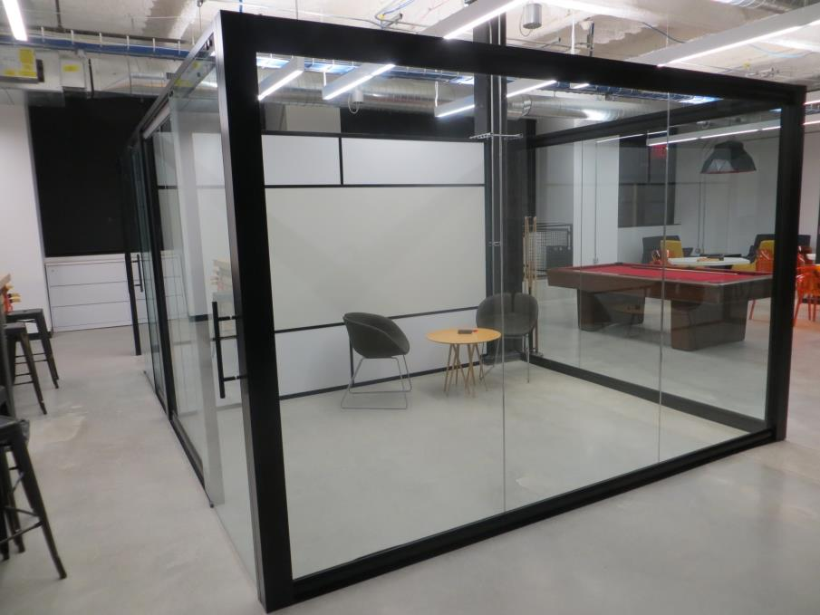

Thank You!
Contact:
Type your name and contact information here
View Series (with Flex Series Dividing Wall)

