Slide 1

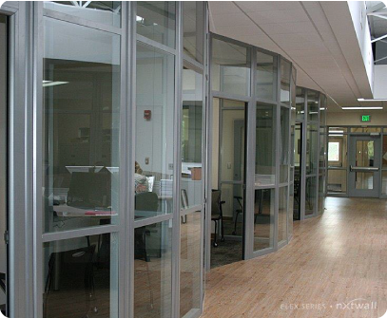
FLEX Architectural Wall System

Slide 2

Who We Are…
Demountable Wall/Partition company focused on offering great aesthetics, flexible design and sustainable products
100% Made in the USA
Delivers a “real” Demountable Wall solution that supports and promotes change, understands the importance of cost while adapting to the needs of an ever changing workplace.
Installations in 40+ States
Headquarters located in Kalamazoo, MI
Corporate showroom in downtown Chicago near the Merchandise Mart

Slide 3
Why use NxtWall Demountable Wall Systems?
      Simple Kit of Parts (Solid-to-Glass or Glass-to-Solid)
      Field Fit (Stick Built vs Unitized or Semi-Unitized)
      Non-Progressive
      Ease and Speed of Construction
      2 to 3 Week Standard Lead Time
      The Most Sustainable Solution in the Industry
      LEED Points (Regional Materials, Local Labor)

Slide 4
Sustainability
Meet the needs of the present without compromising the ability of future generations to meet their own needs.
      Recycled and recyclable content
      Outstanding product reuse strategy
      (Reusable and reconfigurable)
      Regional materials as needed
      Supports worker comfort, safety and health
      Supports daylight harvesting

Slide 5
































Who We Serve

Slide 6
The NxtWall Advantage
Work Flow: Clean efficient process, One Trade group, Low impact on operations
Sustainability: Recycle, Reuse, LEED, Worker comfort
Price: Blended price per lineal foot competitive with GC/Trades
Architectural: Glass, Colors, Unique shapes, Integration
No Permits: Most municipalities do not require a permit to install furniture
Quick lead times: 2-3 Week Standard Lead Times
Flexibility: As requirements change so can our walls
Long Term savings: Reuse/Repurpose strategy
Tax Advantages: Qualifies as Furniture for accelerated depreciation
Speed: No delays as with typical gypsum board construction. Eliminate debris, sanding, finishing and painting
Experience: NxtWall has the expertise, experience and the performance to provide a
successful project on time and on budget

Slide 7

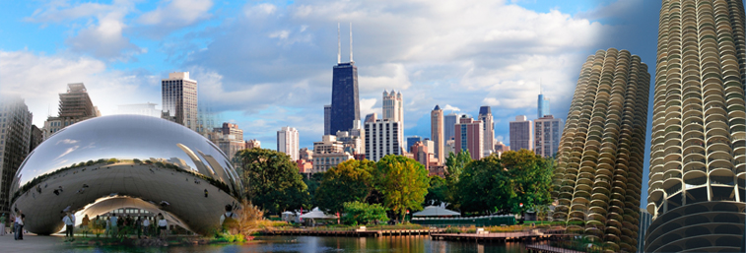
Chicago Showroom
  401 North Franklin, Suite 4E, Chicago, IL 60654
Adjacent to The Merchandise Mart

Slide 8
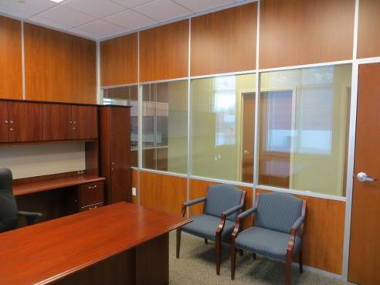
FLEX WALL SERIES
3” thick wall
Floor to ceiling / Freestanding
Wall board can be any ½” material
Easily incorporate glass and solids
Single or double pane glass
Universal swing doors
Great acoustical performance
Wide trim option (Genesis)
Integrated white boards, tackable surfaces, power/data, electric privacy glass, etc.

Slide 9
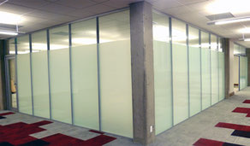
FLEX WALL SERIES DESCRIPTION
The Flex Series is one of the most flexible, sustainable and affordable wall systems available on the market. It offers numerous options that are not commonly found within a demountable wall system.
The Flex wall system fits the needs of your workspace – both today and tomorrow’s needs.
Designed to accommodate reconfigurations with ease, Flex systems are easily switched from solid panels to glass to whiteboard and even to tackable fabric panels, all with minimal interruption and downtime.

Slide 10
FLEX WALL SERIES SPECIFICATIONS
Wall Type: Architectural based office wall
__________________________________________________________________________________
Partition Coverstrips (Trim): Thin/Flat: 1-1/16”W
Genesis/Flat: 1-9/16”W
__________________________________________________________________________________
Frame Material: Aluminum
__________________________________________________________________________________
Wall Thickness: 3-1/16”
__________________________________________________________________________________
Studs: Multi-directional studs or square angle corner posts
__________________________________________________________________________________
Panel Options: Unlimited choice
(Melamine, Veneer, Vinyl-wrapped gypsum, Glass, MDF, Fabric-wrapped tackable softboard, metal grating, etc…)
__________________________________________________________________________________
Door Options: Solid, Frameless glass, Aluminum framed glass
(Any height sliding or swing configurations)
__________________________________________________________________________________
Maximum Overall Height: 20’
__________________________________________________________________________________
Glazing Options: Single or double pane, clear tempered, frosted, mixed

Slide 11
FUNCTIONALITY
Integrates with existing construction
Ability to Accommodate any design layout
Reversible doors and door frames
Height Adjustable
Integrates with whiteboards and electronics with ease
Supports difficult building environments
Easy access to infrastructure and wiring
Compressive and extremely scalable wall solution
Unlimited choice of wall modulations

Slide 12
AVAILABLE OPTIONS
Frame Finishes:
• Standard MS Silver powder coat
• Custom powder coat
• Clear anodized
• Custom anodized
Wall Panels:
• Unlimited!
Doors:
• Options for security, privacy, & accessibility
• Sliding doors to maximize sq/ft
• Swing doors
• Aluminum Framed
• Veneer, glass, or laminate
• Single or double doors
Door Hardware:
• Locking and non-locking bar pulls
• Numerous options available

Slide 13
FLEX SERIES
PHOTO GALLERY

Slide 14
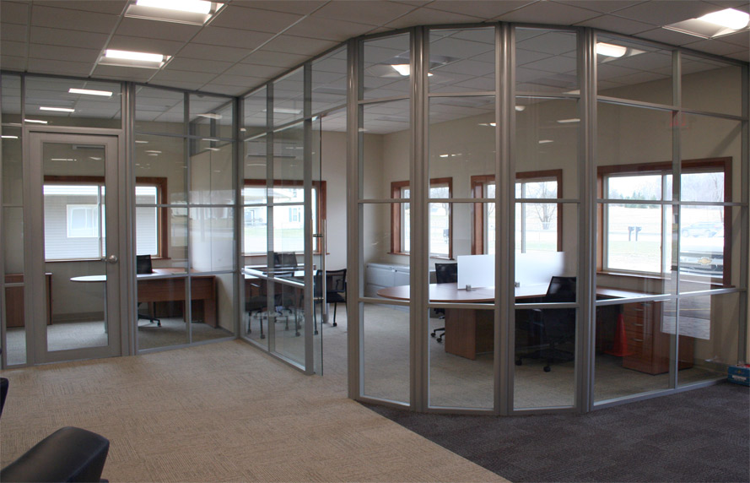
Solid Core Swing Door, Sidelight and Laminate

Slide 15
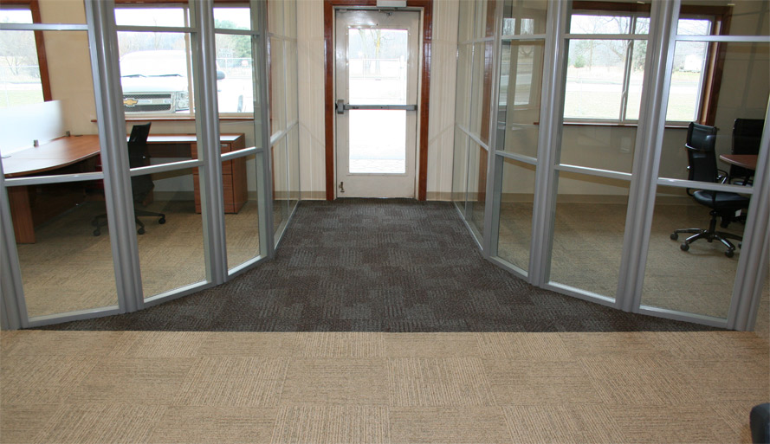

Slide 16
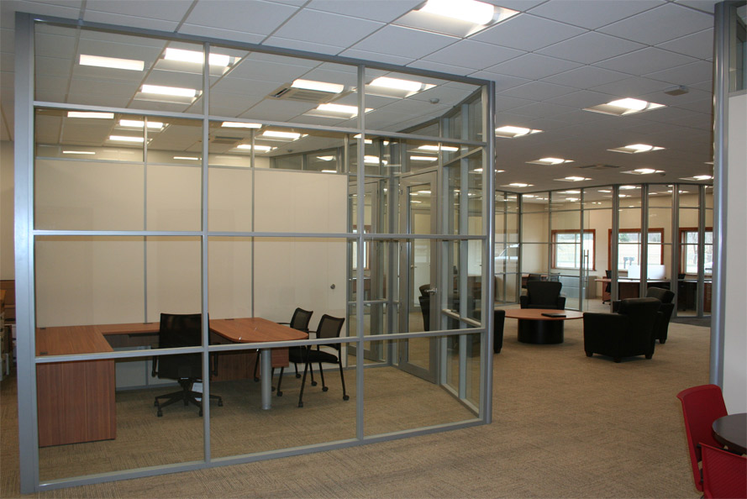

Slide 17
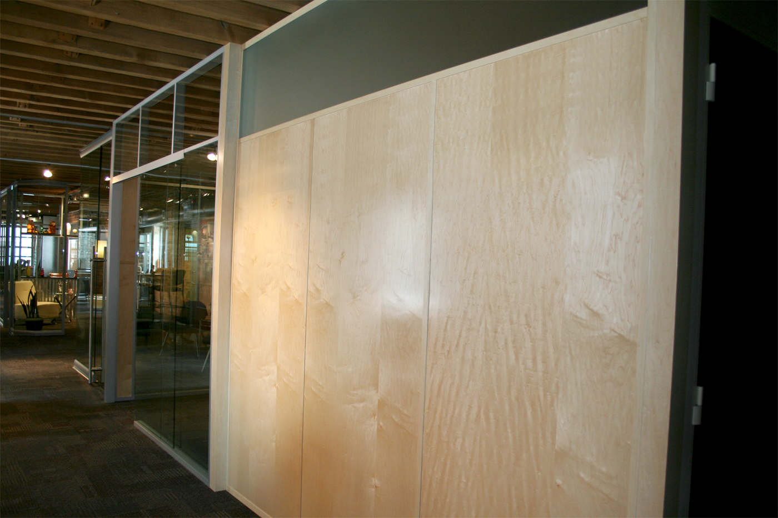

Slide 18
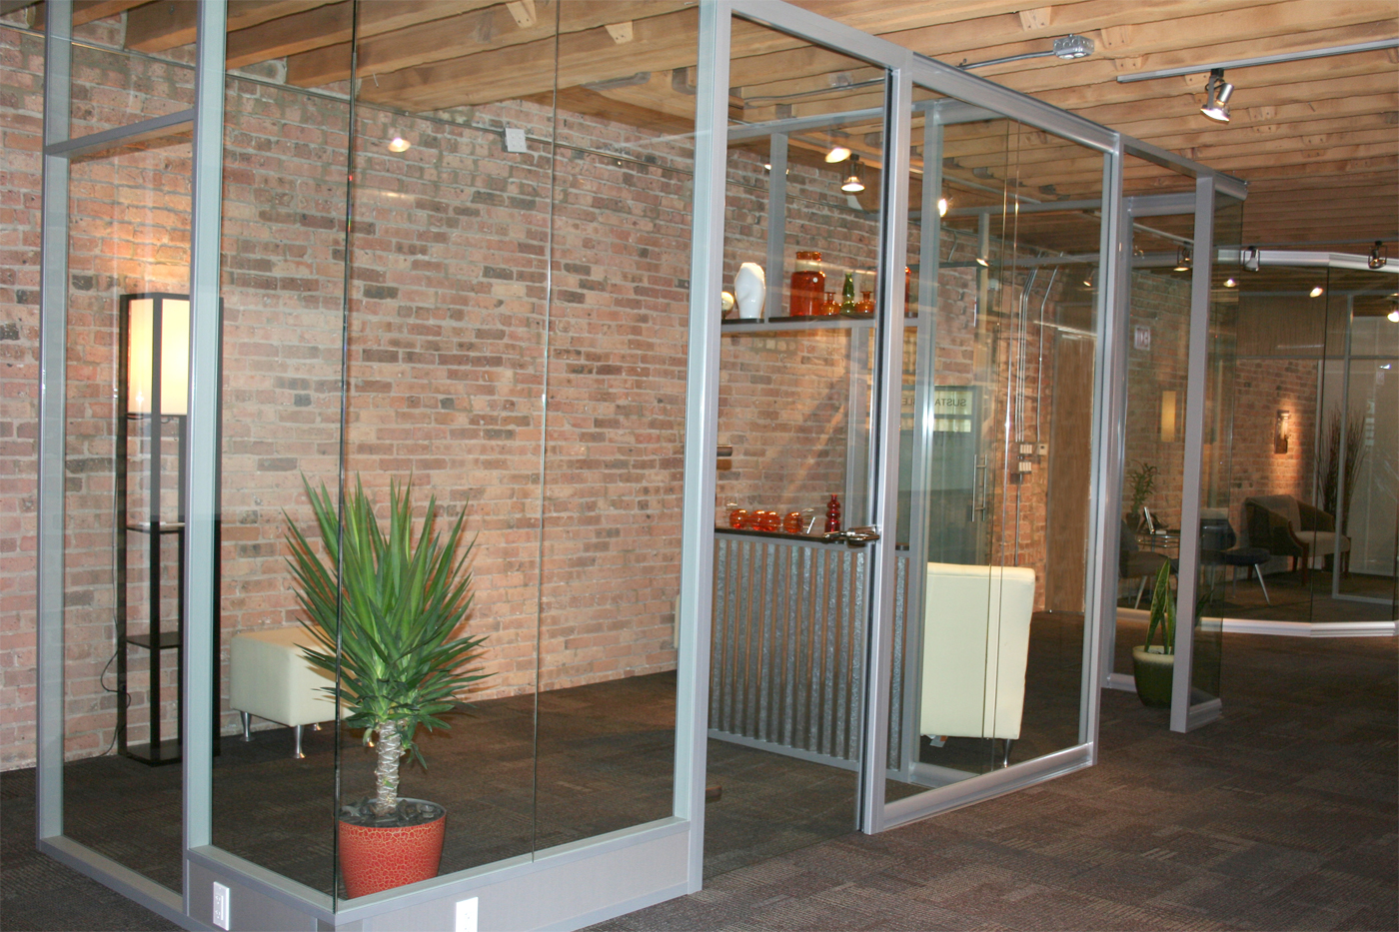

Slide 19
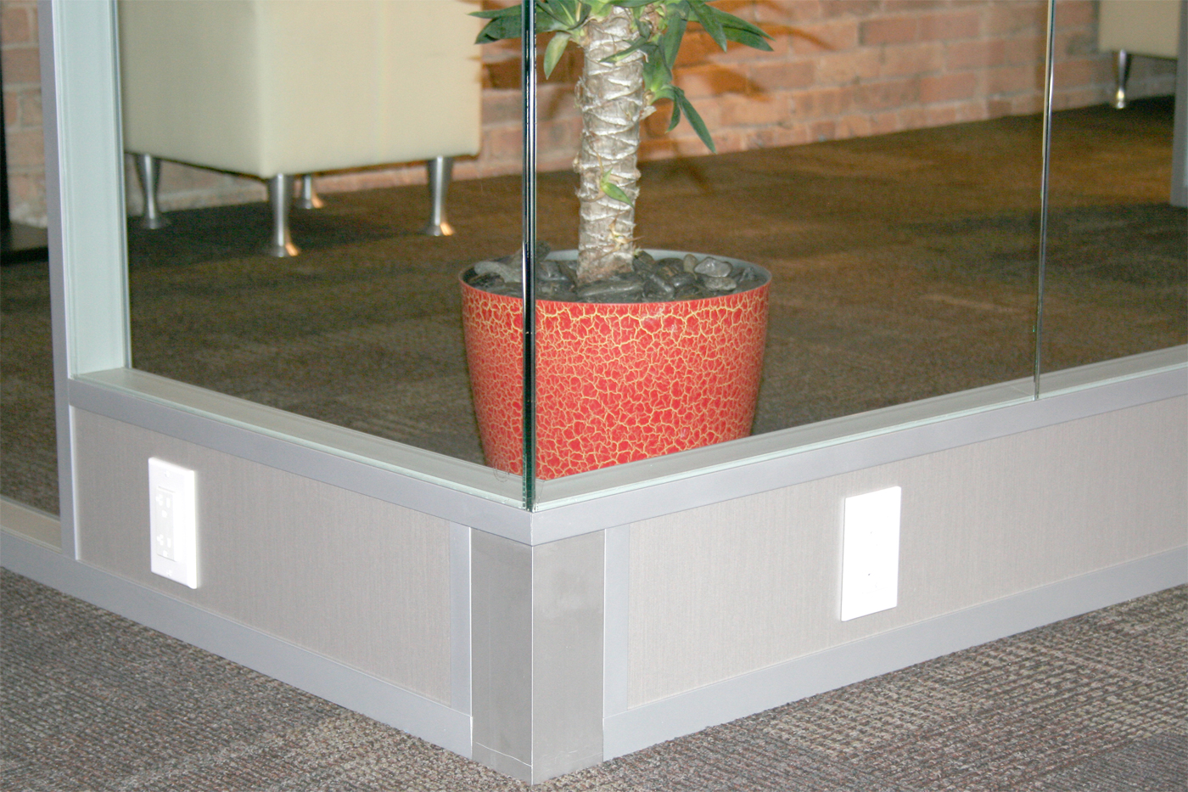

Slide 20
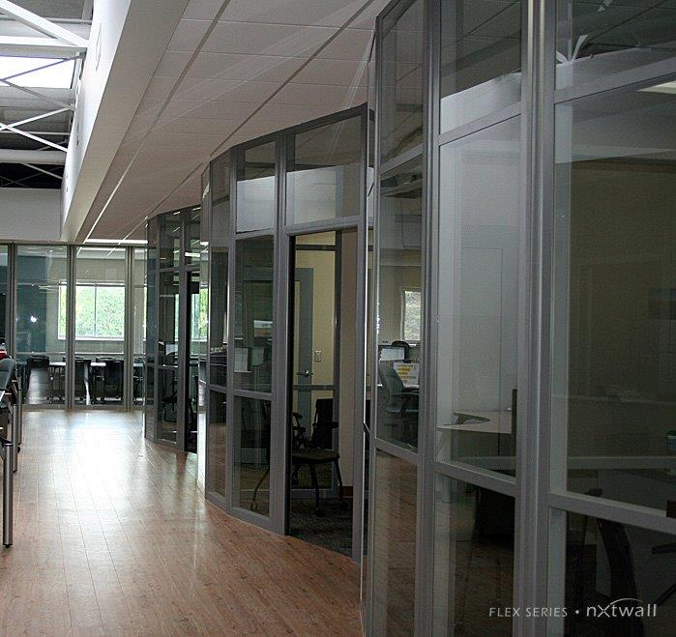

Slide 21
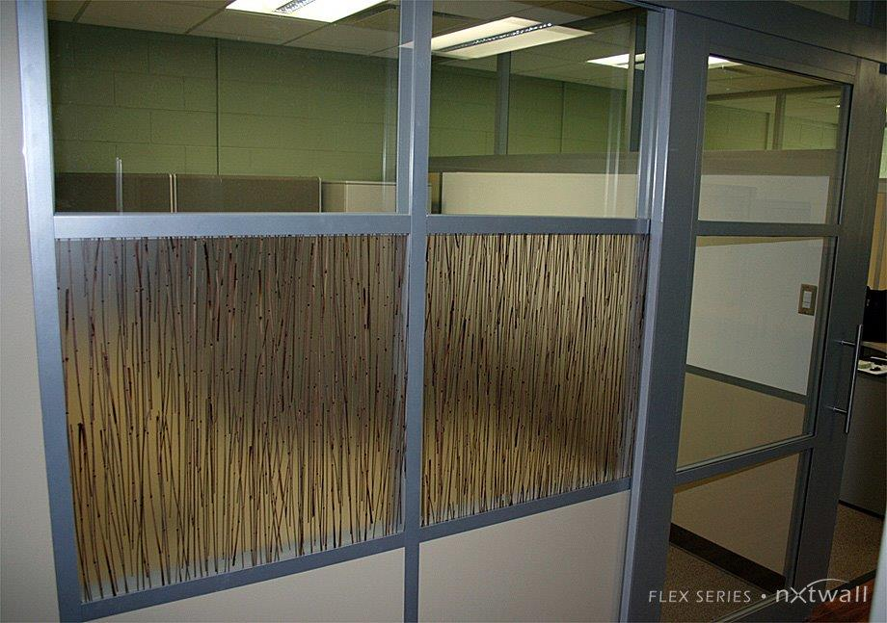

Slide 22
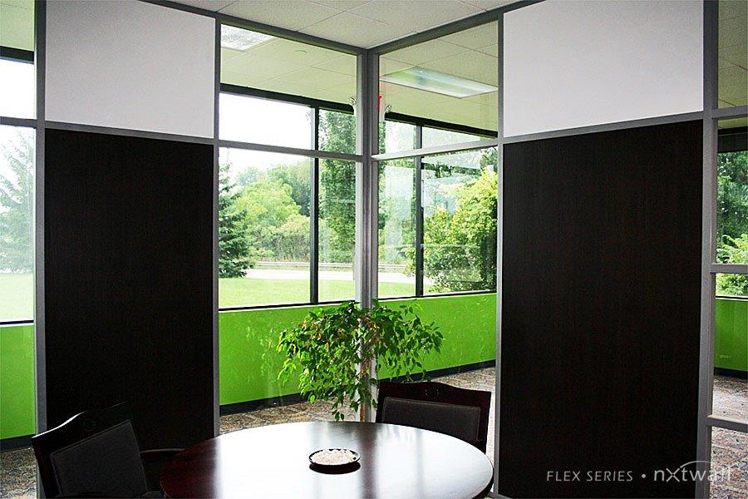

Slide 23
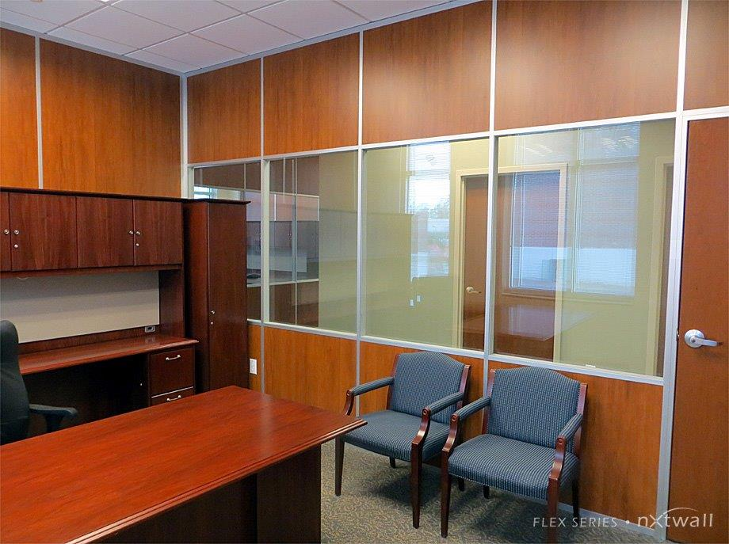

Slide 24
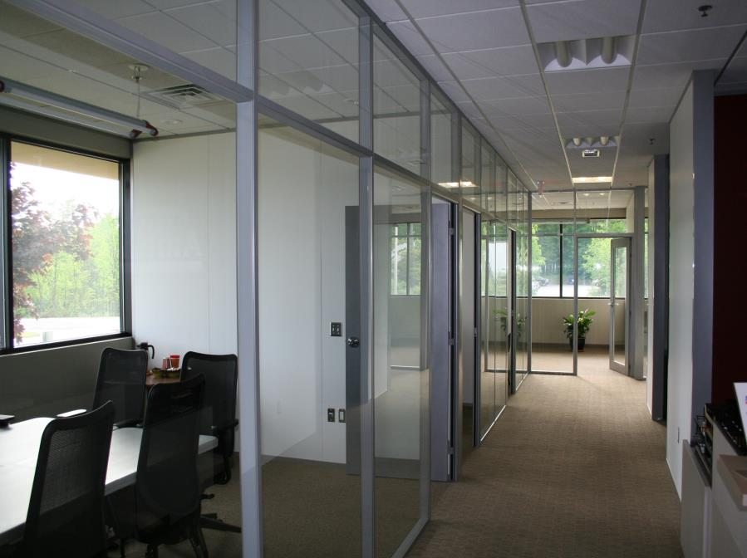

Slide 25
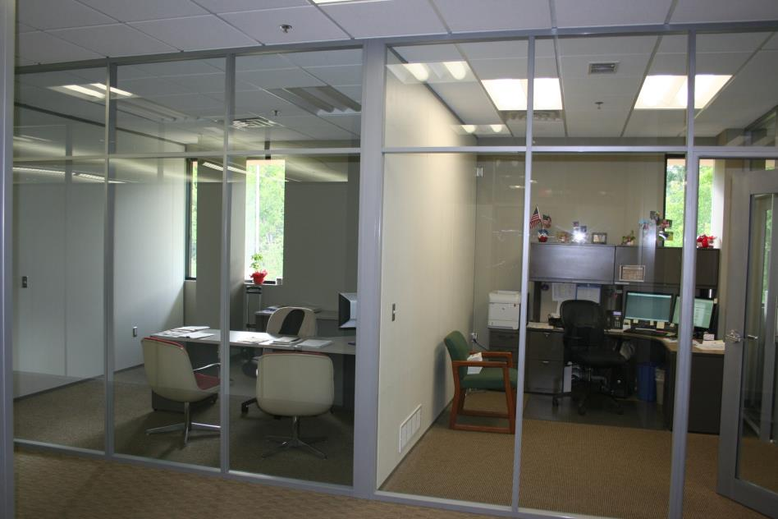
Solid Core Swing Door, Sidelight and Laminate

Slide 26
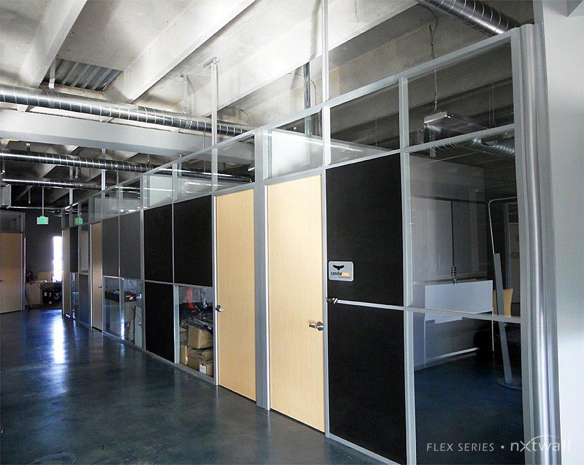

Slide 27
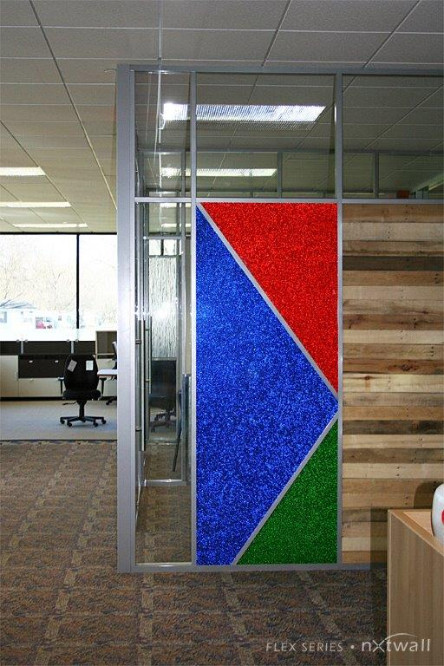
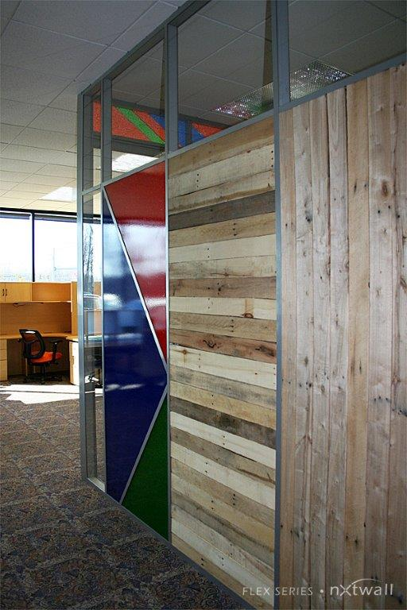

Slide 28
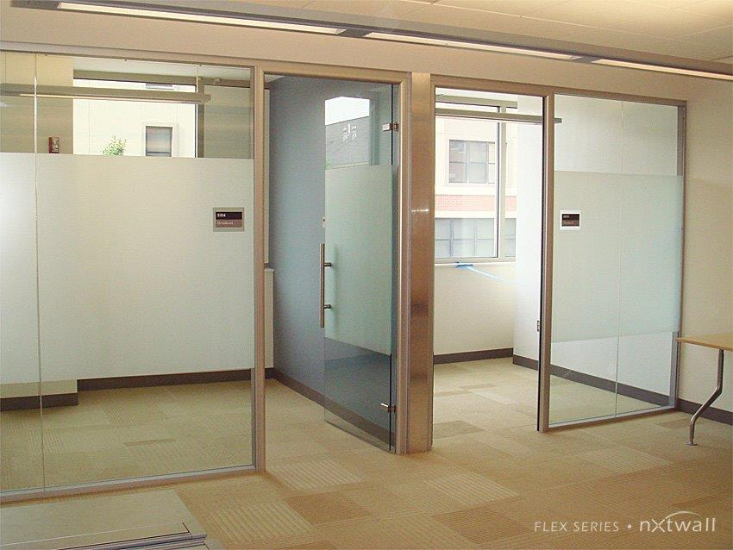

Slide 29
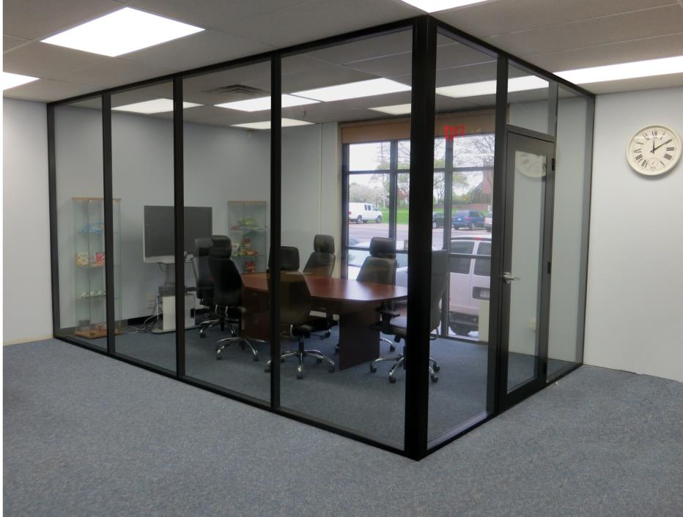
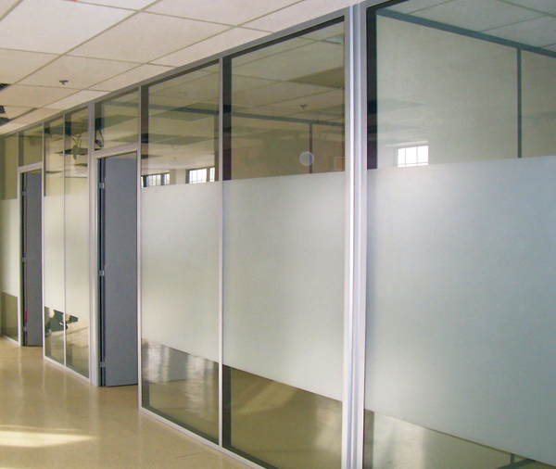

Slide 30
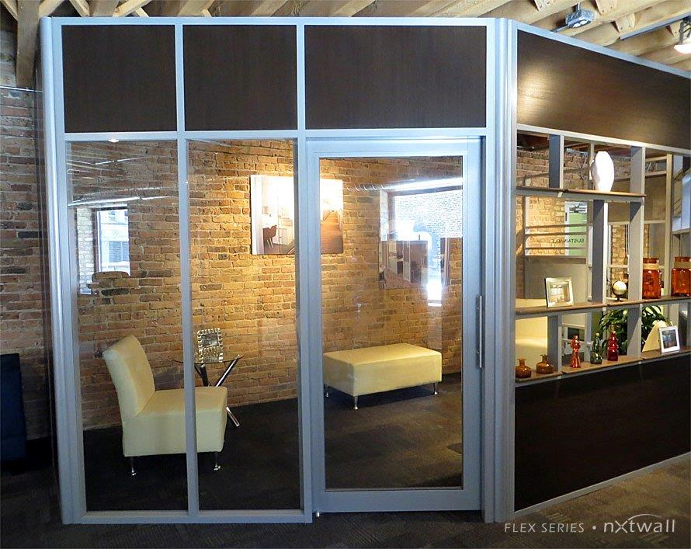

Slide 31
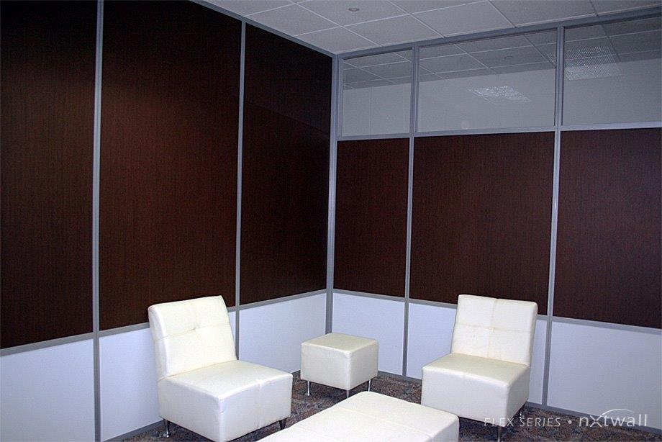

Slide 32
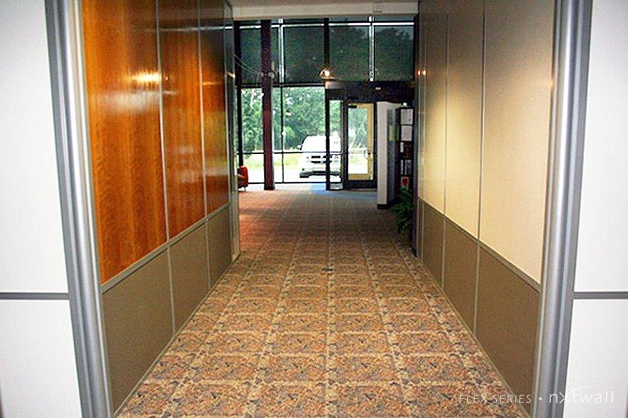
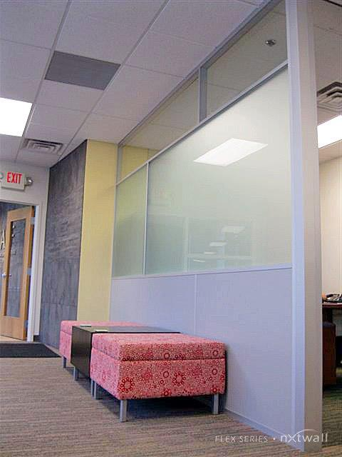
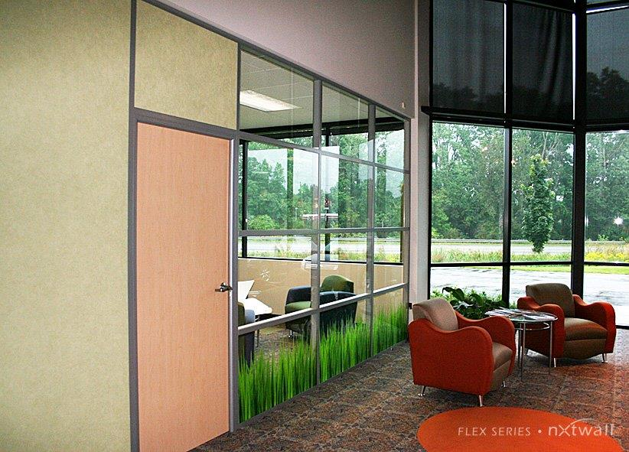

Slide 33
www.nxtwall.com
269-488-2752

