Slide 1


Slide 2
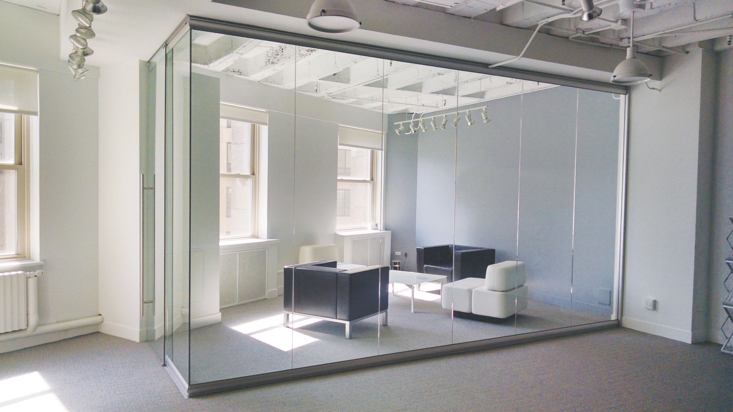
View Series

Slide 3
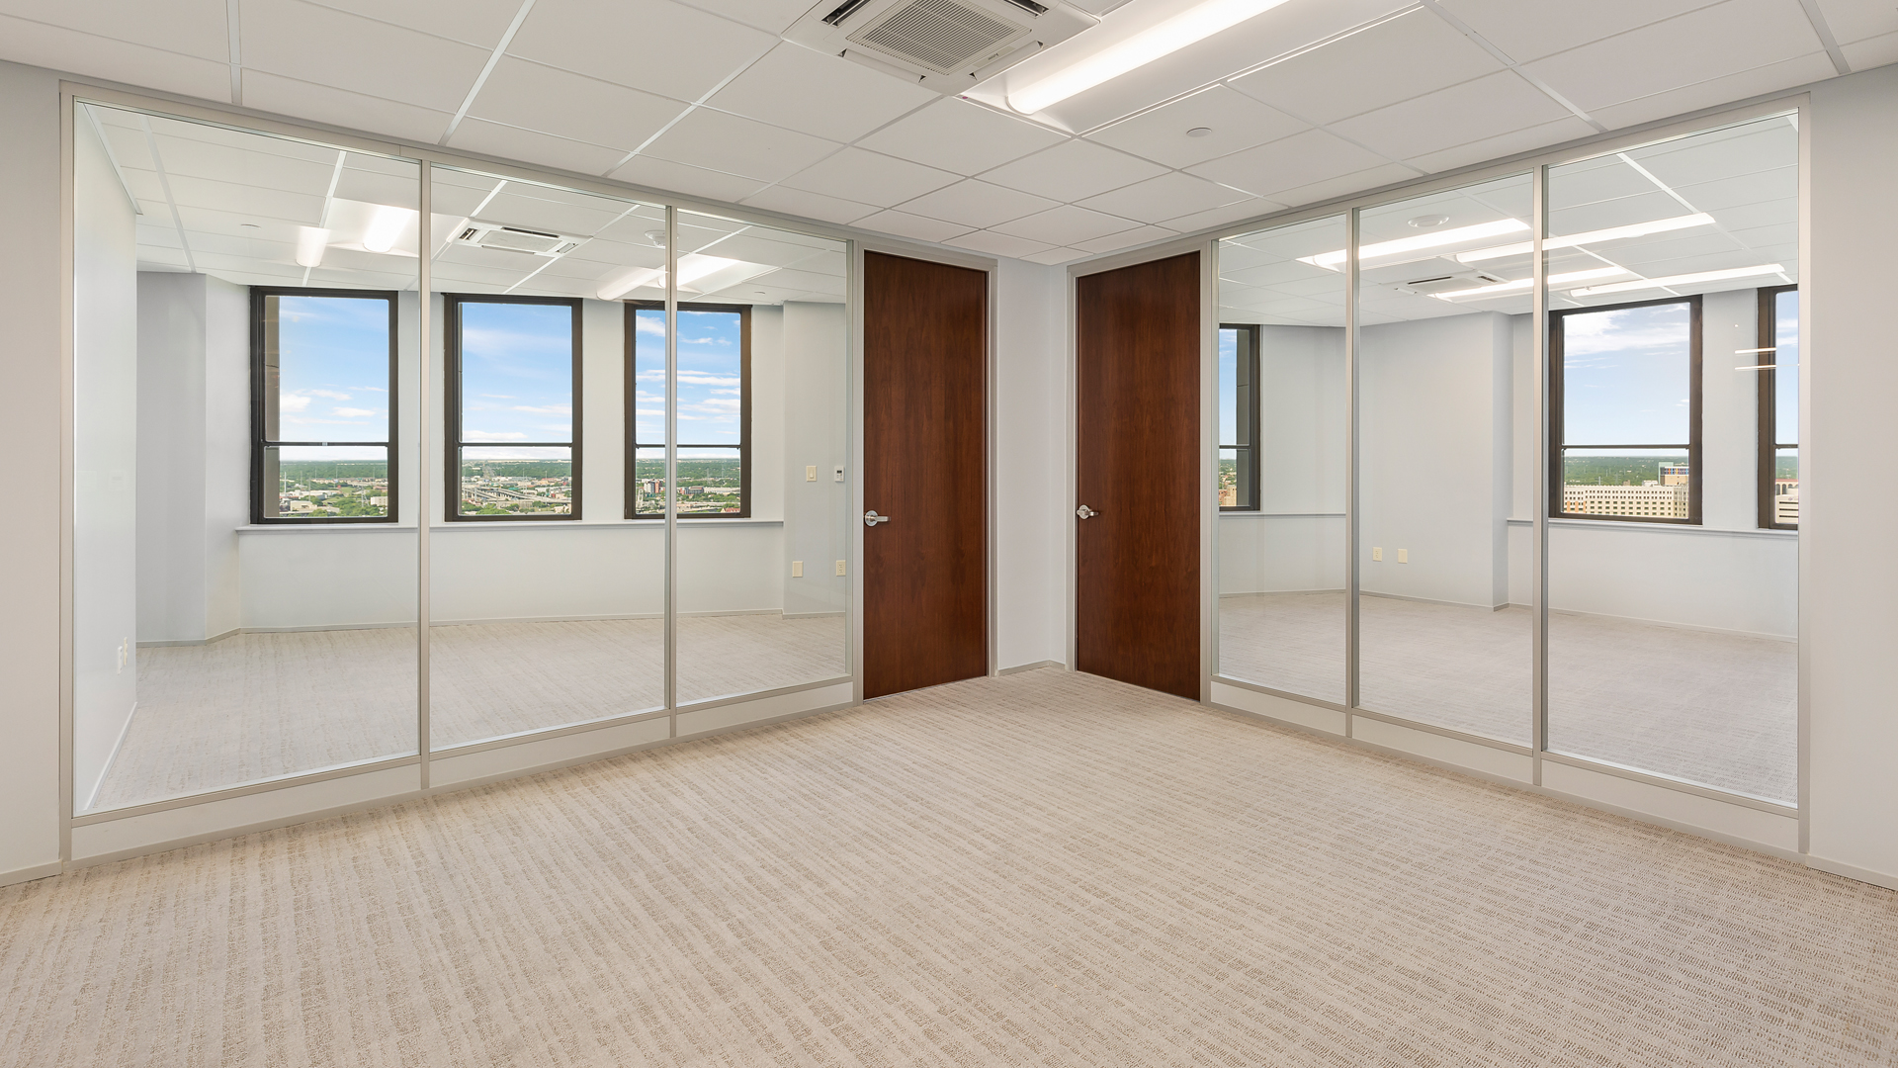
Flex Series

Slide 4
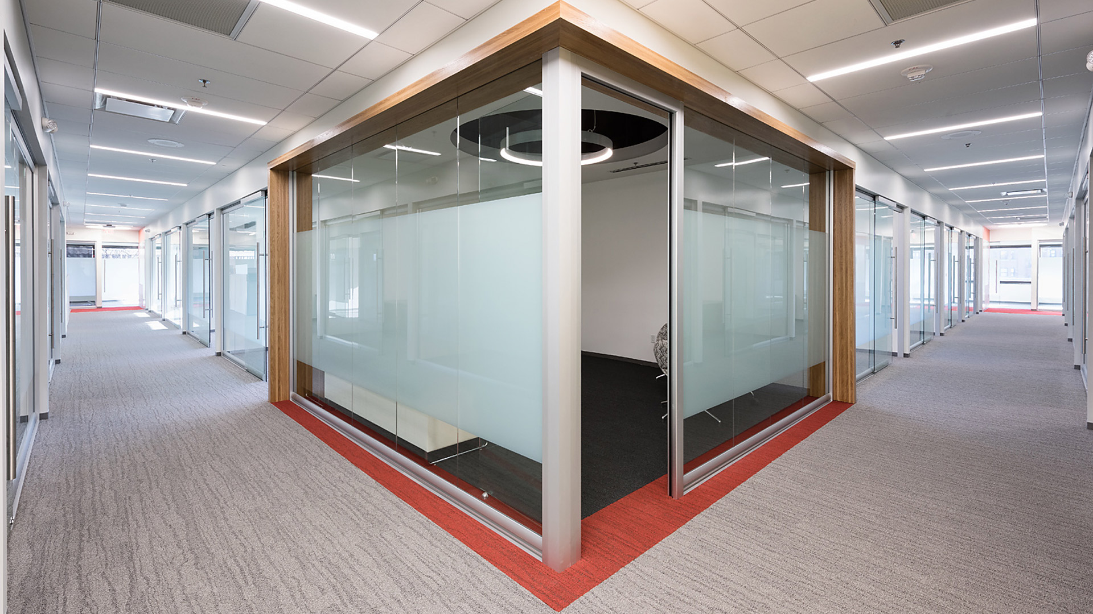
View Series

Slide 5
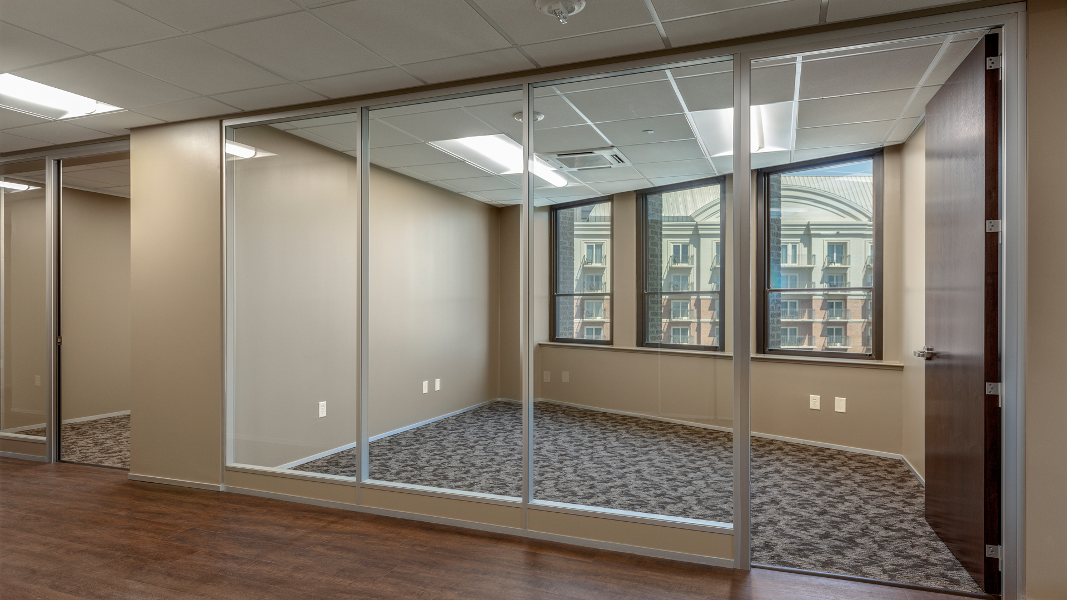
Flex Series

Slide 6
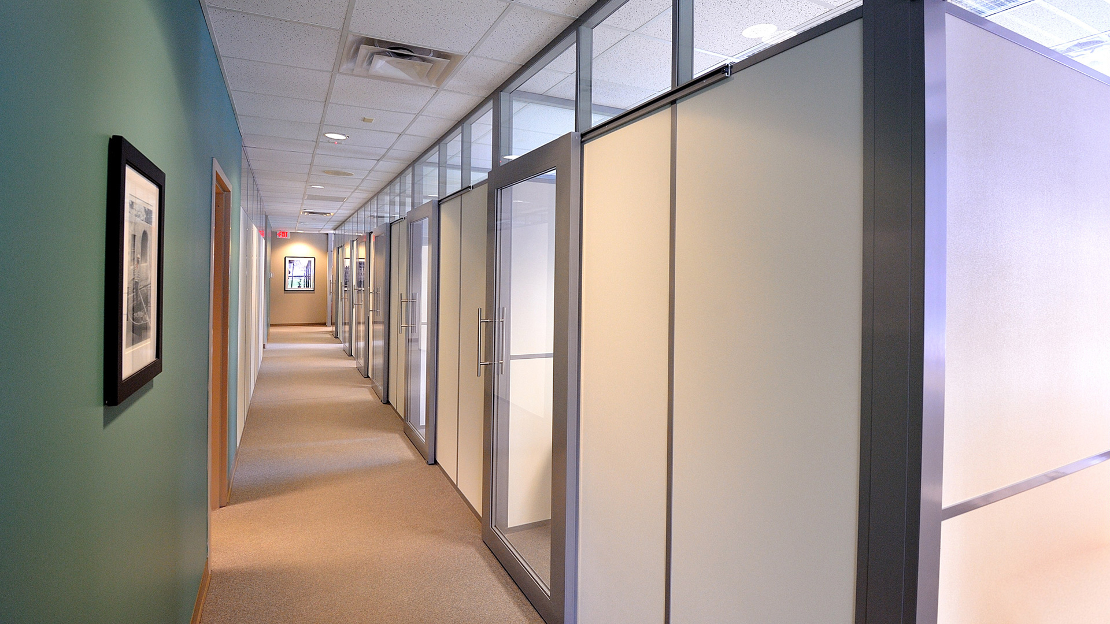
Flex Series

Slide 7
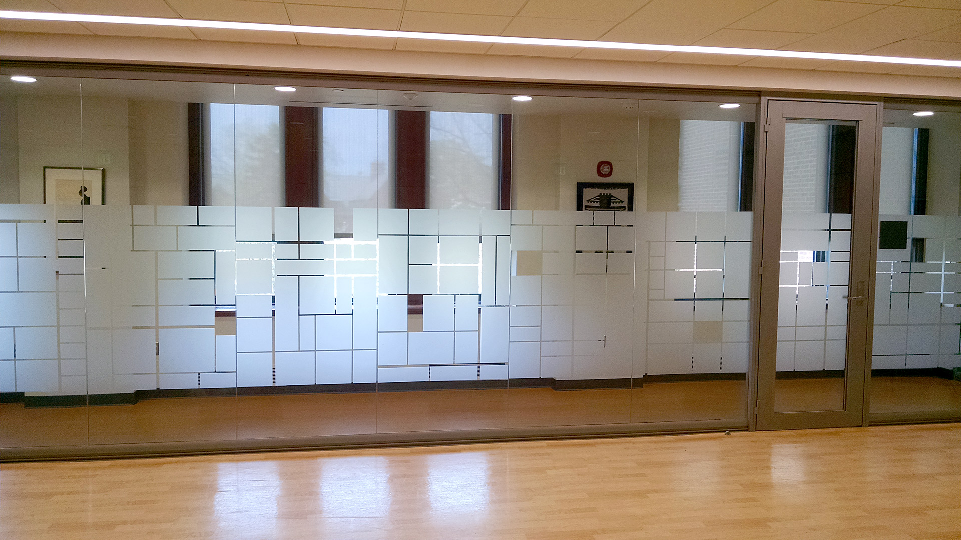
View Series

Slide 8
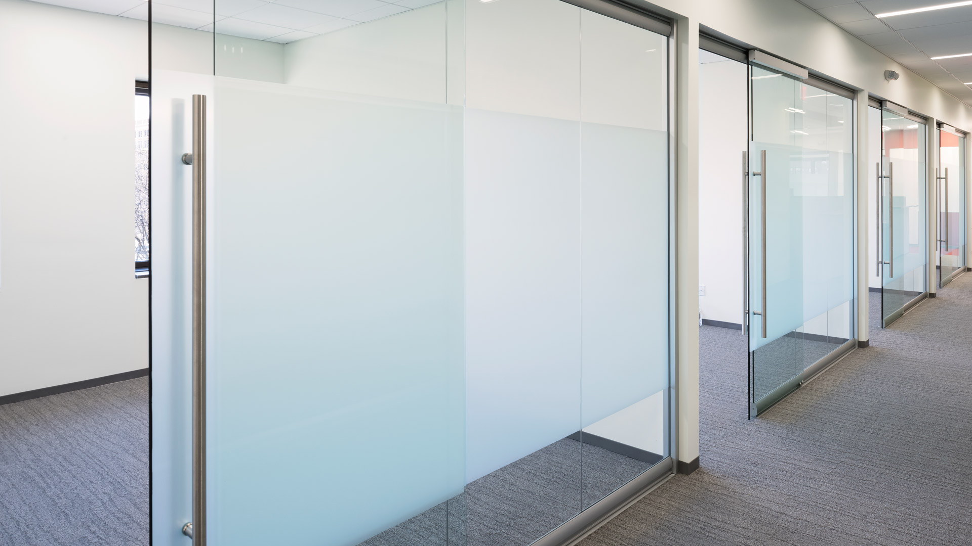
View Series

Slide 9
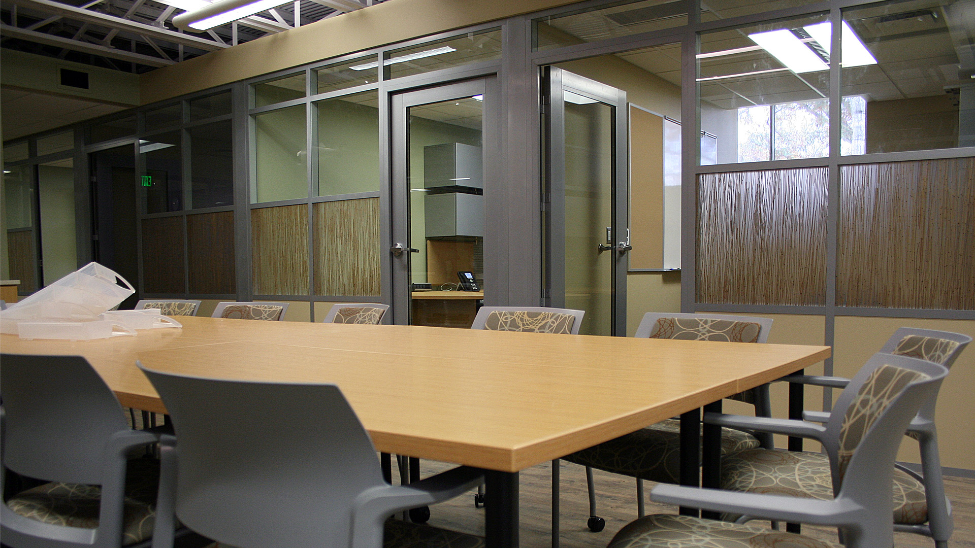
Flex Series

Slide 10
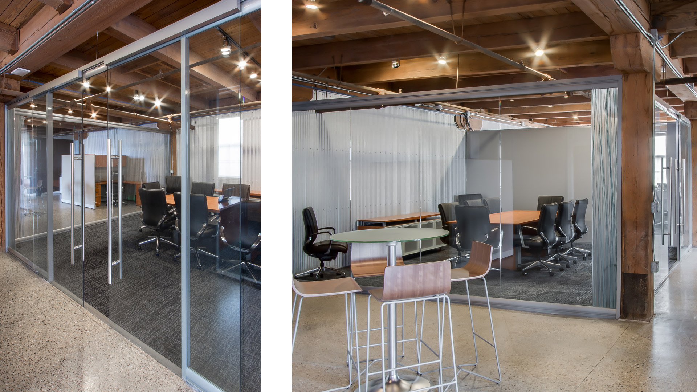
View Series

Slide 11
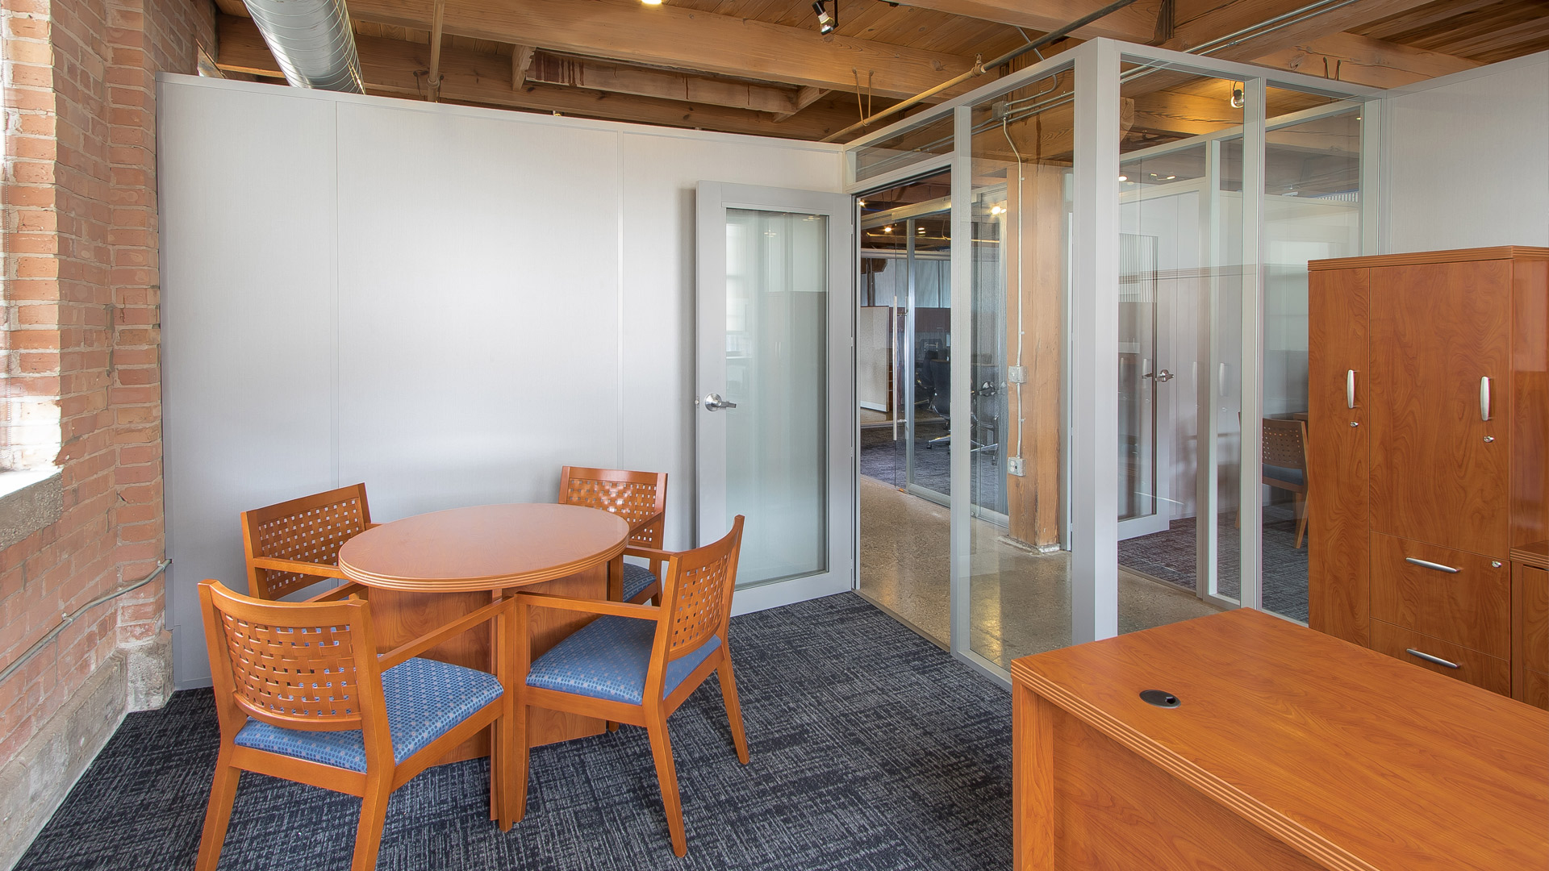
Flex Series

Slide 12
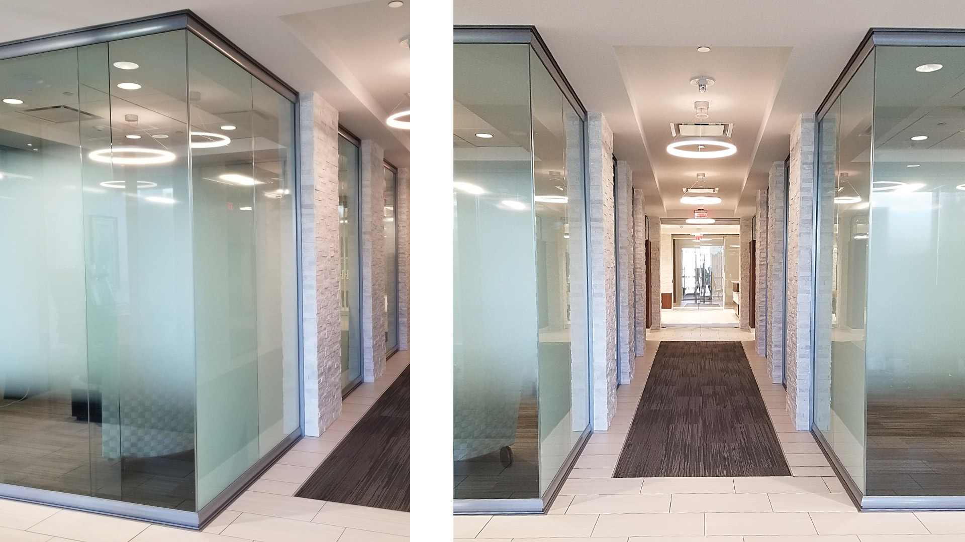
View Series

Slide 13
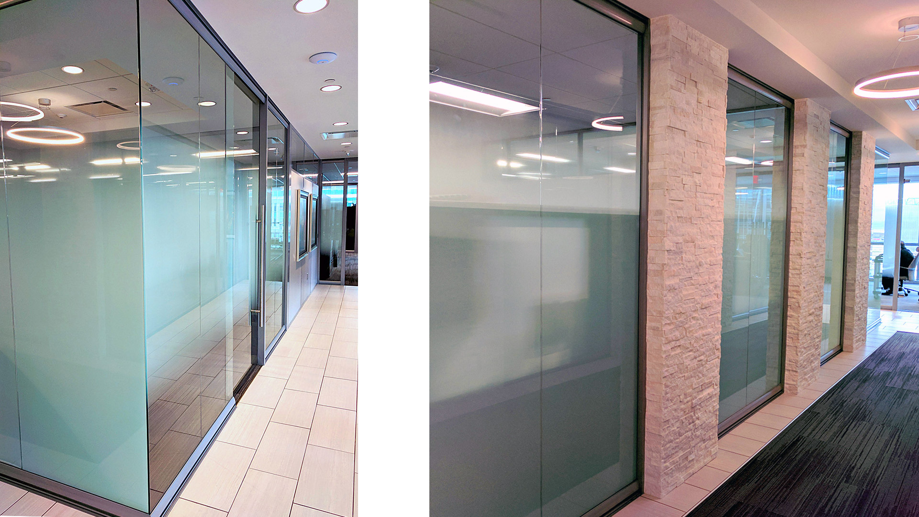
View Series

Slide 14
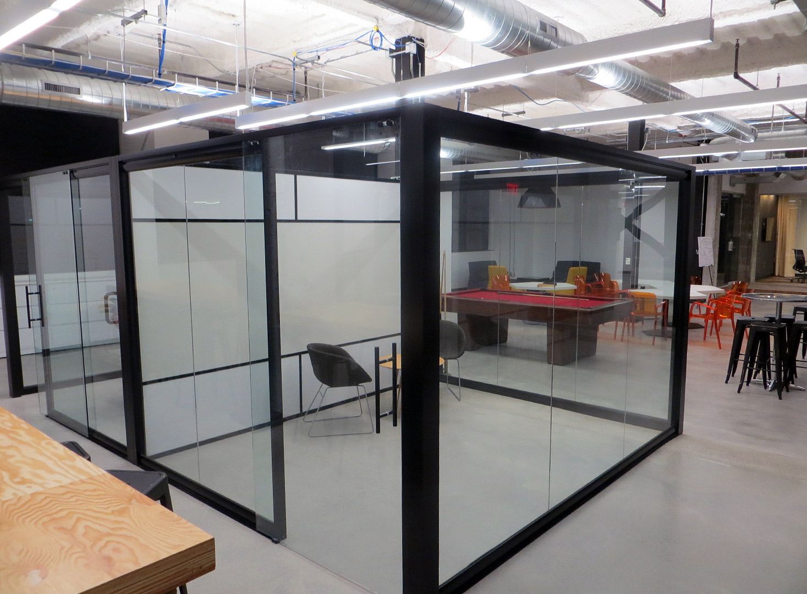
View/Flex Series

Slide 15

View Series

Slide 16
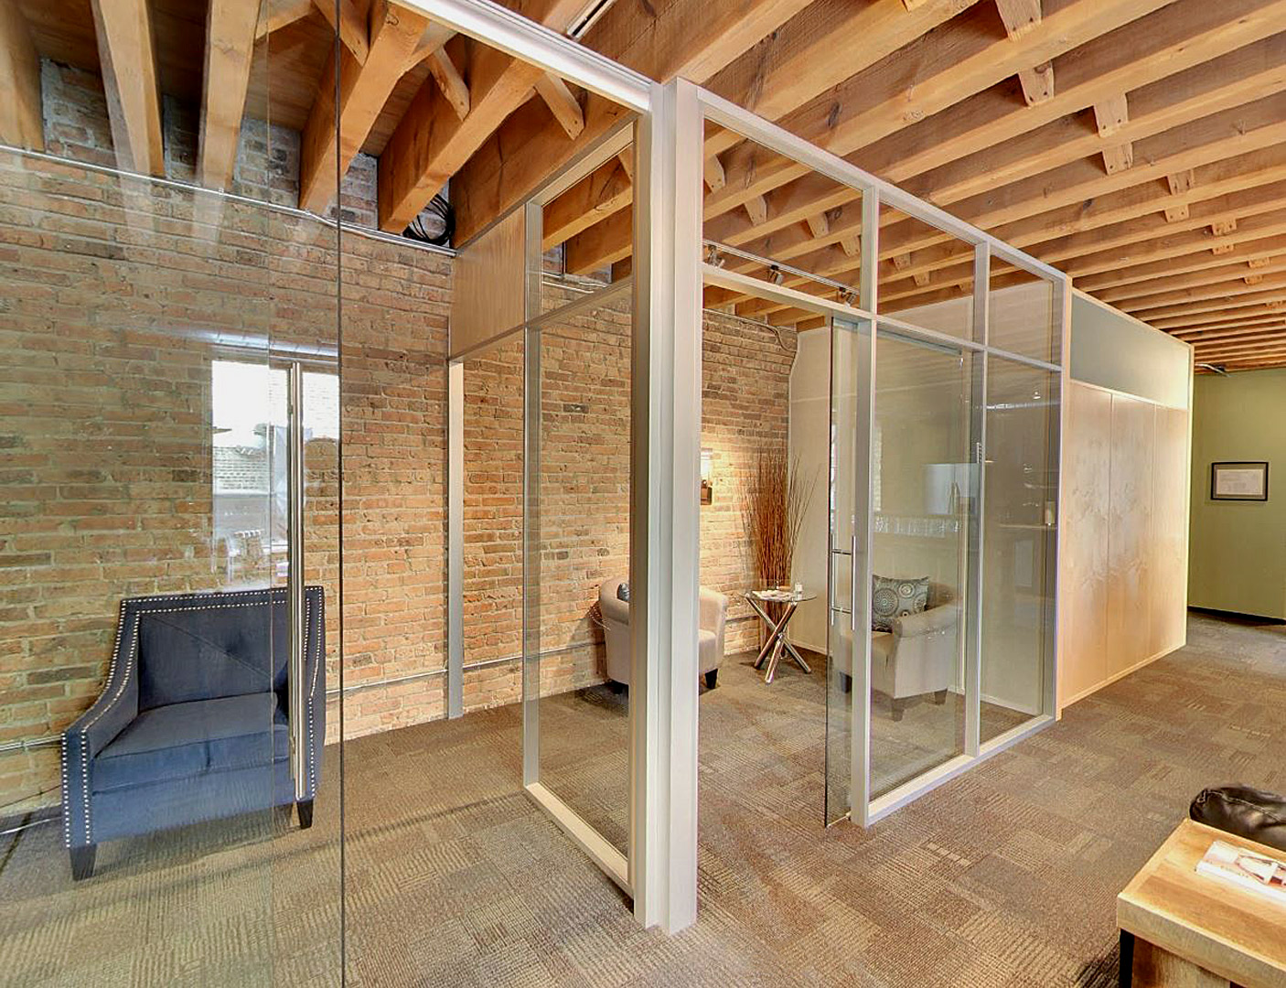
Flex Series

Slide 17
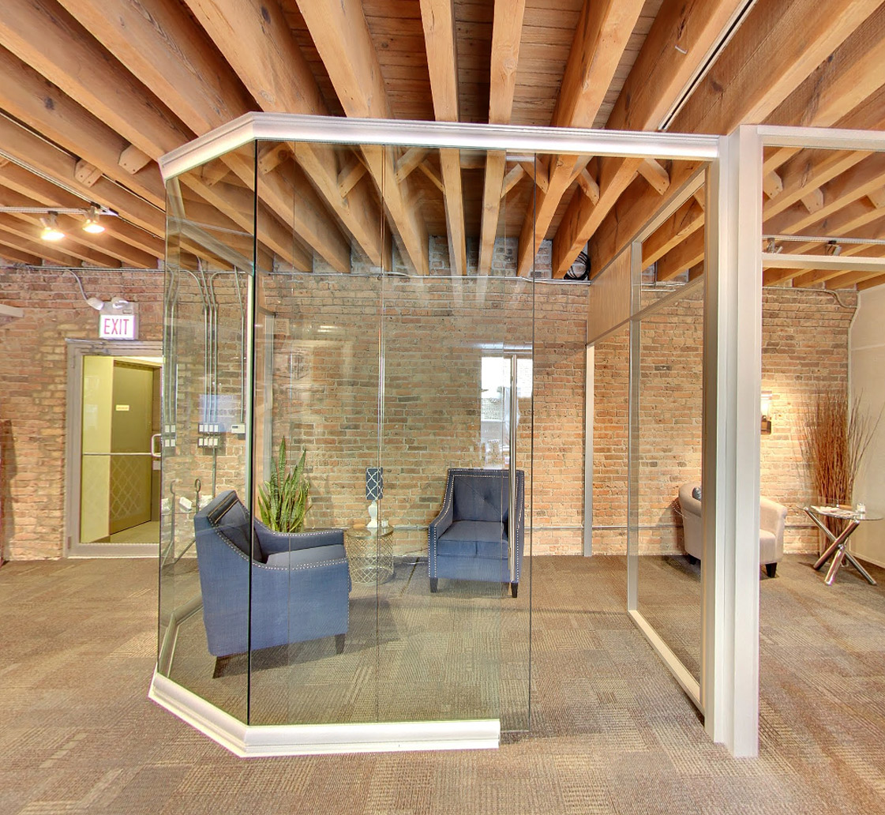
View Series

Slide 18

Flex Series

Slide 19
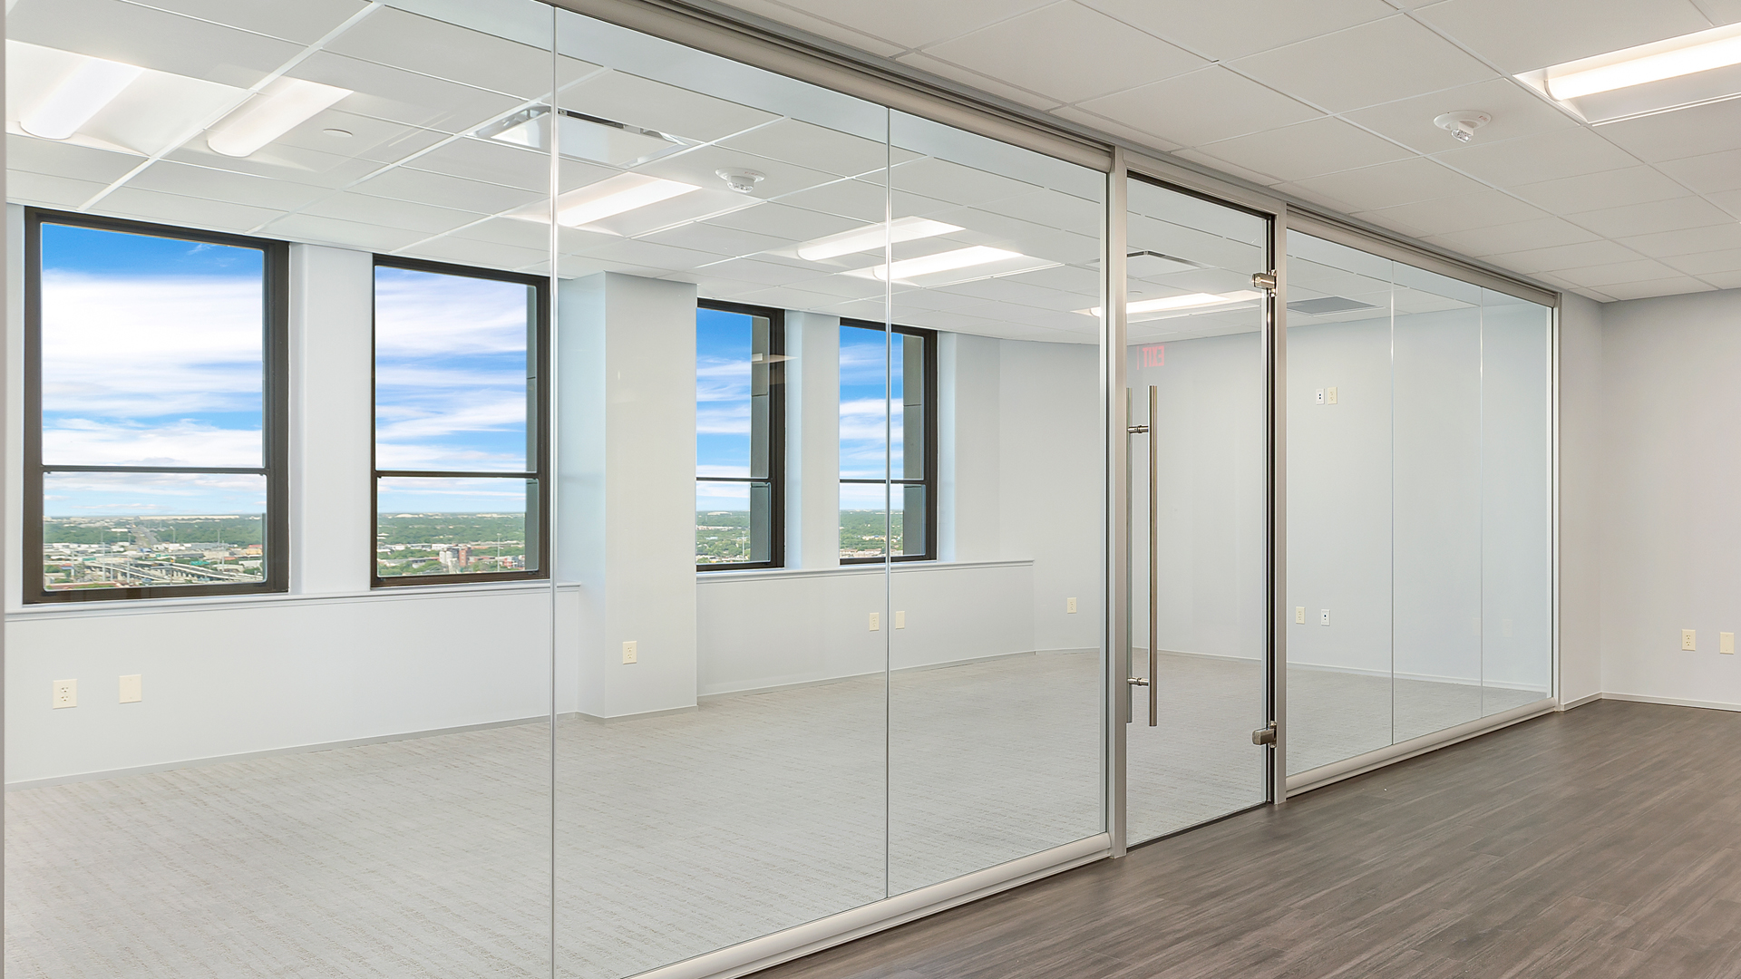
View Series

Slide 20
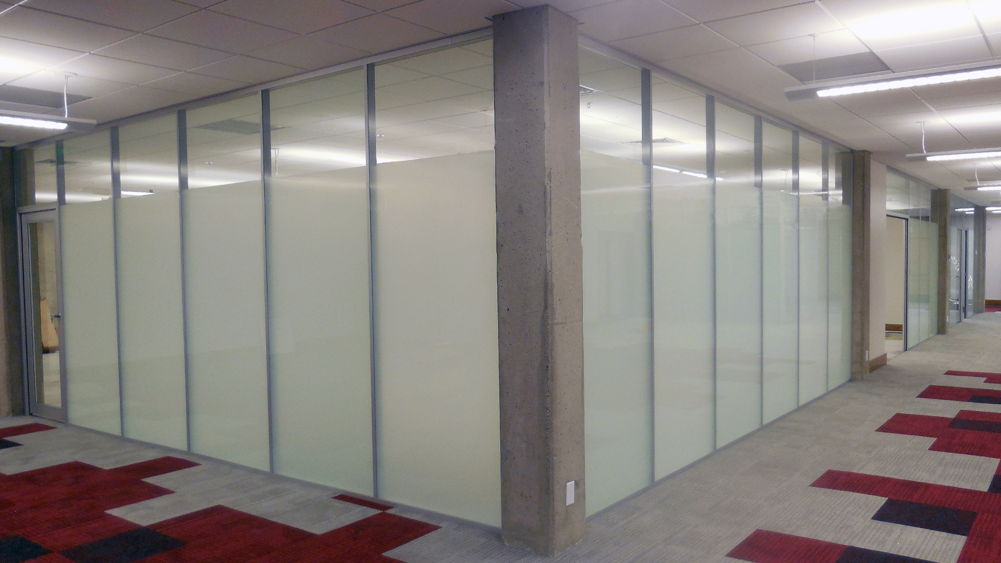
Flex Series

Slide 21
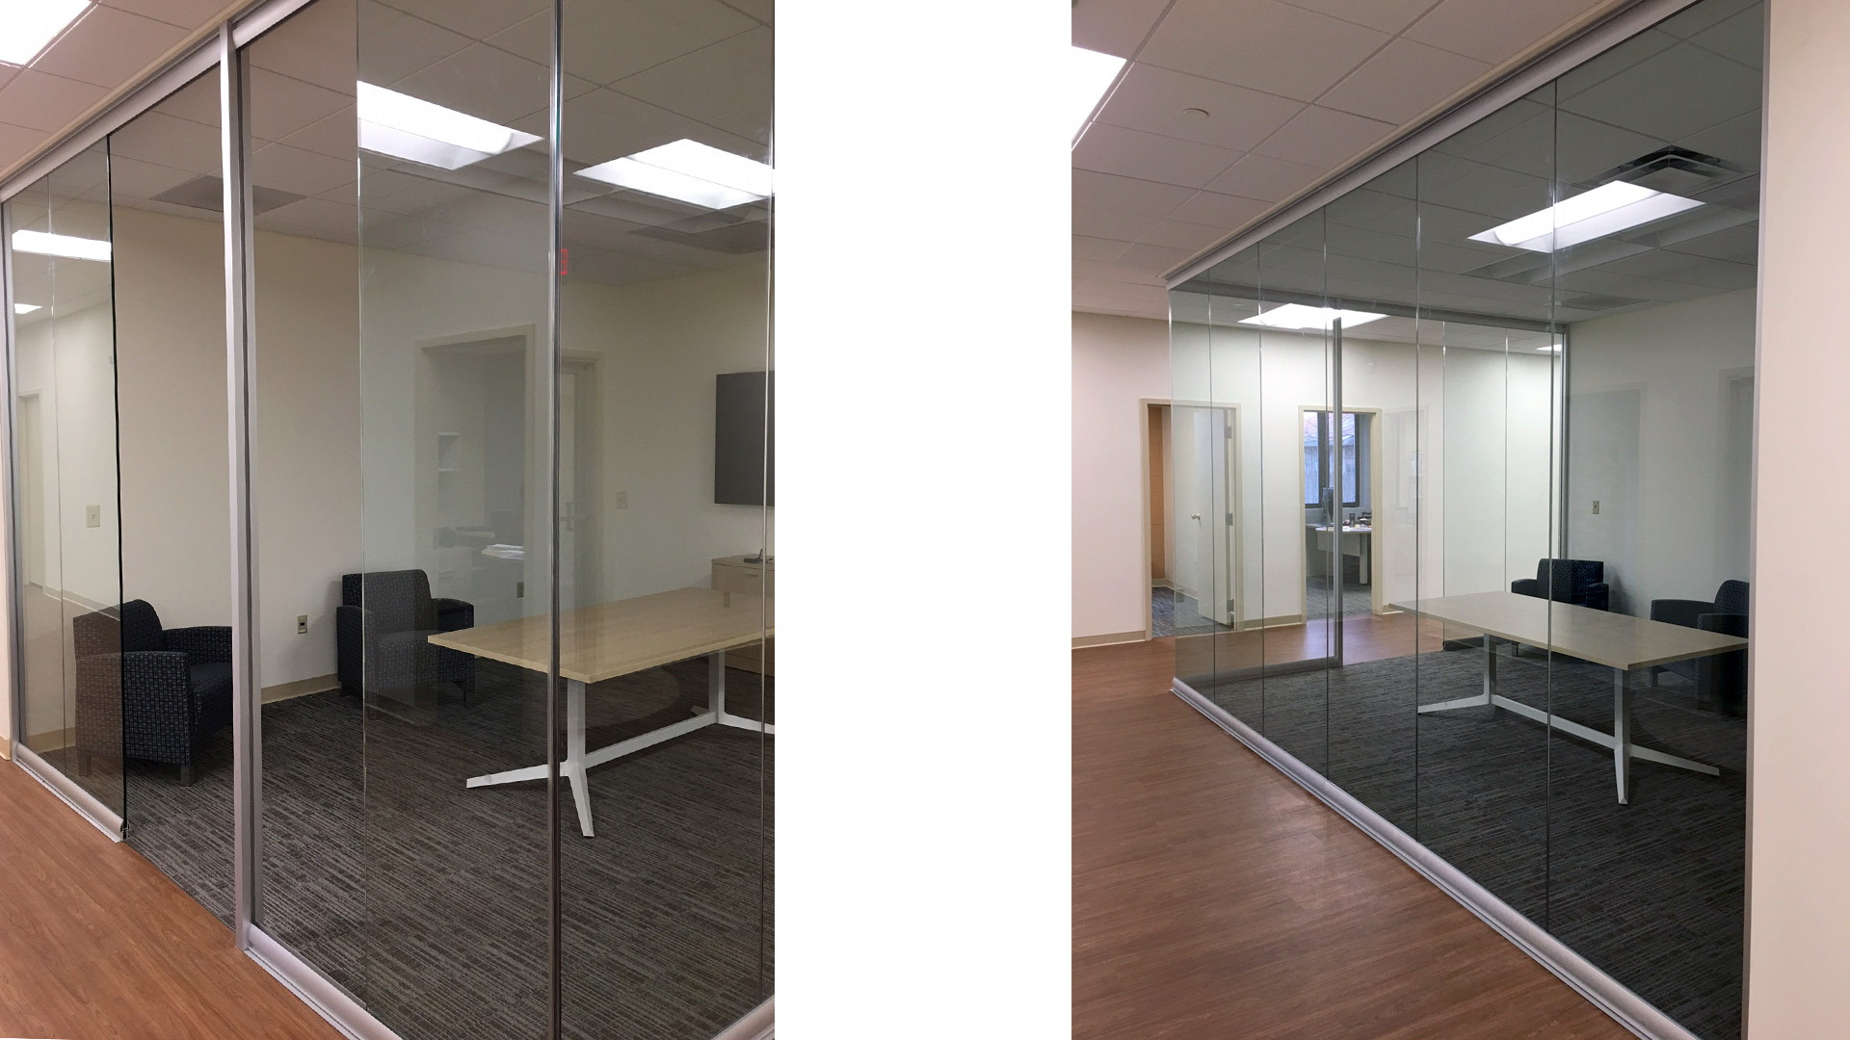
View Series

Slide 22
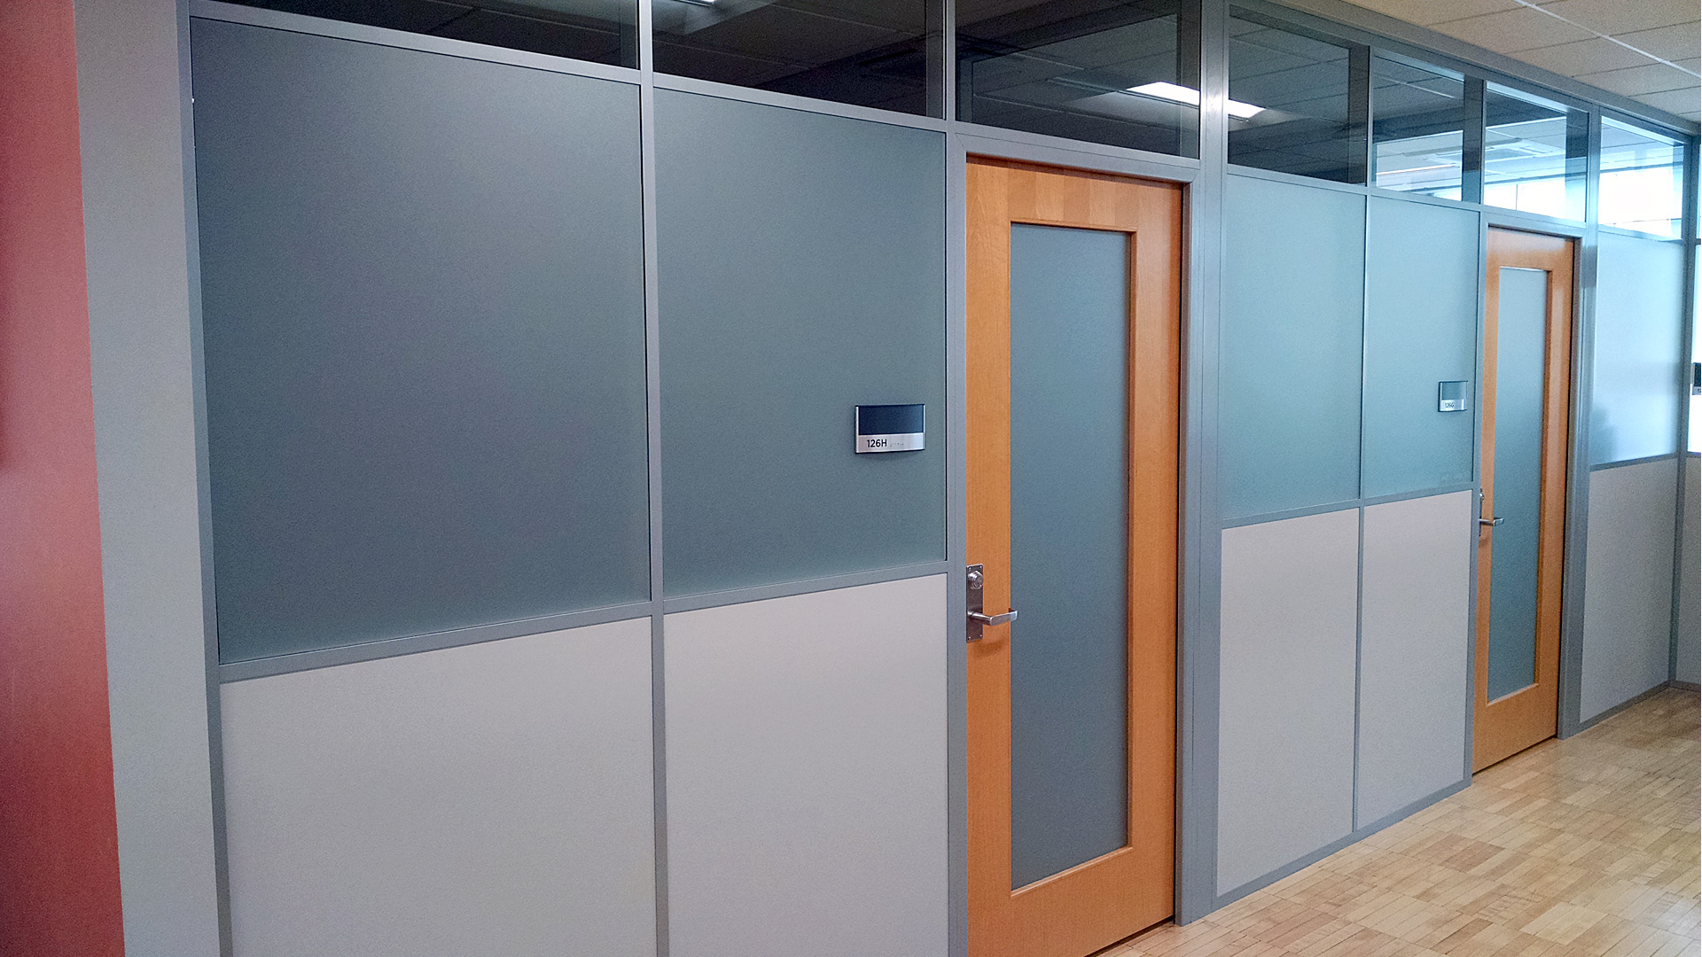
Flex Series

Slide 23
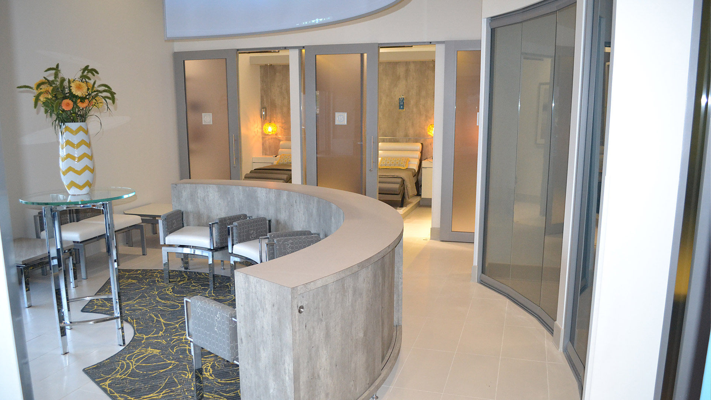
View/Flex Series

Slide 24
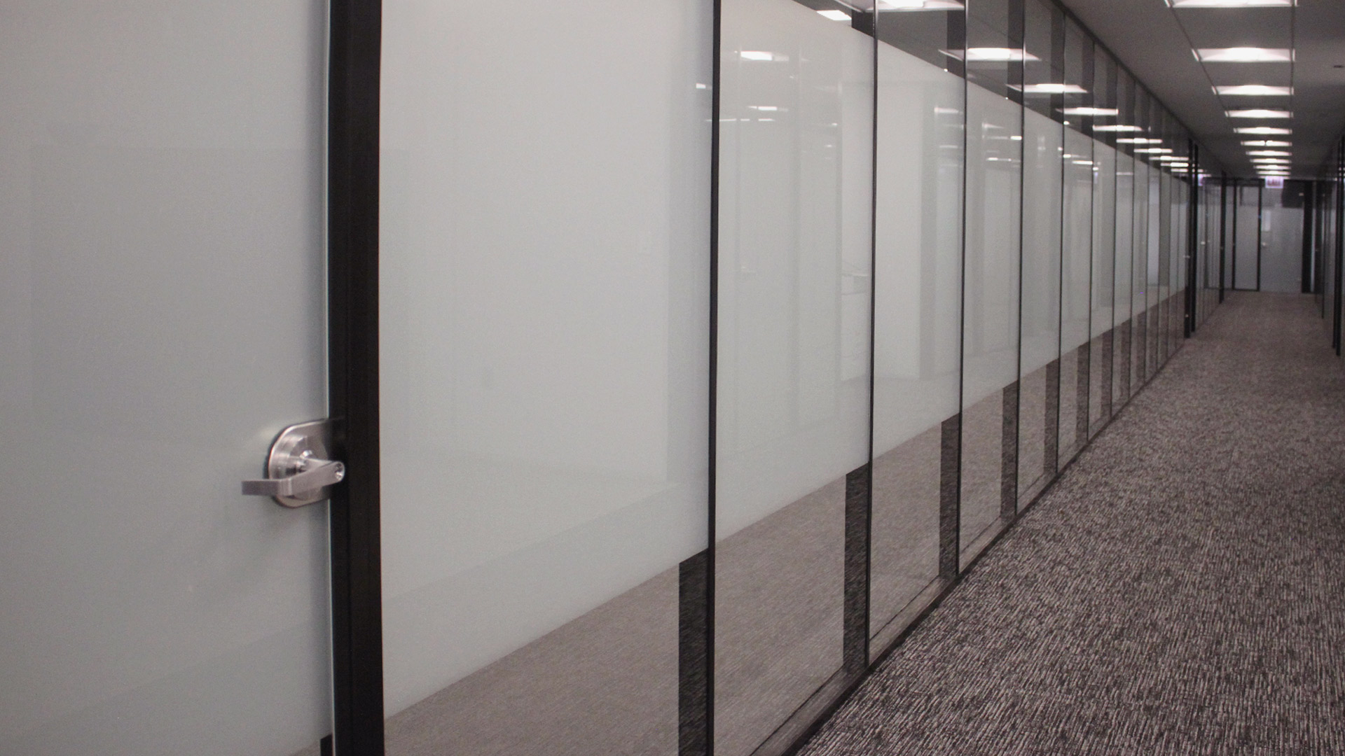
Flex Series

Slide 25
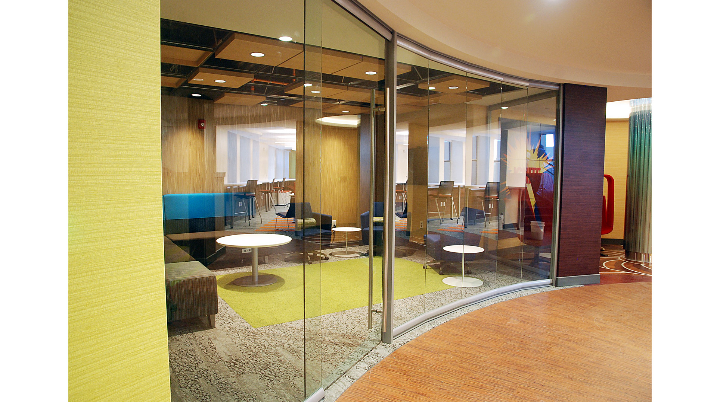
View Series

Slide 26
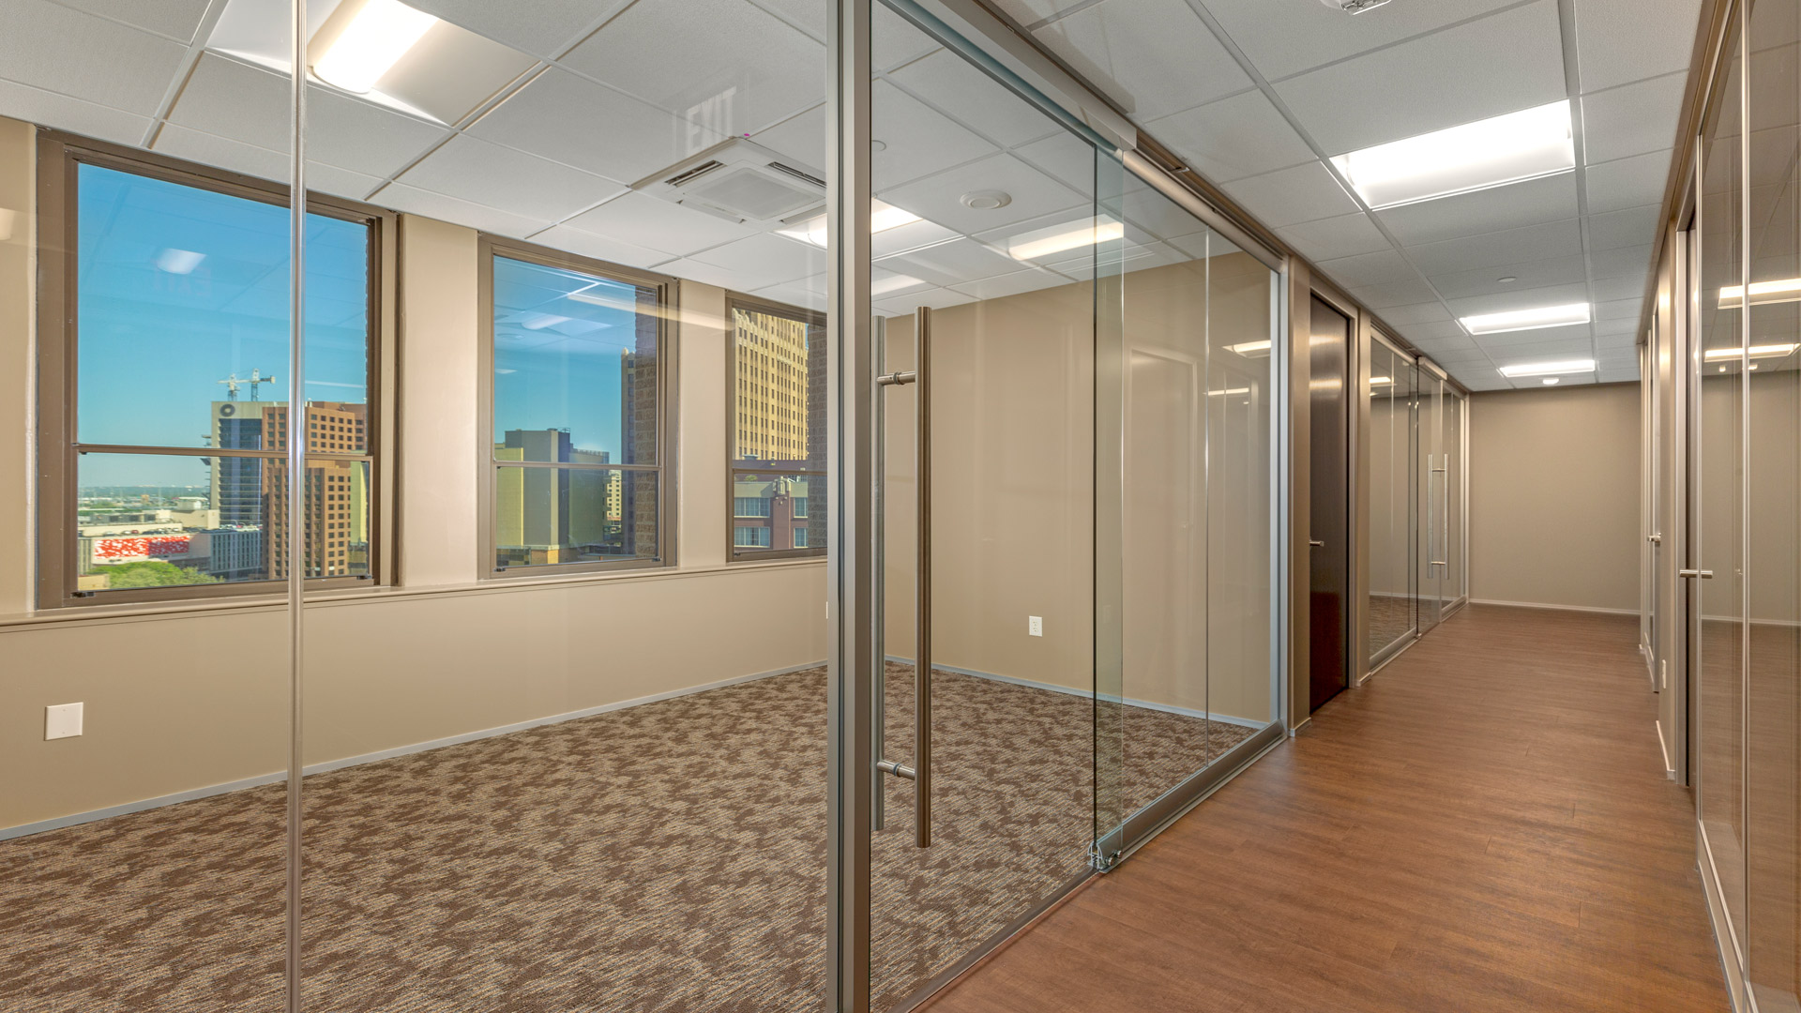
View Series

Slide 27
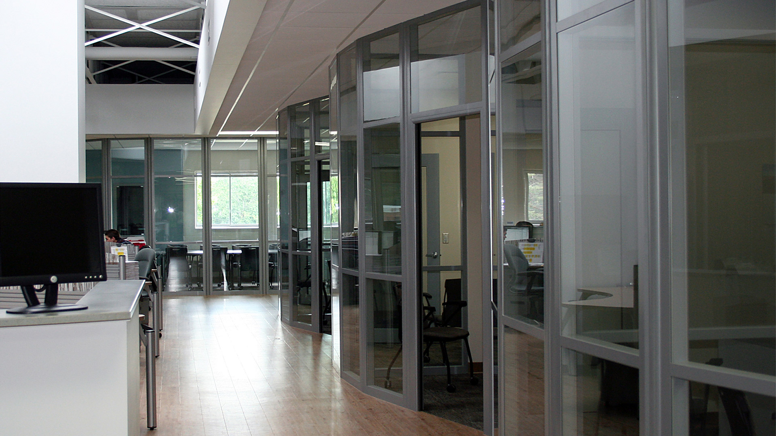
Flex Series

Slide 28
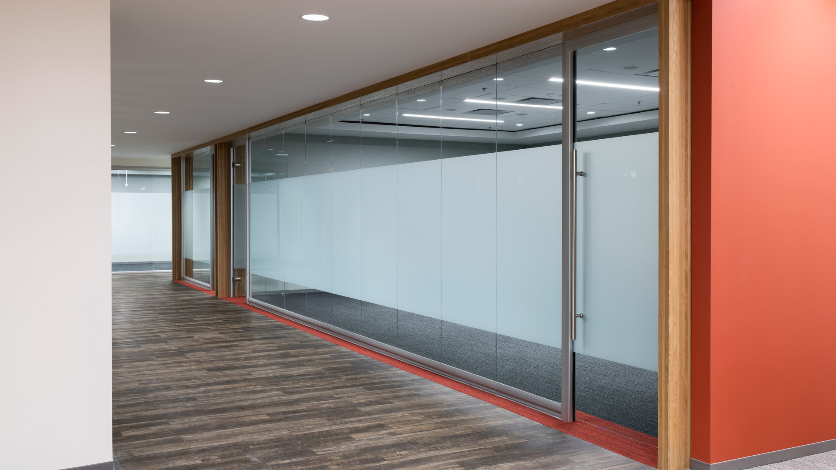
View Series

Slide 29
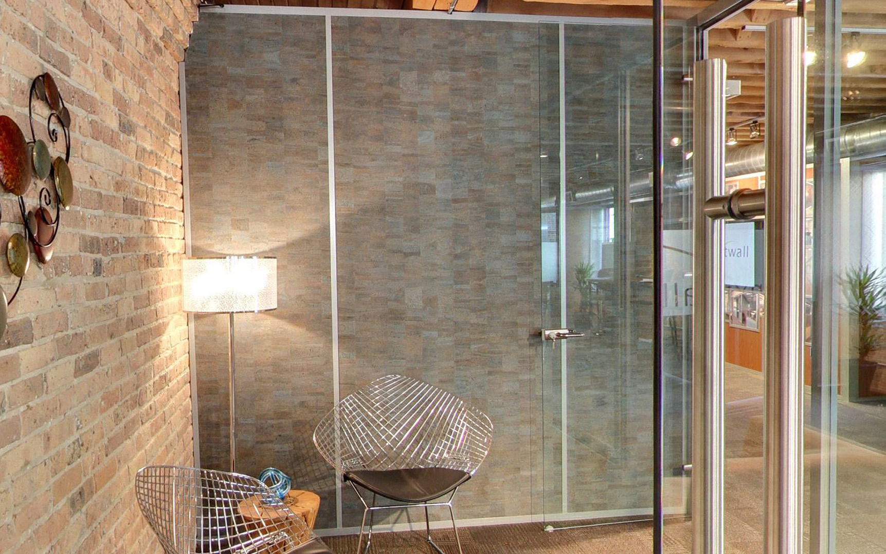
Flex Series

Slide 30
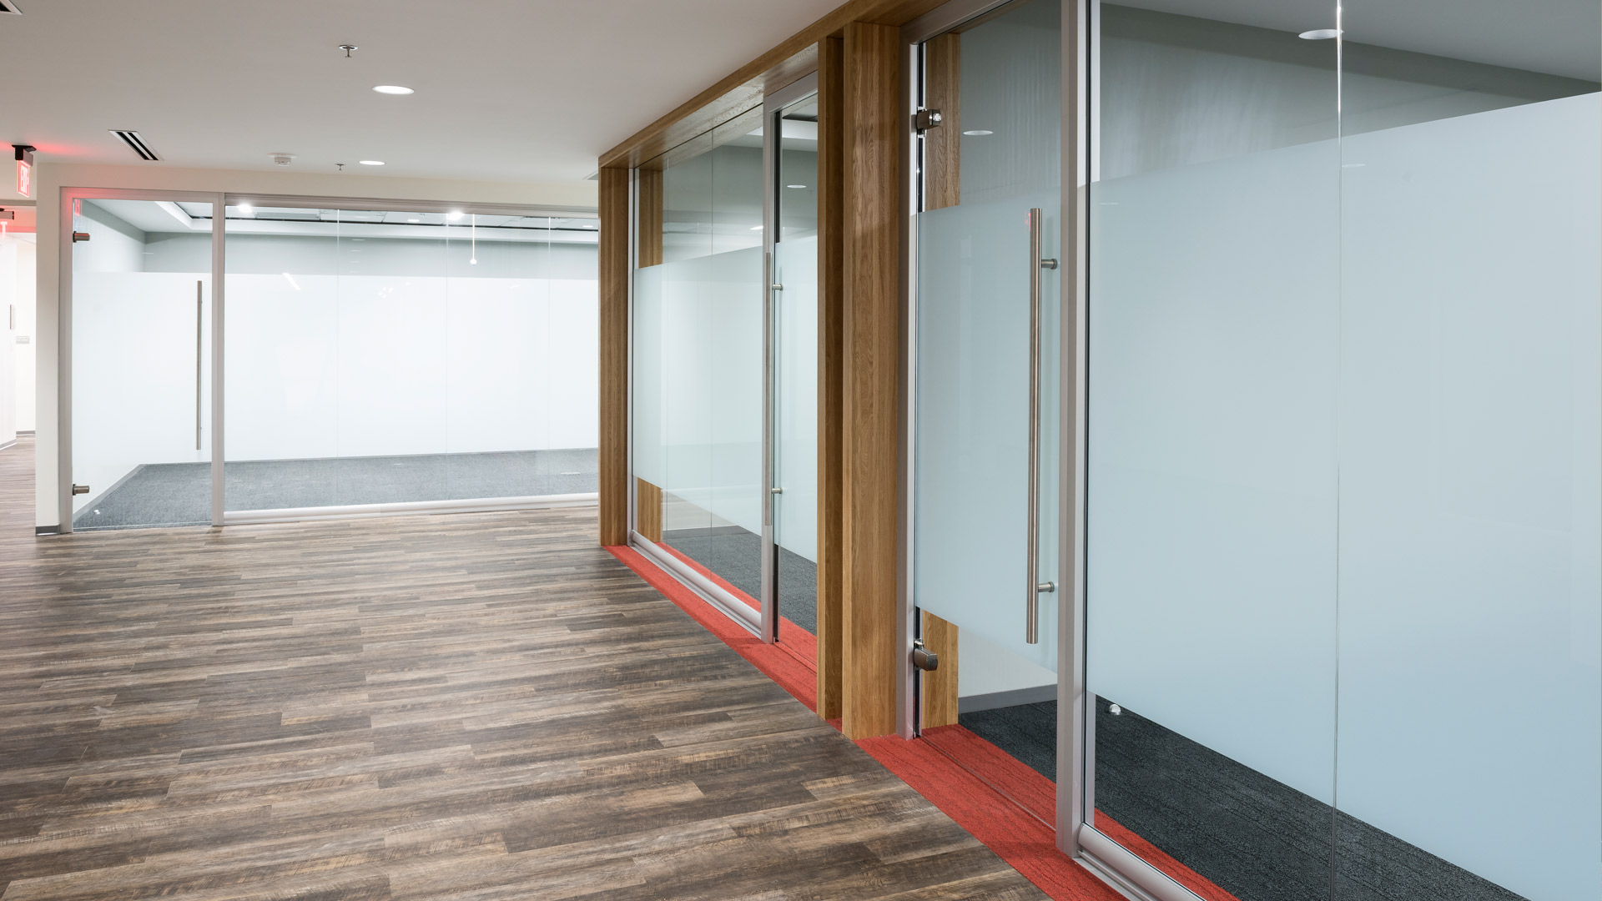
View Series

Slide 31
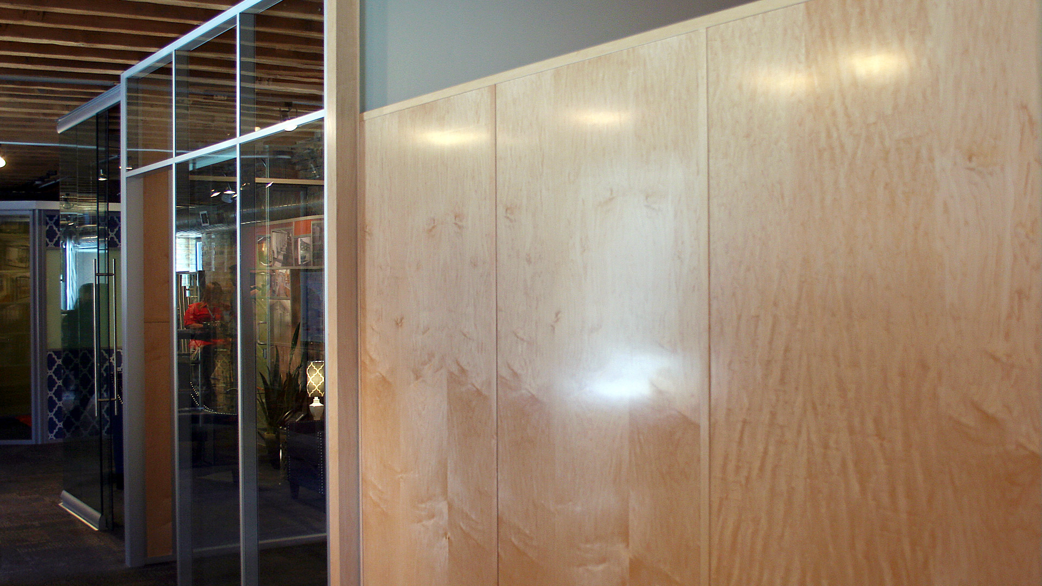
Flex Series

Slide 32
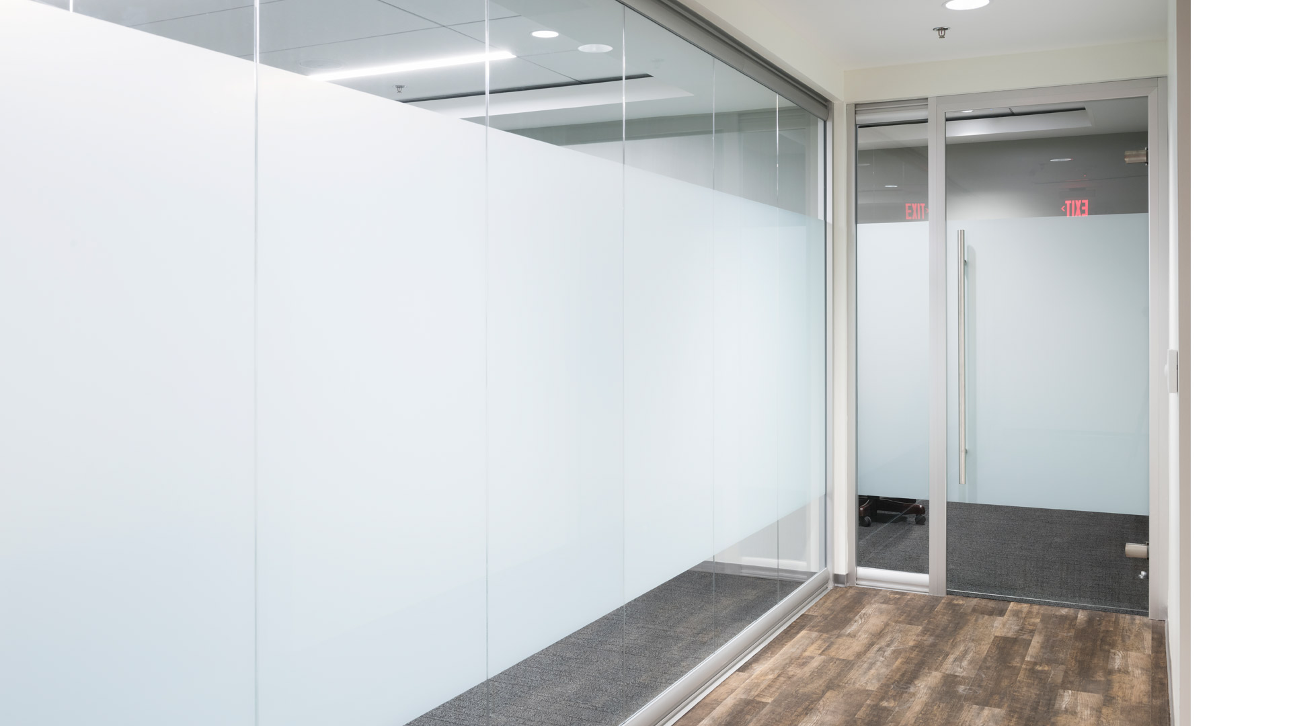
View Series

Slide 33
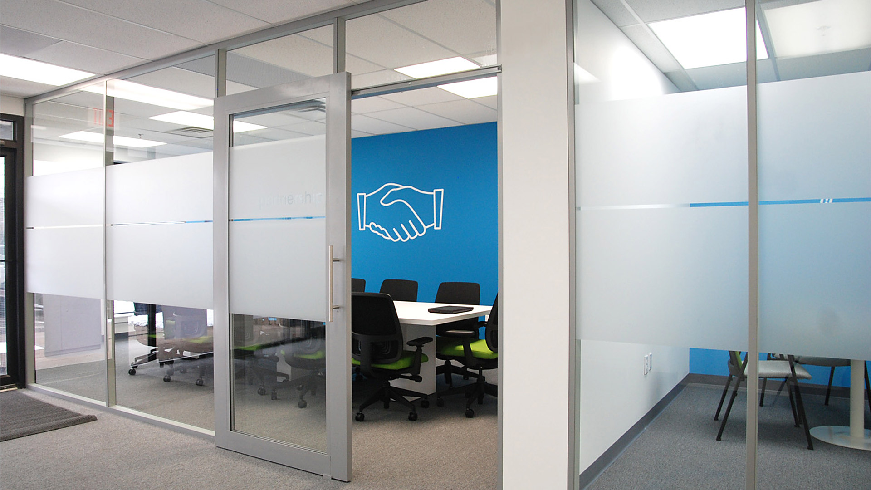
Flex Series

Slide 34
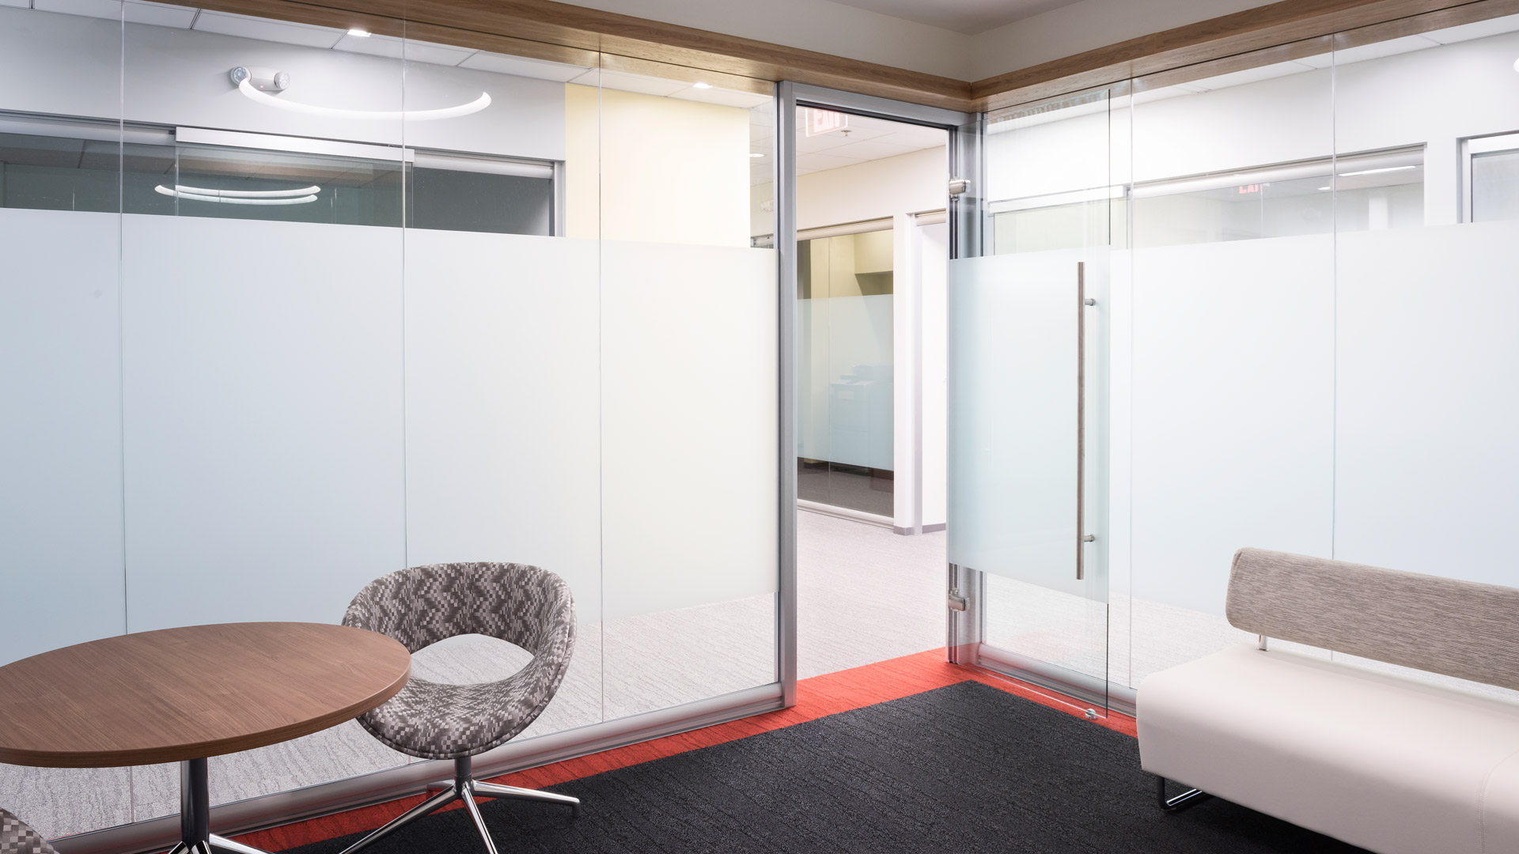
View Series

Slide 35
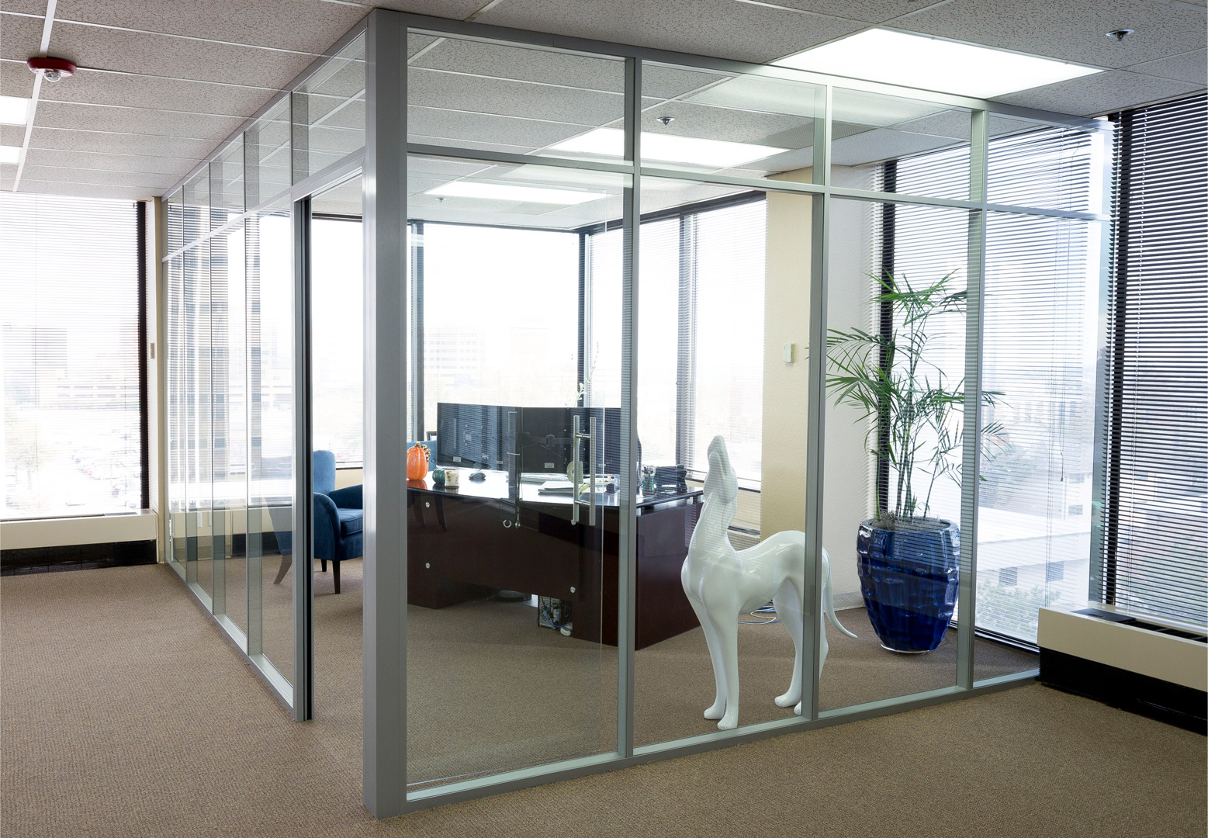
Flex Series

Slide 36
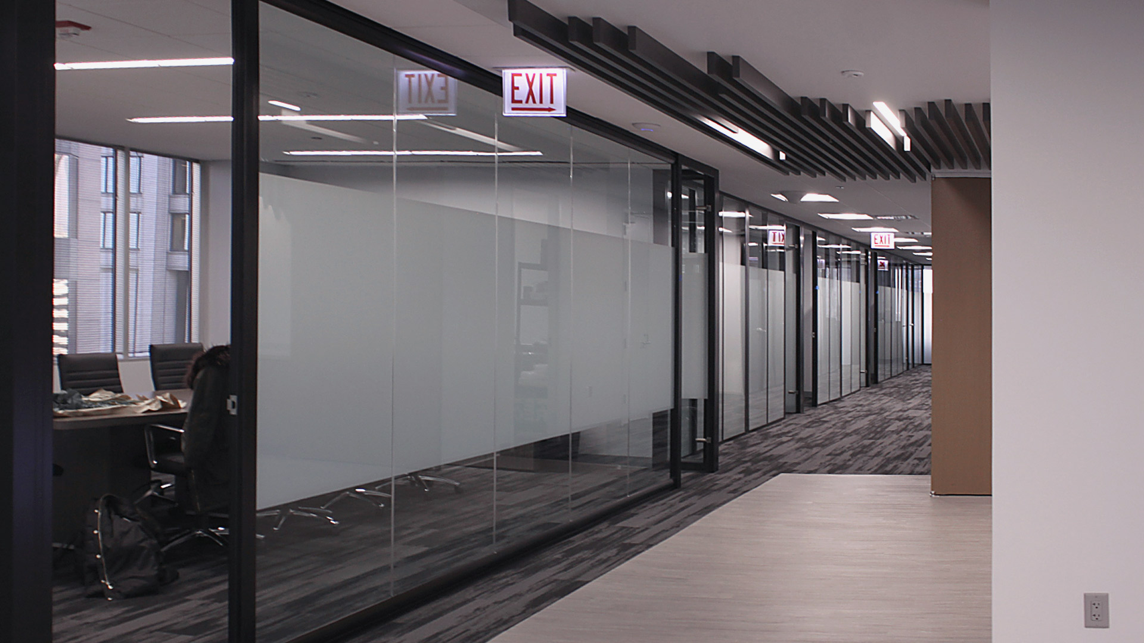
View/Flex Series

Slide 37
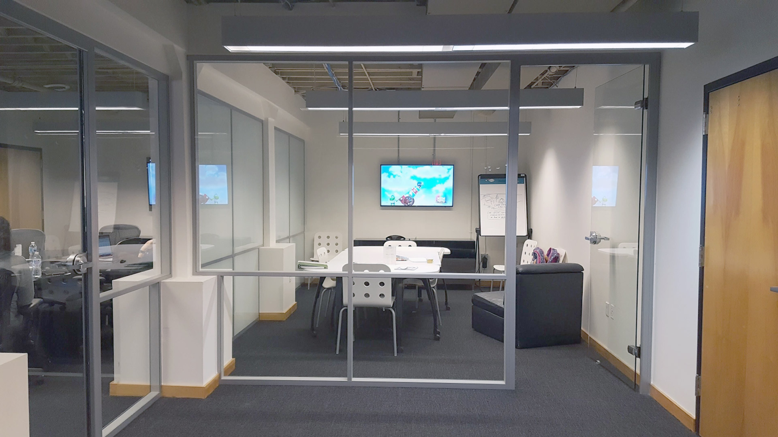
Flex Series

Slide 38
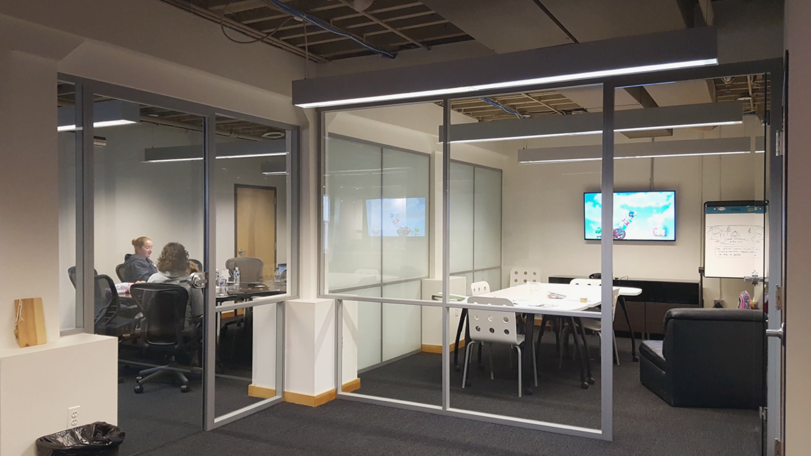
Flex Series

Slide 39
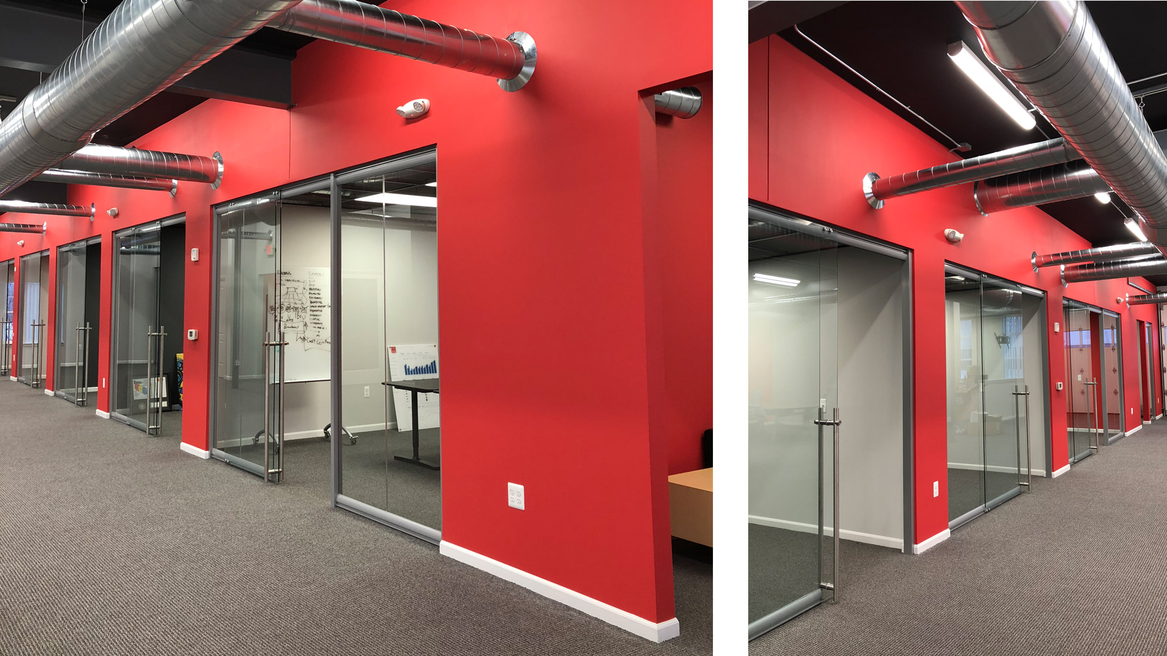
View Series

Slide 40
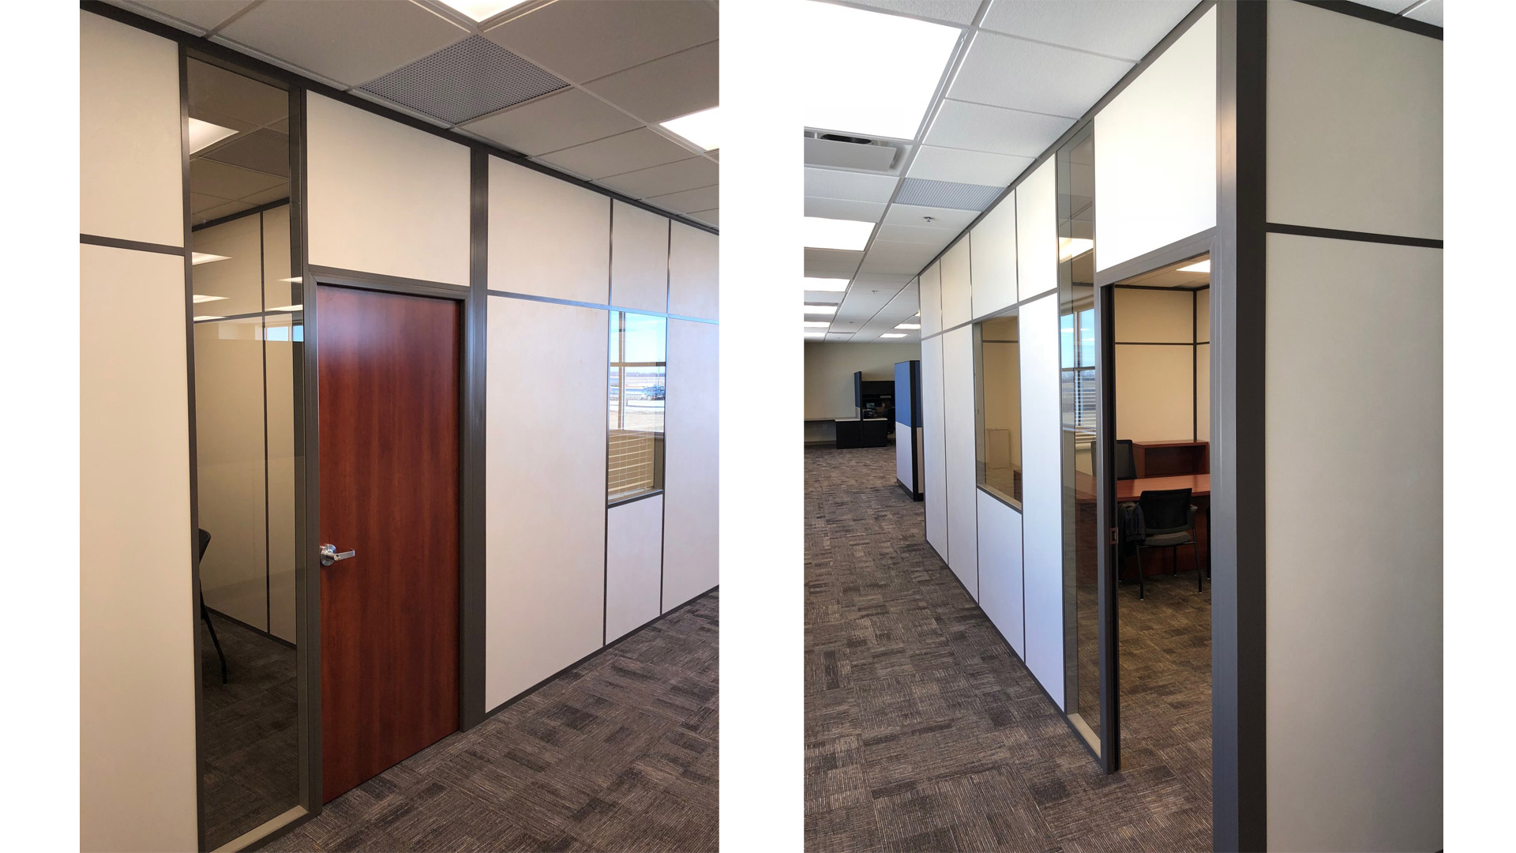
Flex Series

Slide 41
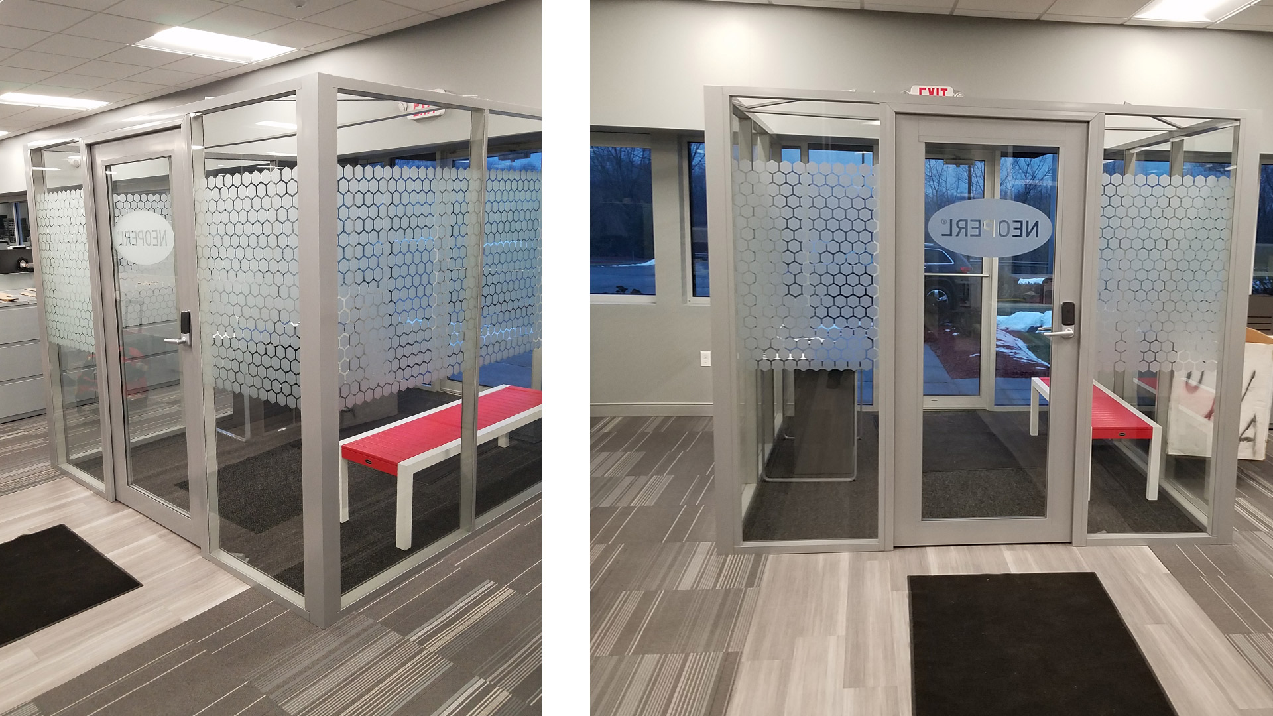
Flex Series

Slide 42
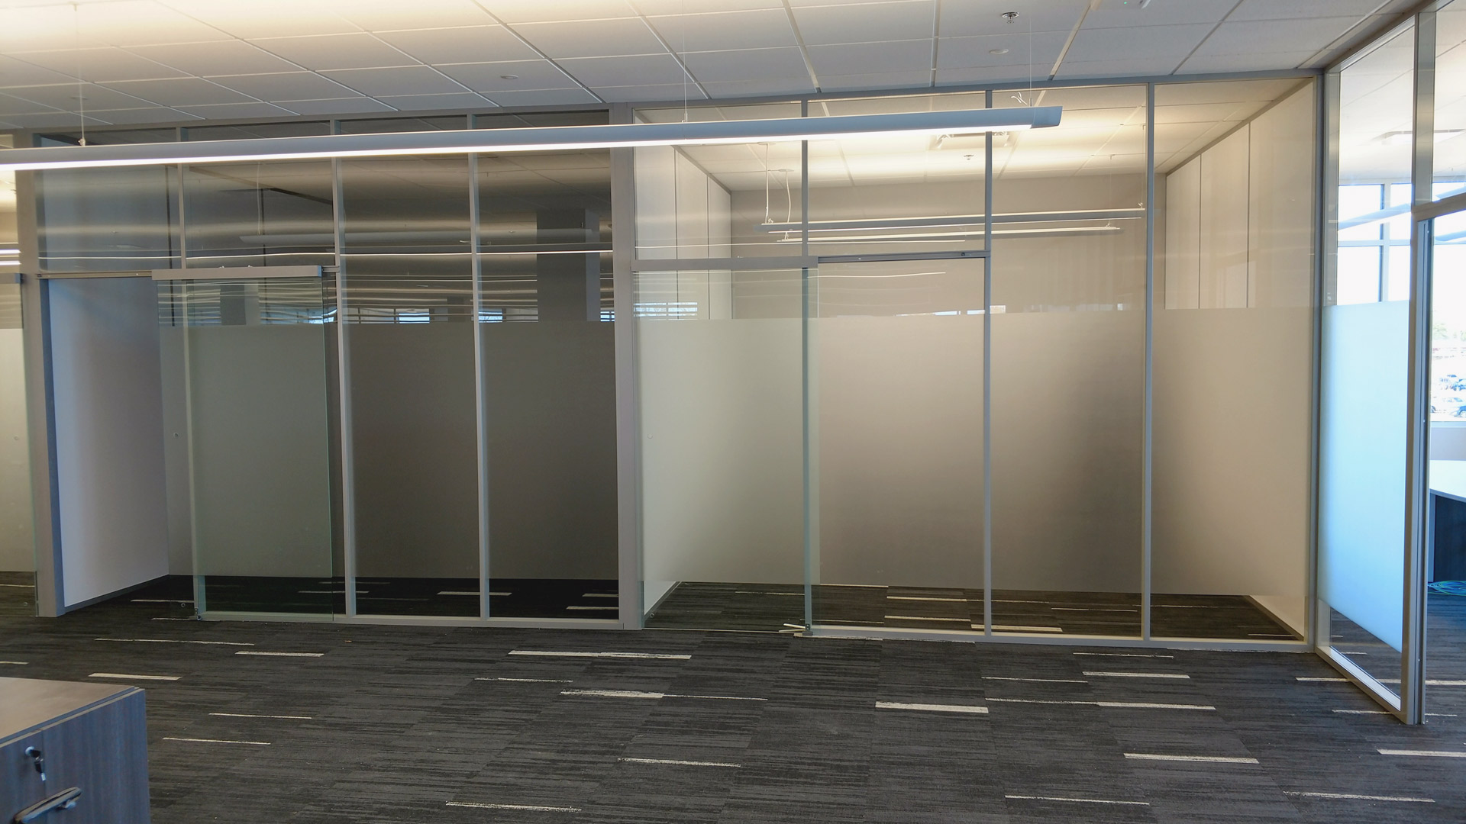
Flex Series

Slide 43

View Series

Slide 44

Flex Series

Slide 45
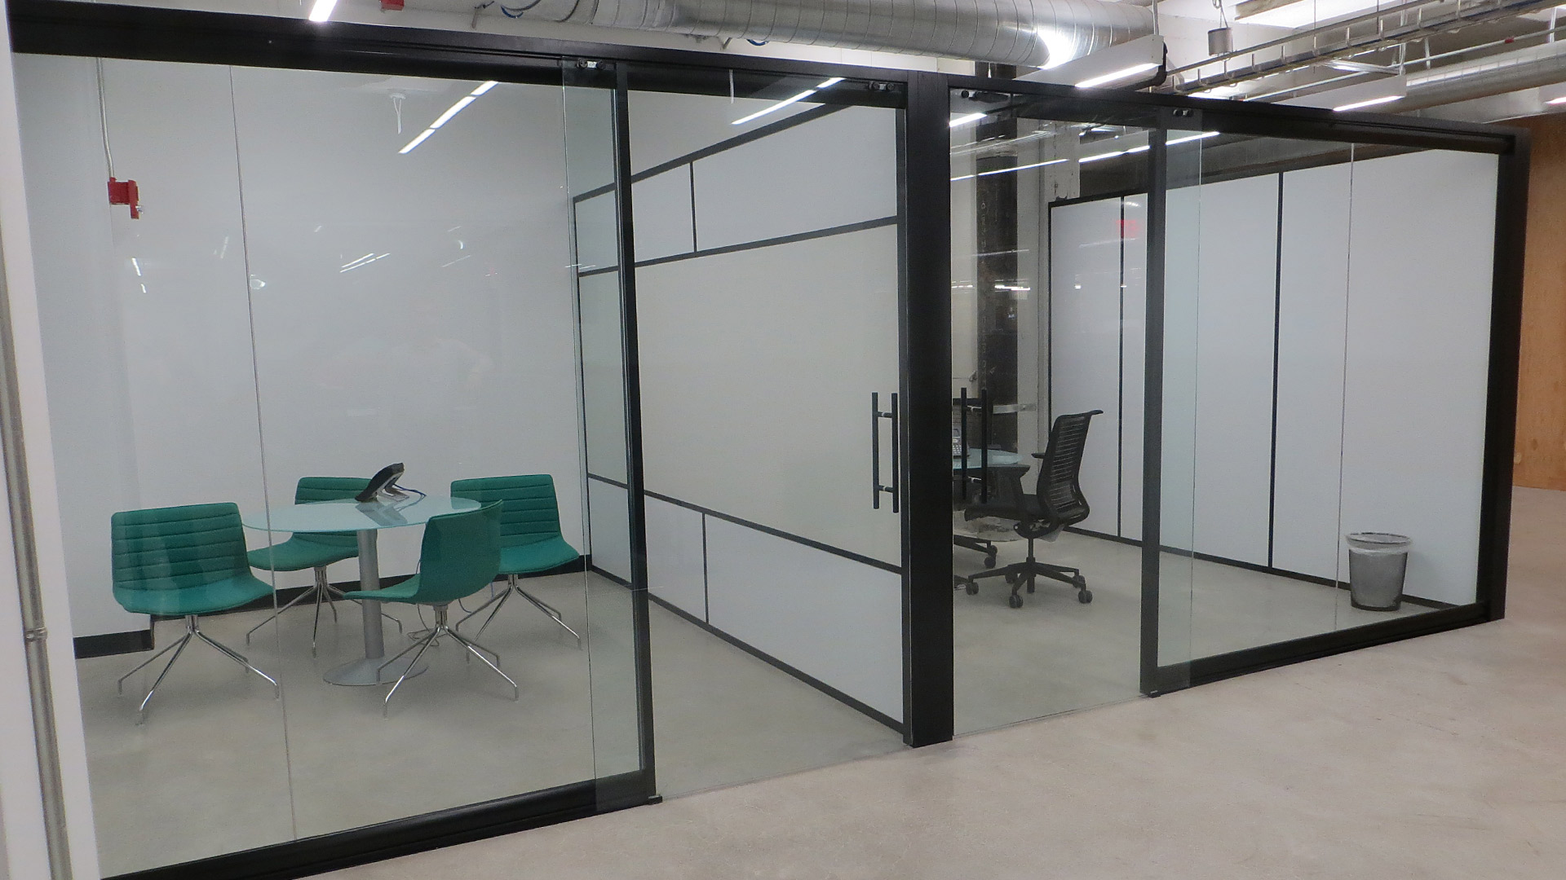
View/Flex Series

Slide 46
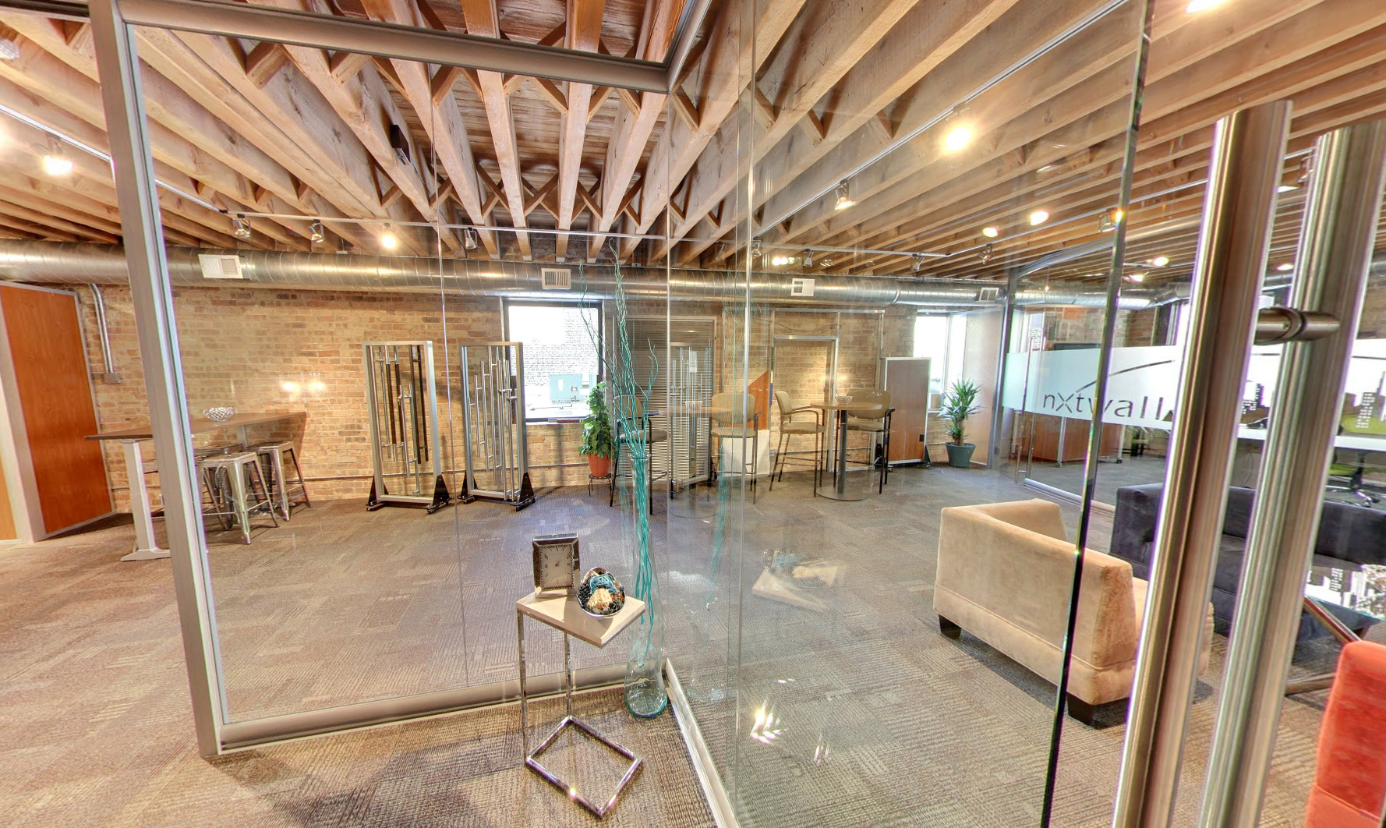
View Series

Slide 47
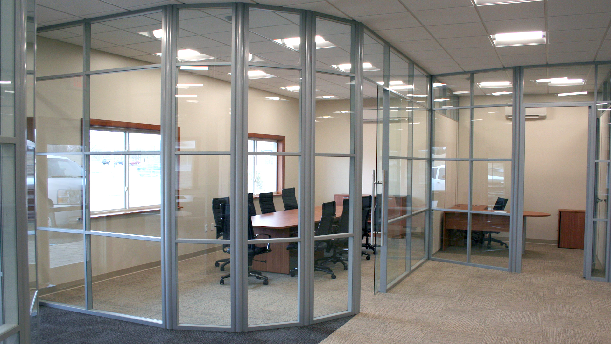
Flex Series

Slide 48
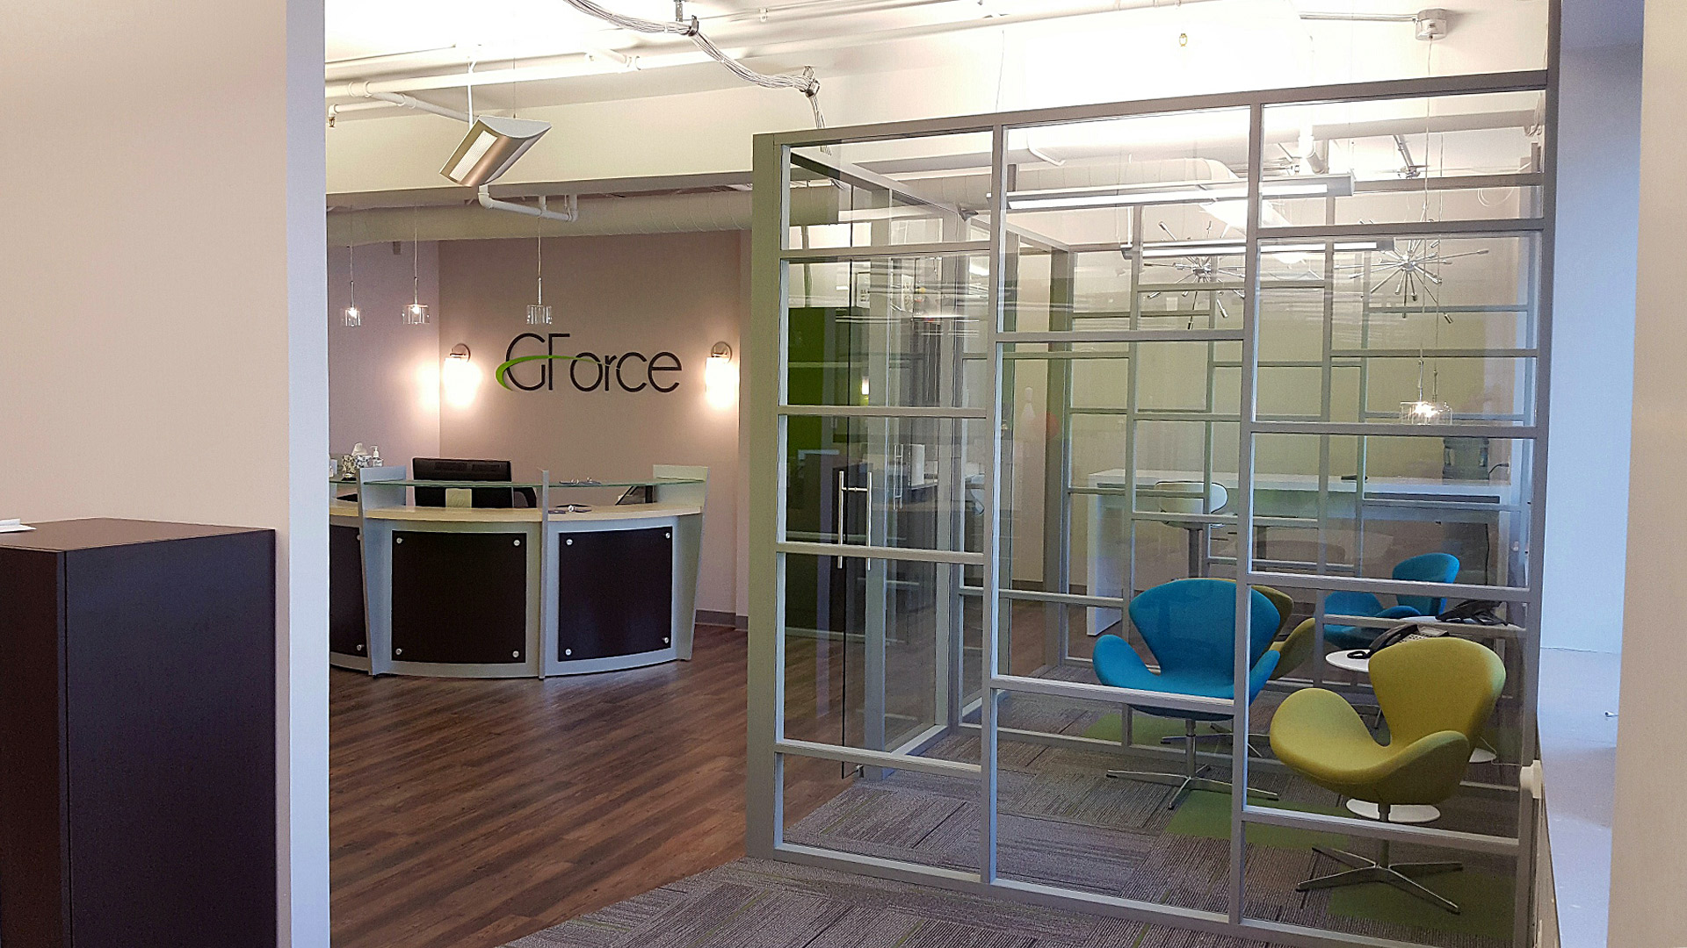
Flex Series

Slide 49
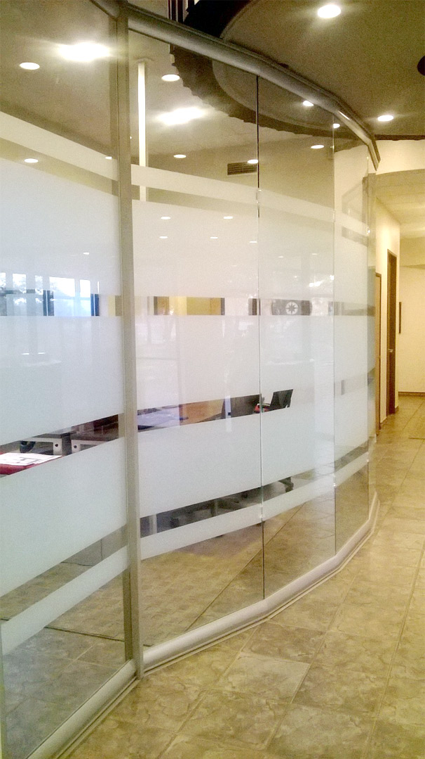
View Series

Slide 50
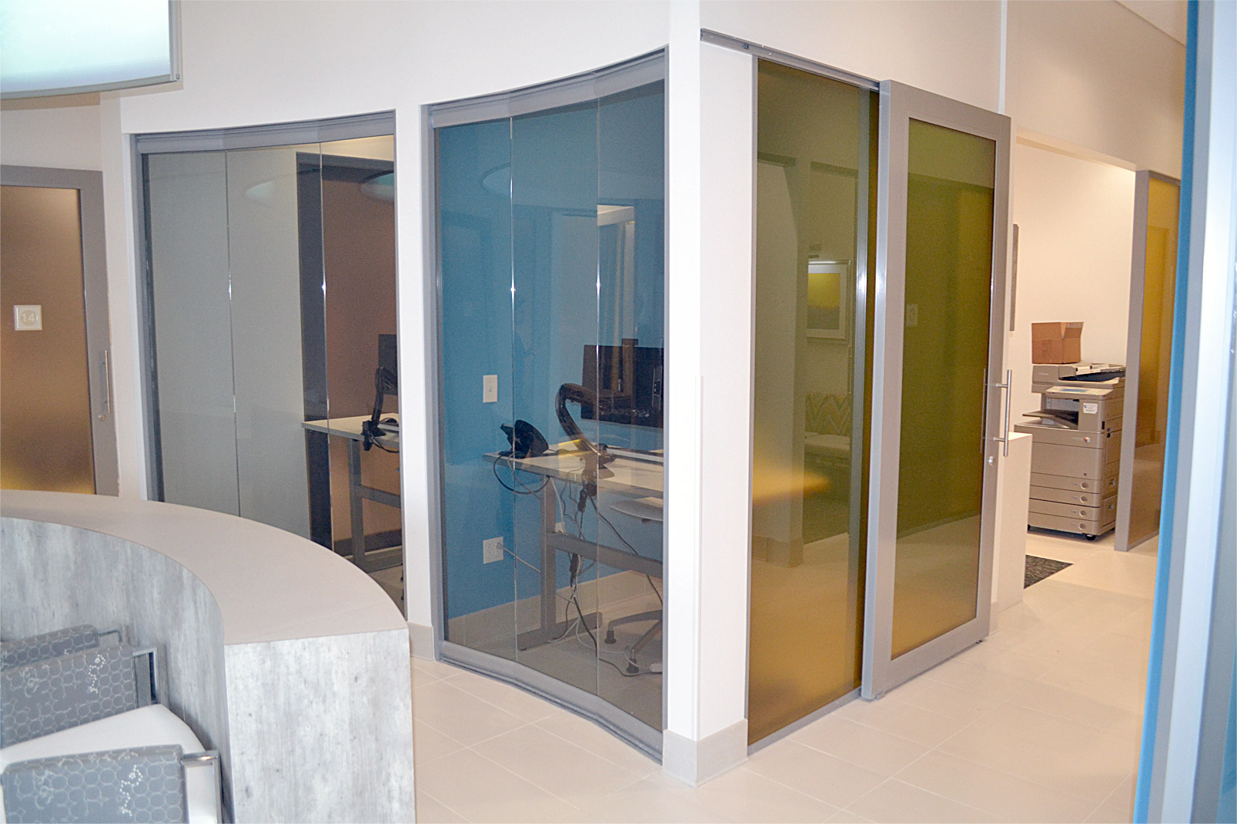
View/Flex Series

Slide 51
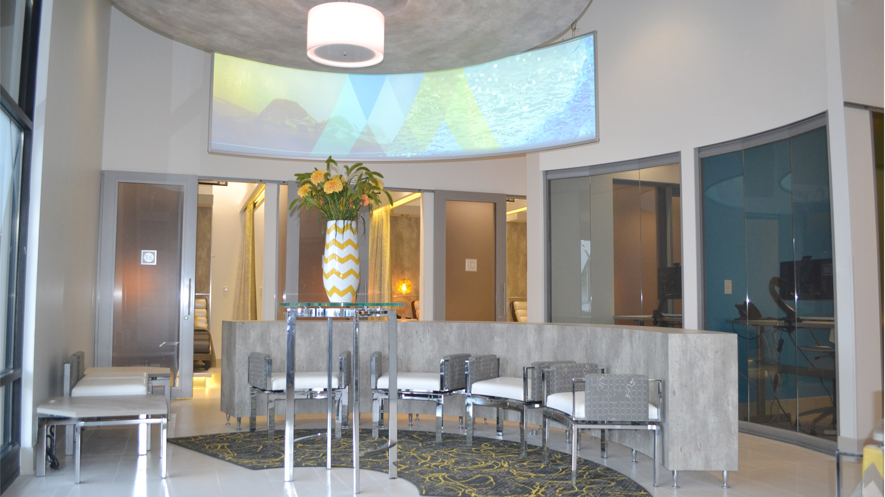
View/Flex Series

Slide 52
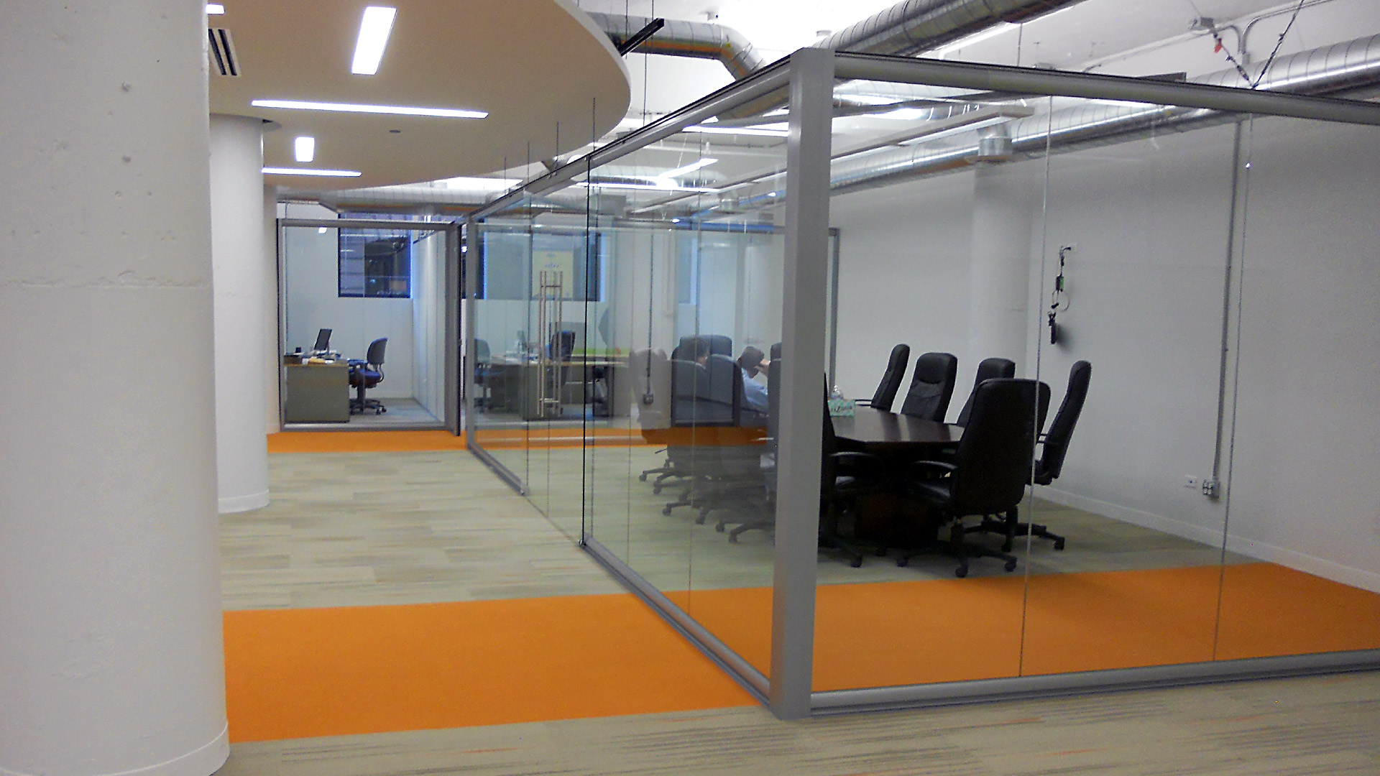
View Series

Slide 53
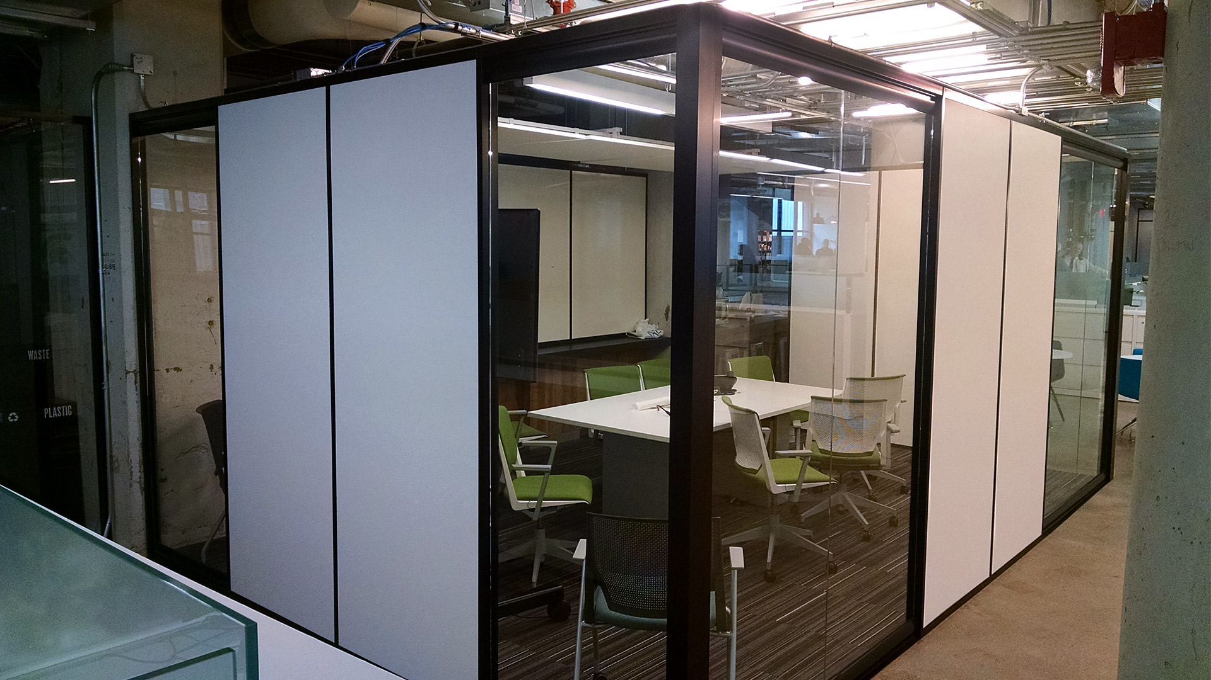
View/Flex Series

Slide 54
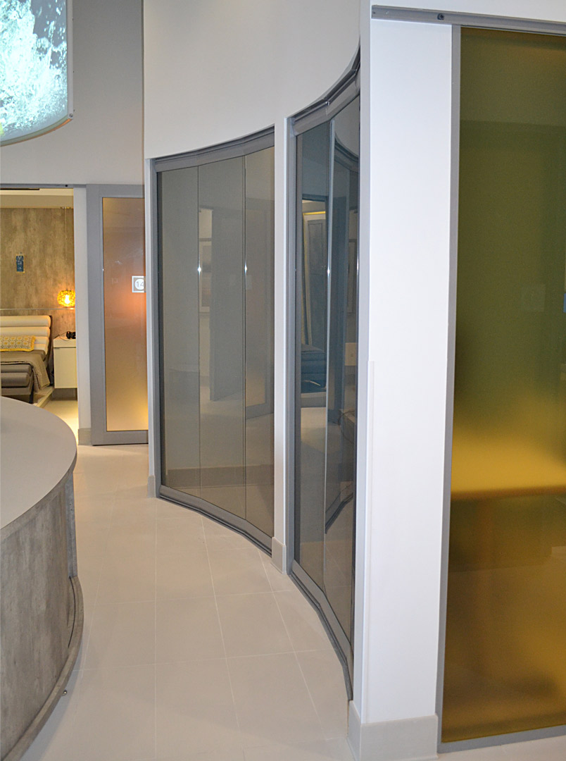
View/Flex Series

Slide 55
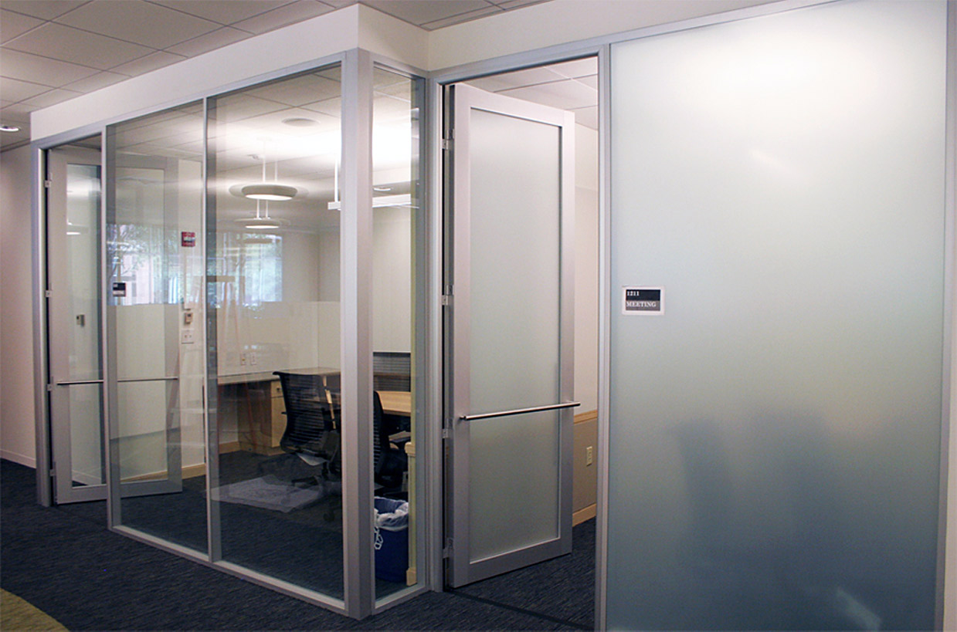
Flex Series

Slide 56

View Series

Slide 57

Flex Series

Slide 58

View Series

Slide 59

Flex Series

Slide 60

View Series

Slide 61

Flex Series

Slide 62

View Series

Slide 63

View/Flex Series

Slide 64

Flex Series

Slide 65

Flex Series

Slide 66

View/Flex Series

Slide 67

Flex Series

Slide 68

Flex Series

Slide 69

View Series

Slide 70

View Series

Slide 71

Flex Series

Slide 72

Flex Series

Slide 73

View Series

Slide 74

Flex Series

Slide 75

View Series

Slide 76

View/Flex Series

Slide 77

View Series

Slide 78

View/Flex Series

Slide 79

View Series

Slide 80

Flex Series

Slide 81

Flex Series

Slide 82


Flex Series

Slide 83

View Series

Slide 84


Flex Series

Slide 85

Flex Series

Slide 86

View Series

Slide 87

View Series

Slide 88

Flex Series

Slide 89

Flex Series

Slide 90

View Series

Slide 91

View/Flex Series

Slide 92

Flex Series

Slide 93


Flex Series

Slide 94

View Series

Slide 95

Flex Series

Slide 96

Flex Series

Slide 97

View Series

Slide 98

Flex Series

Slide 99

View/Flex Series

Slide 100

Flex Series

Slide 101

Flex Series

Slide 102
View/Flex Series

Slide 103

View Series

Slide 104

Flex Series

Slide 105

Flex Series

Slide 106

Flex Series

Slide 107

Flex Series

Slide 108

Flex Series

Slide 109

Flex Series

Slide 110

View Series

Slide 111

Flex Series

Slide 112

Flex Series

Slide 113

Flex Series

Slide 114

Flex Series

Slide 115

Flex Series

Slide 116
Website: www.nxtwall.com
Email: info@nxtwall.com
Phone: 269-488-2752

