Slide 1

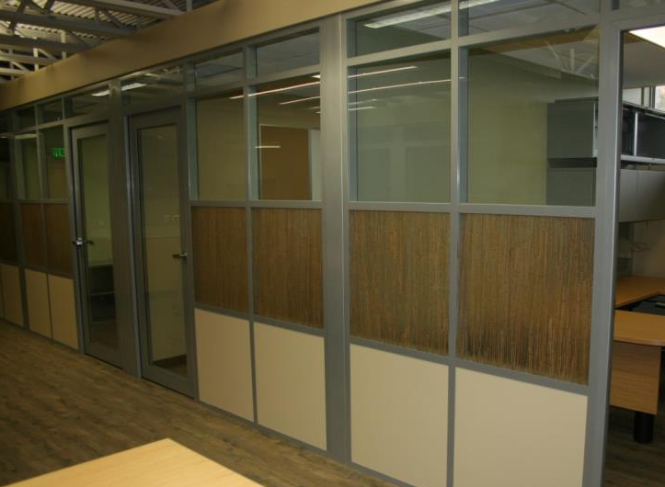
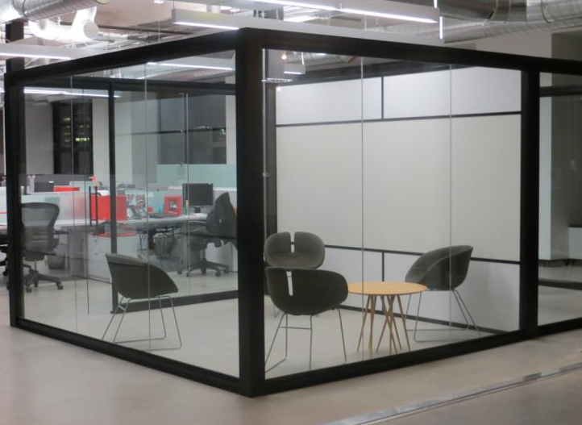
Kalamazoo, MI
Headquarters
Downtown Chicago
Corporate Showroom
The Sustainable Solution
Flex Series: Endless Glass/Solids options
View Series: Center Pane Glass

Slide 2
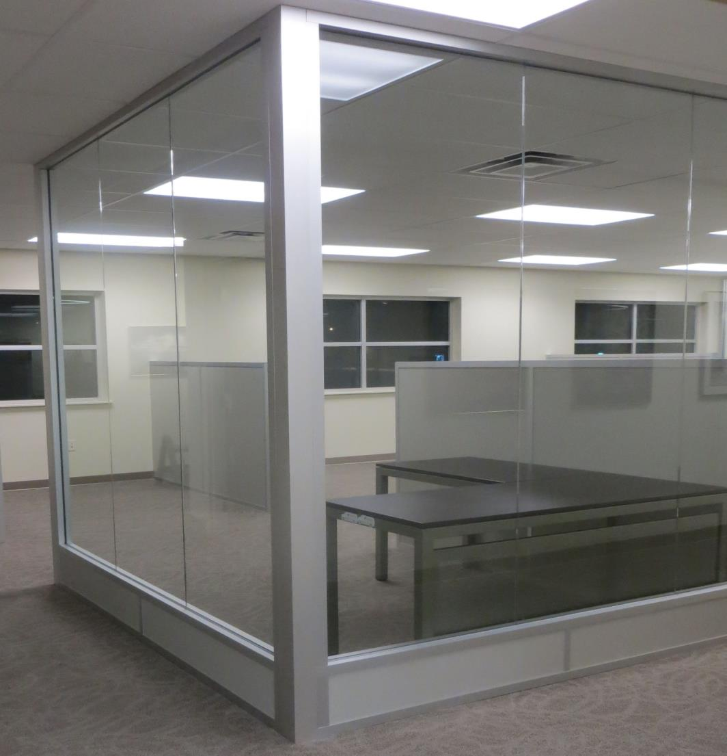
Flex Series

Slide 3
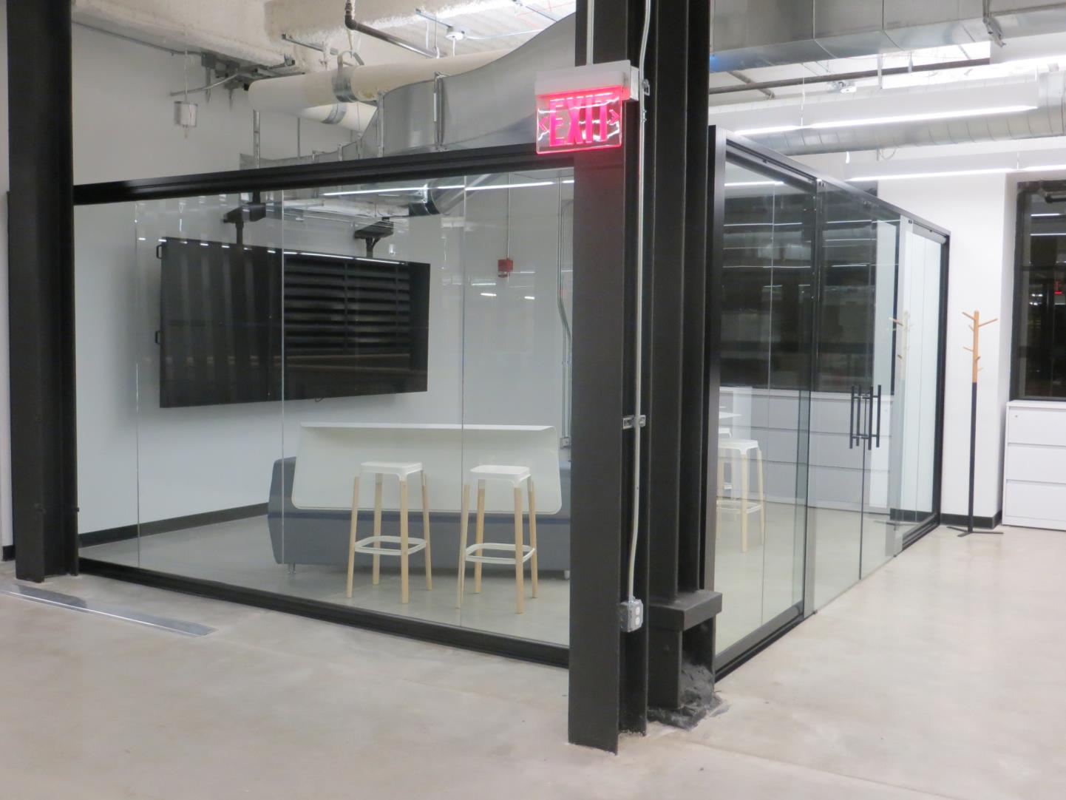
View Series

Slide 4
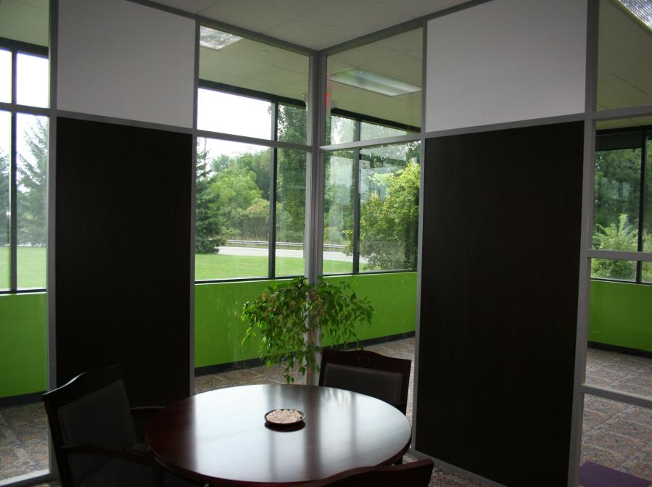
Flex Series

Slide 5
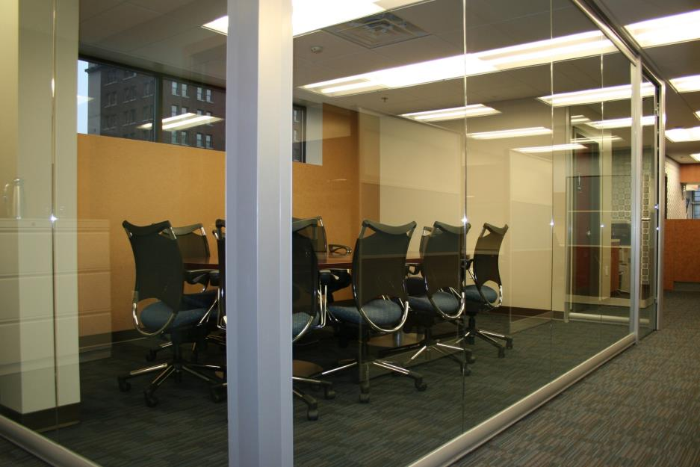
View Series

Slide 6
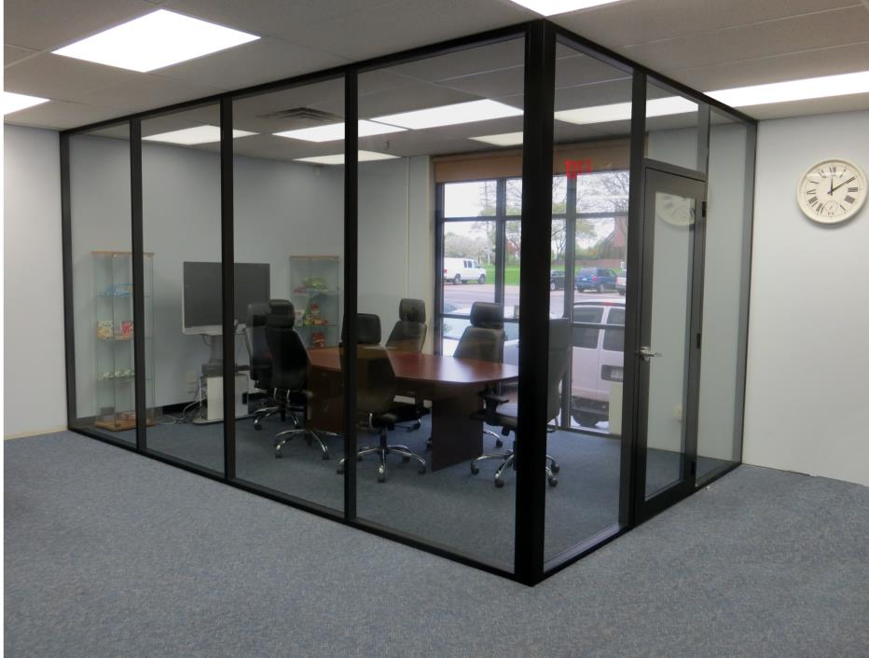
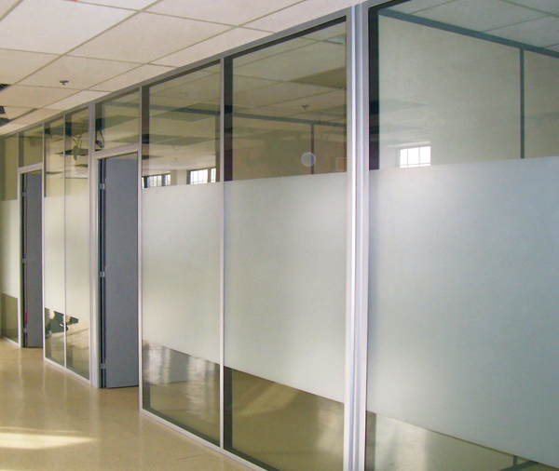
Flex Series

Slide 7
Who is
Manufactured in the USA
Privately Owned
Focused on offering great aesthetics, flexible design and sustainable products
Core Values (Aesthetics - Function – Speed of Construction – Cost)
Installations in 40+ States
Headquarters located in Kalamazoo, MI
Corporate Showroom Downtown Chicago near the Merchandise Mart

Slide 8
Demountable Walls?
Why
      Field Fit/Stick Built
      Simple Kit of Parts
      Ease and Speed of construction
      2 to 3 week standard Lead Time……..
      Economical Alternative
      The most Sustainable in the Industry
      LEED Points (Regional Materials, Local Labor)

Slide 9
Installation
Simple single Office Installation using the Flex Series incorporating Glass and Solid.
CLICK TO ADVANCE SLIDE

Slide 10
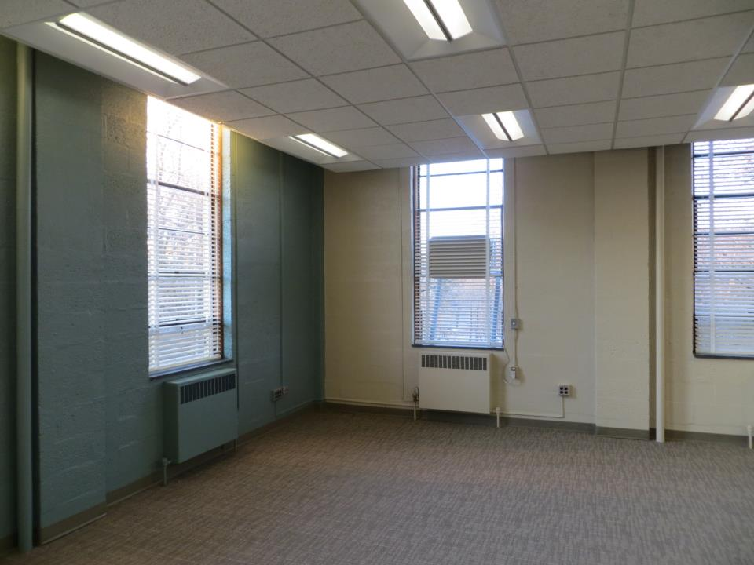
Click to advance
Area for new office

Slide 11
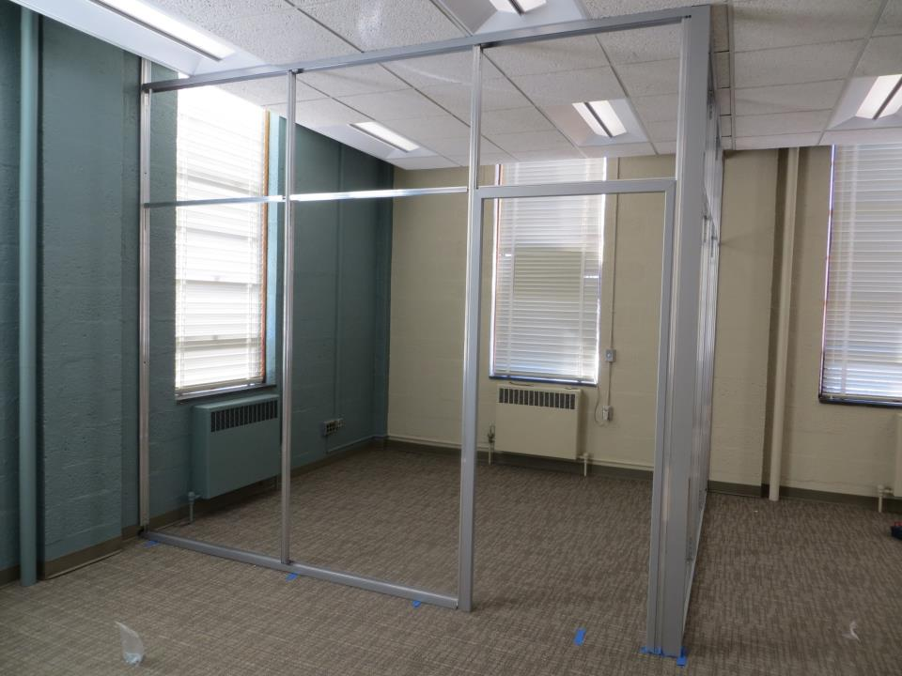
Click to advance
Flex Series with Clearstory and Swing Door

Slide 12
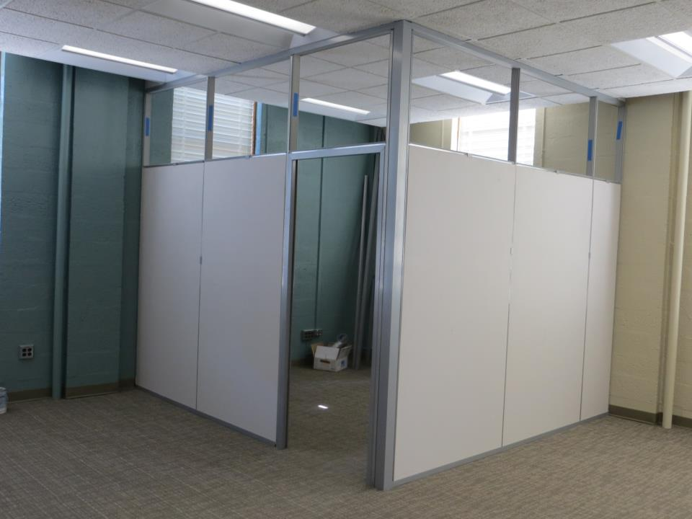
Click to advance
Customer chose raw Gypsum to be painted

Slide 13
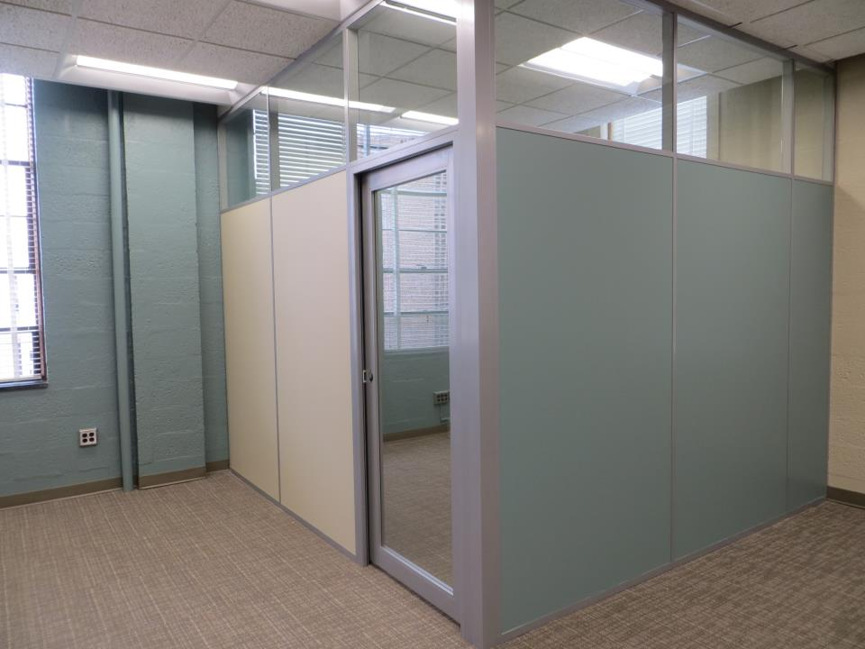
Installation by a two man crew in four hours

Slide 14
Definition of stickbuilt in English: Stickbuilt
Syllabification: stick·built Pronunciation: ˈstikˌbilt/
Adjective: built piece-by-piece on the premises, rather than constructed from prefabricated units.
Constructed largely or entirely on site
Adaptive to building conditions
Easily change Wall Finishes and Functions
Quick access to Wall cavity for Utility maintenance and Blocking requirements
Simple Kit of Parts
Non Progressive
Non Unitized
Speed of Construction
Efficiently deconstructed when relocating
Stores efficiently
Appreciates in Value
100% recyclable with minimal effort

Slide 15


With Change is Good
& Easy……….
With a Stick Built Demountable Wall/Partition it is easy to reconfigure your space, change wall color, add features (Whiteboards, Chalkboards, Fabric Panels, Glass, 3-Form, Architectural applied materials…) or access the wall cavity for mechanical purposes.
Add Glass to Conf. Room
New Managers Office
Color
Hang Monitor #303

Slide 16

You can take it with you
NxtWall Demountable Walls/Partitions are classified as Furniture. They can be quickly dismantled and packaged to relocate across the hall or across the Country.
If your new space has taller ceilings or wider areas the existing framework can be modified to fit and supplemented with new parts saving you time and money.
When packaging and storing the Simple Kit of Parts reduces your Storage footprint when compared to non Stick Built Systems.

Slide 17
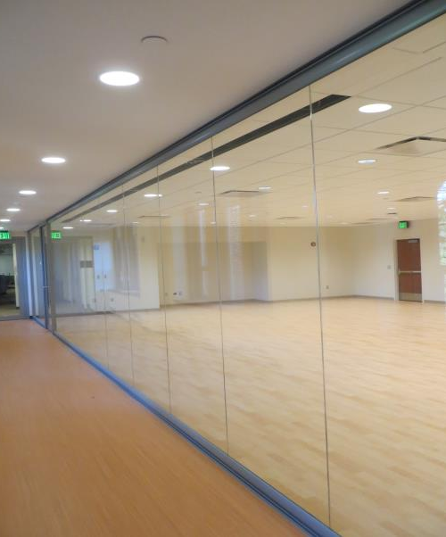
Price is what you pay. Value is what you get
NxtWall Demountable Walls/Partitions actually appreciate throughout their lifecycle. The first time you reconfigure a space or relocate a Stick Built Demountable Wall your investment is recovered..

Slide 18
Wall SERIES
Flex = Glass/Solid
View = Glass Only

Slide 19
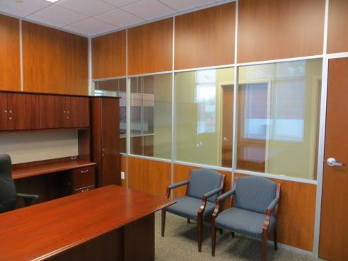

Flex Wall Series
Endless Solids & Glass
3” Thick Wall
  Floor to Ceiling/Freestanding
Board can be any ½” material
Easily Incorporate Glass and Solids.
Single or Double pane Glass
Universal Swing Doors
Barn and Pocket Door Options
Great Acoustical Performance
Wide Trim option (Genesis)
Integrated White Board, Tackable Surface, Fabric, Electrical, Electric Privacy Glass, etc.
4” Thick (Genesis) Side wall option

Slide 20
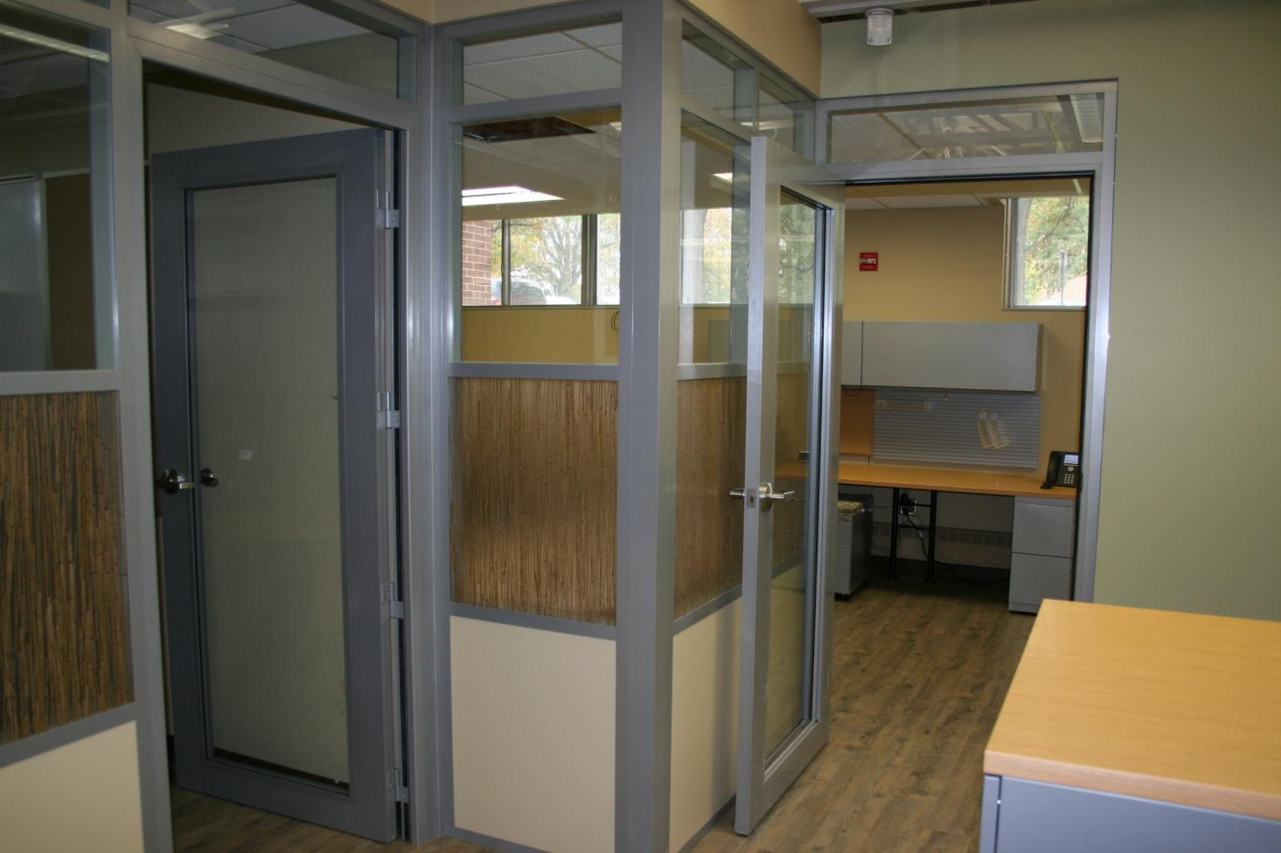
Flex Series

Slide 21
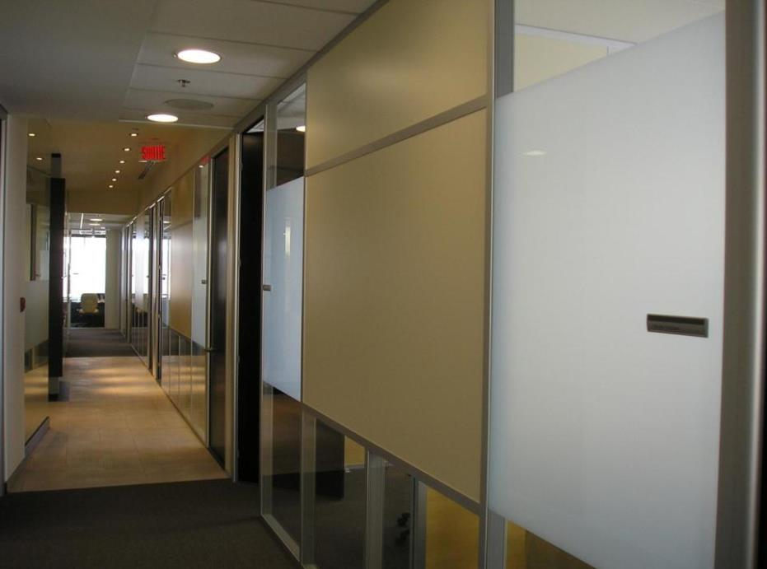
Flex Series

Slide 22
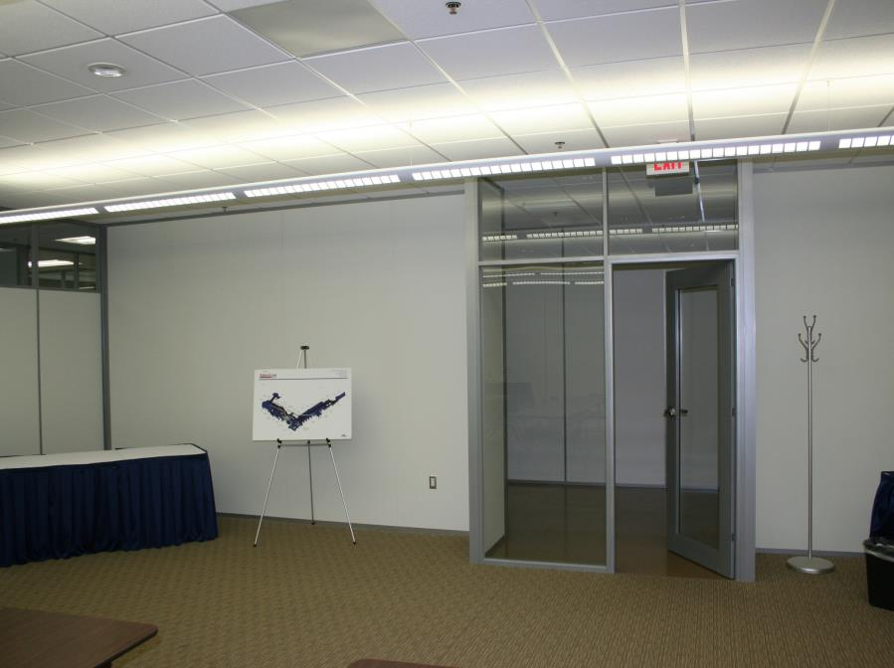
Flex Series

Slide 23
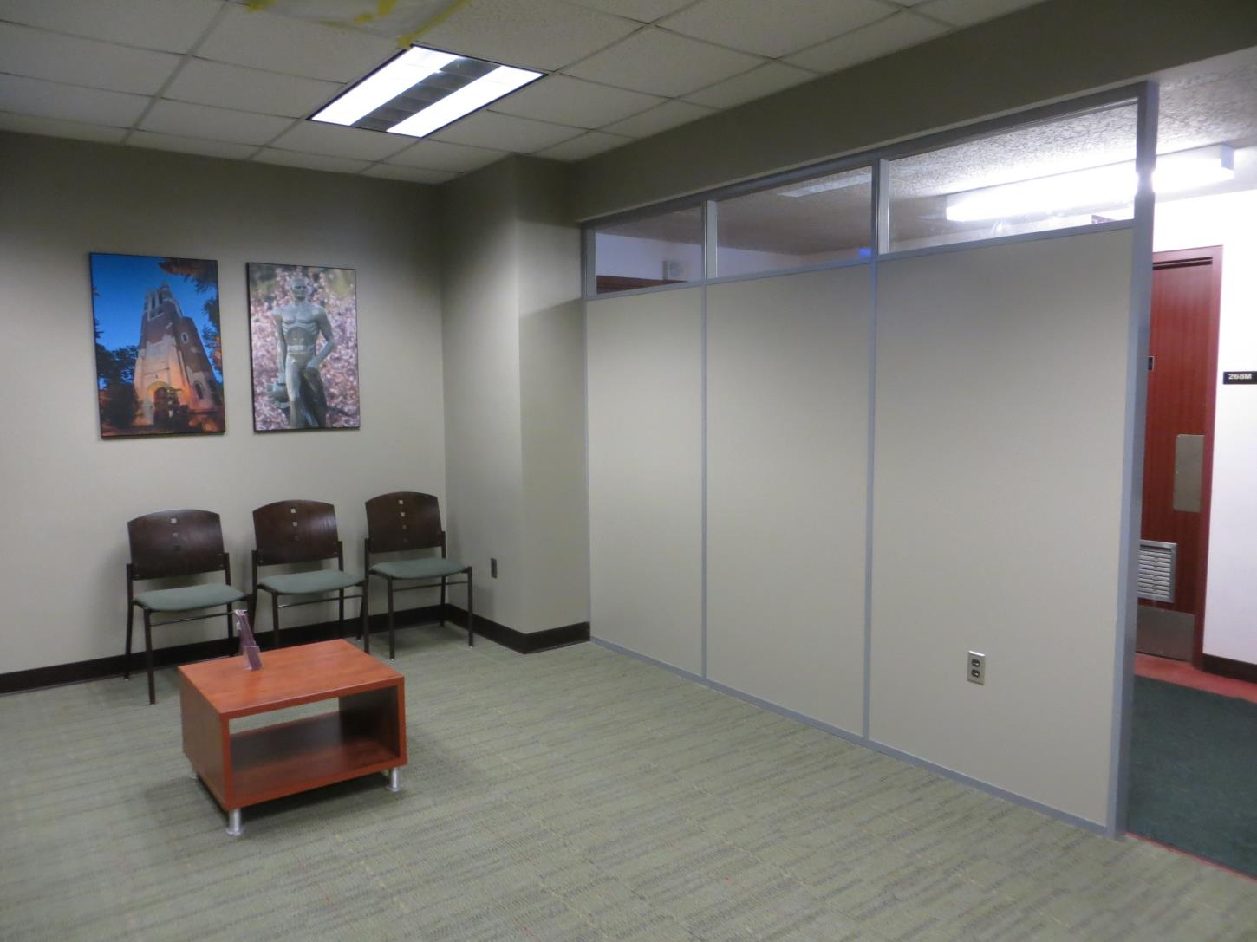
Flex Series

Slide 24
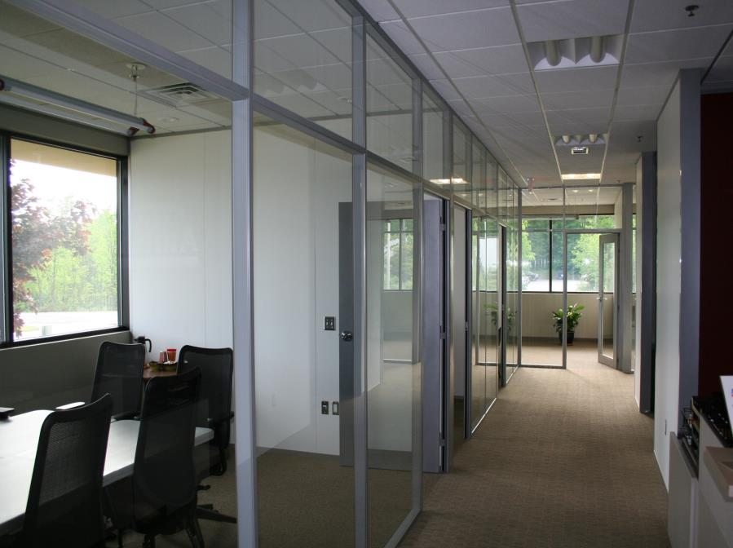
Flex Series

Slide 25
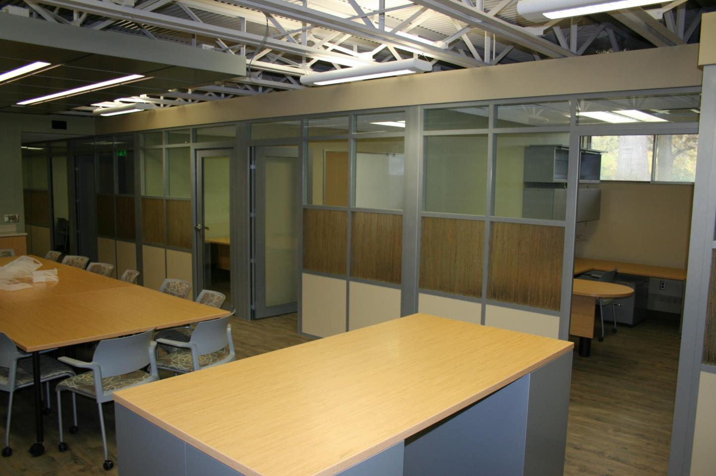
Flex Series

Slide 26
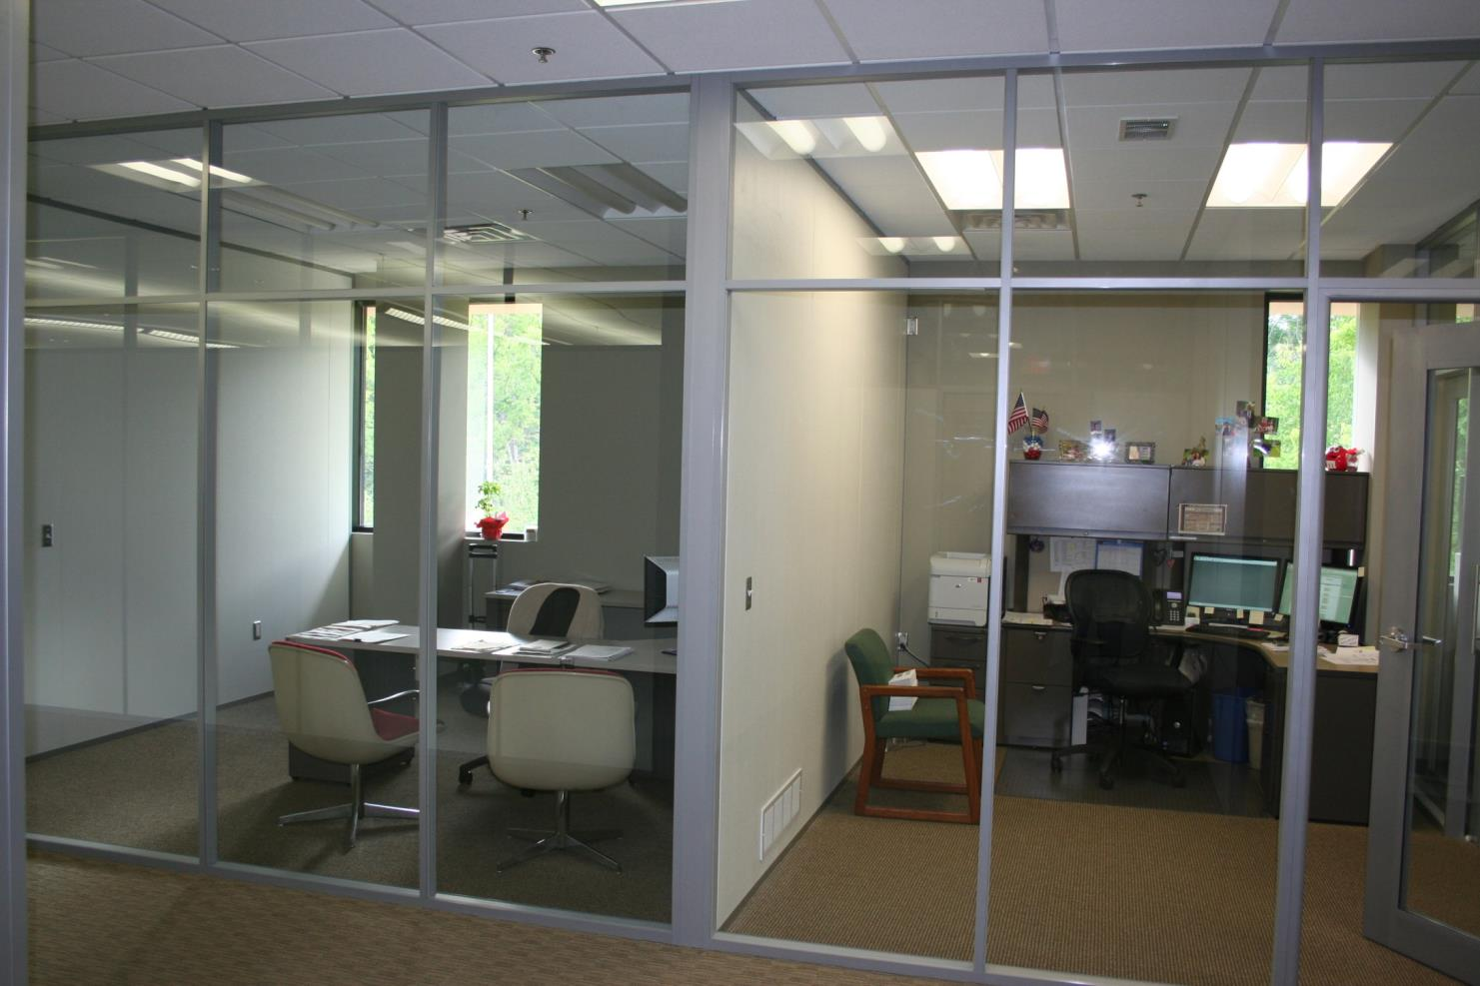
Flex Series
Solid Core Swing Door, Sidelight and Laminate

Slide 27
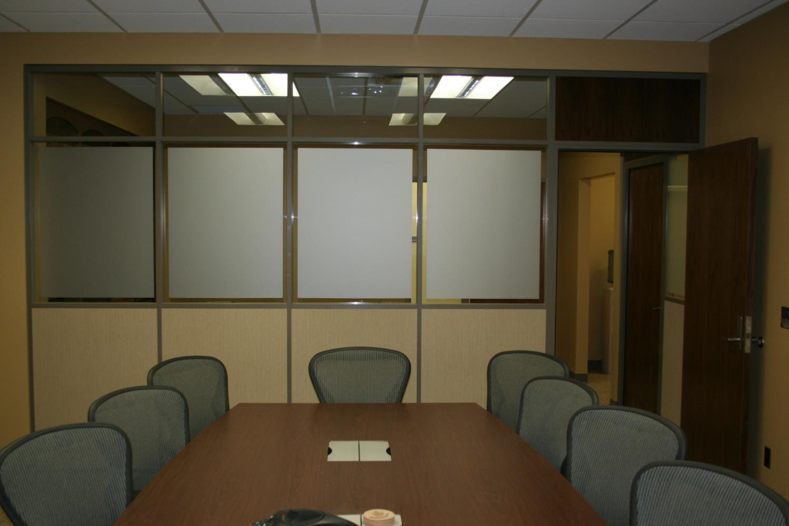
Flex Series
Solid Core Swing Door, Sidelight and Laminate

Slide 28
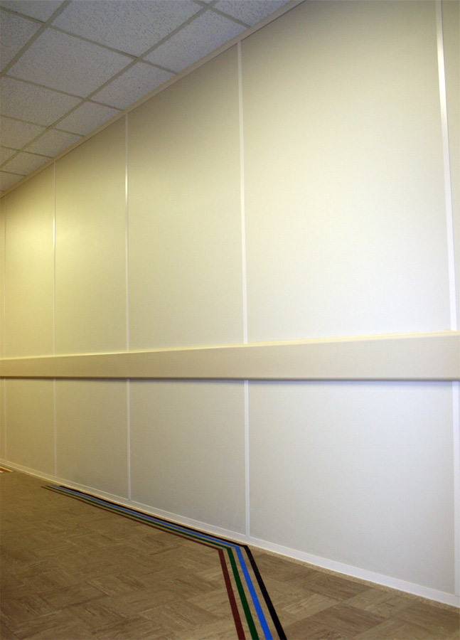
Trim with Matching Wall Board

Slide 29
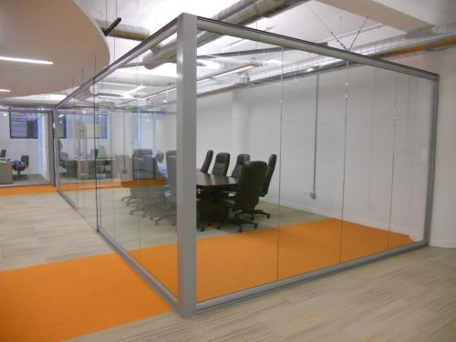
View Wall Series
CENTER MOUNTED GLASS
Center Mounted Single Pane Glass 3/8” to 5/8”
Floor to Ceiling or Freestanding
Integrated Sliding Doors
Universal Swing Doors
Designed as a stand alone Storefront or compliments the Flex Series for a total Office solution

Slide 30
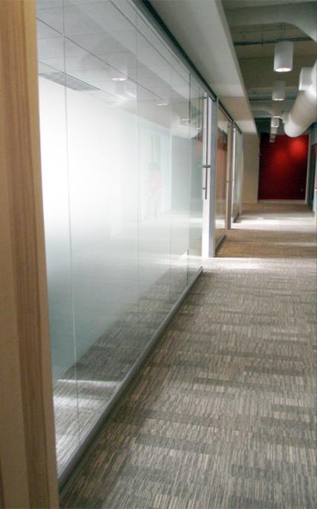
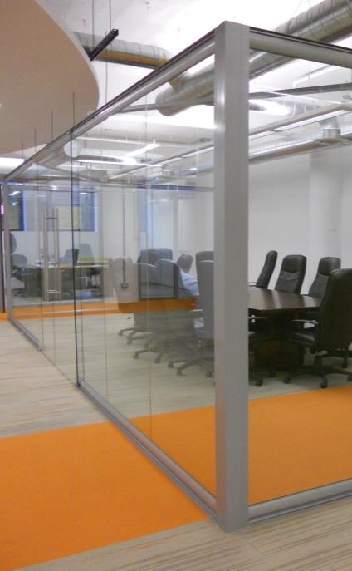
View Series
View Series

Slide 31
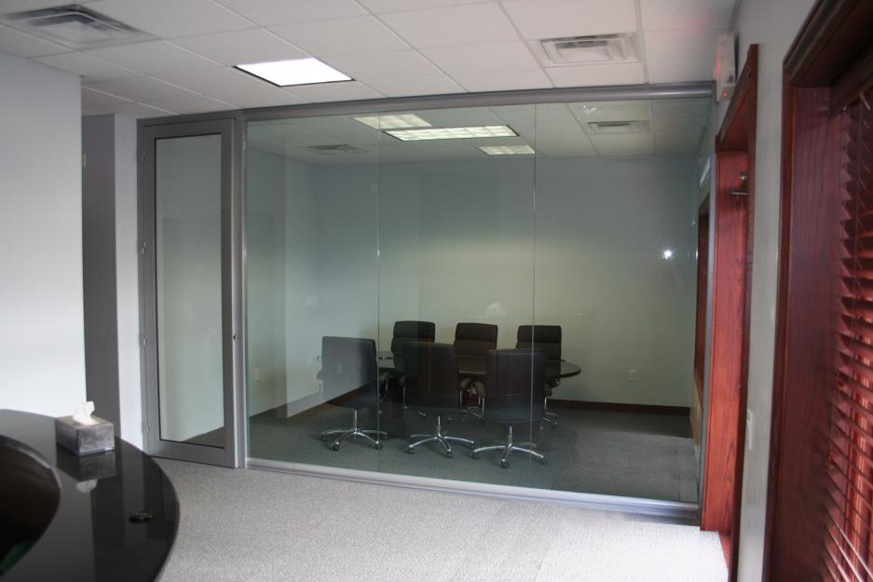
View Series

Slide 32
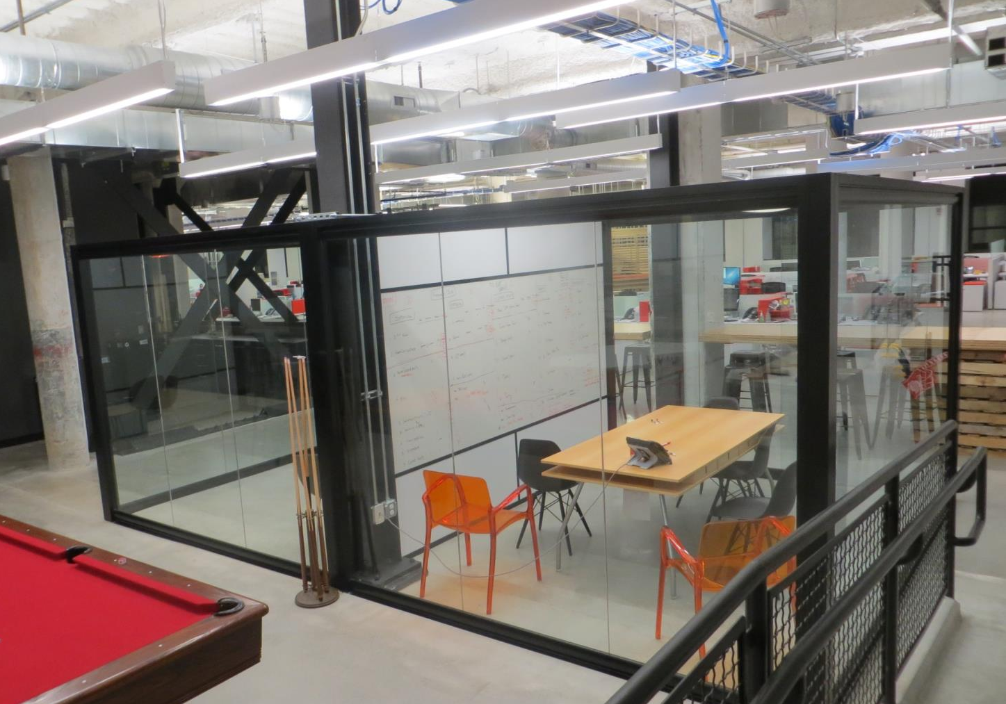
View Series

Slide 33
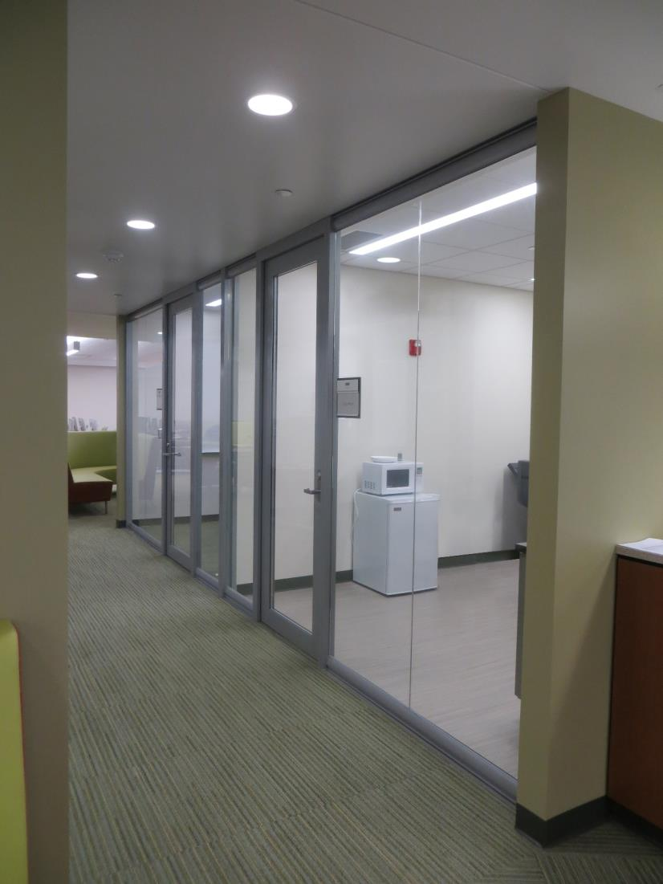
View Series

Slide 34
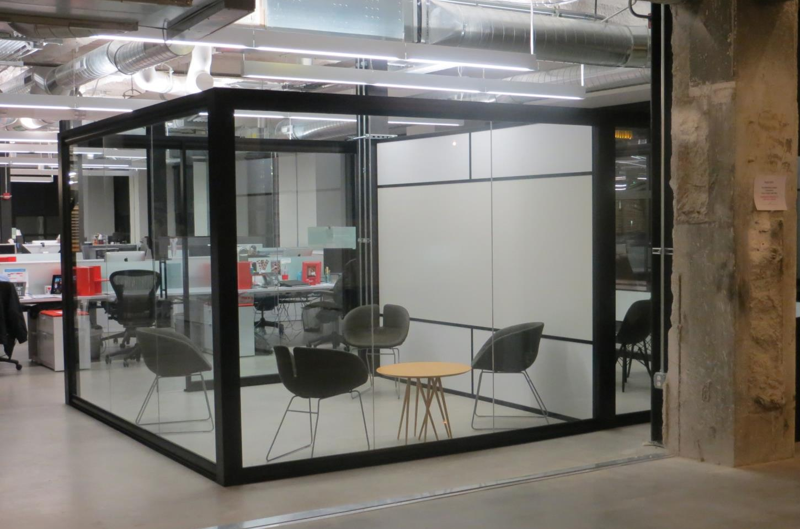
View Series

Slide 35
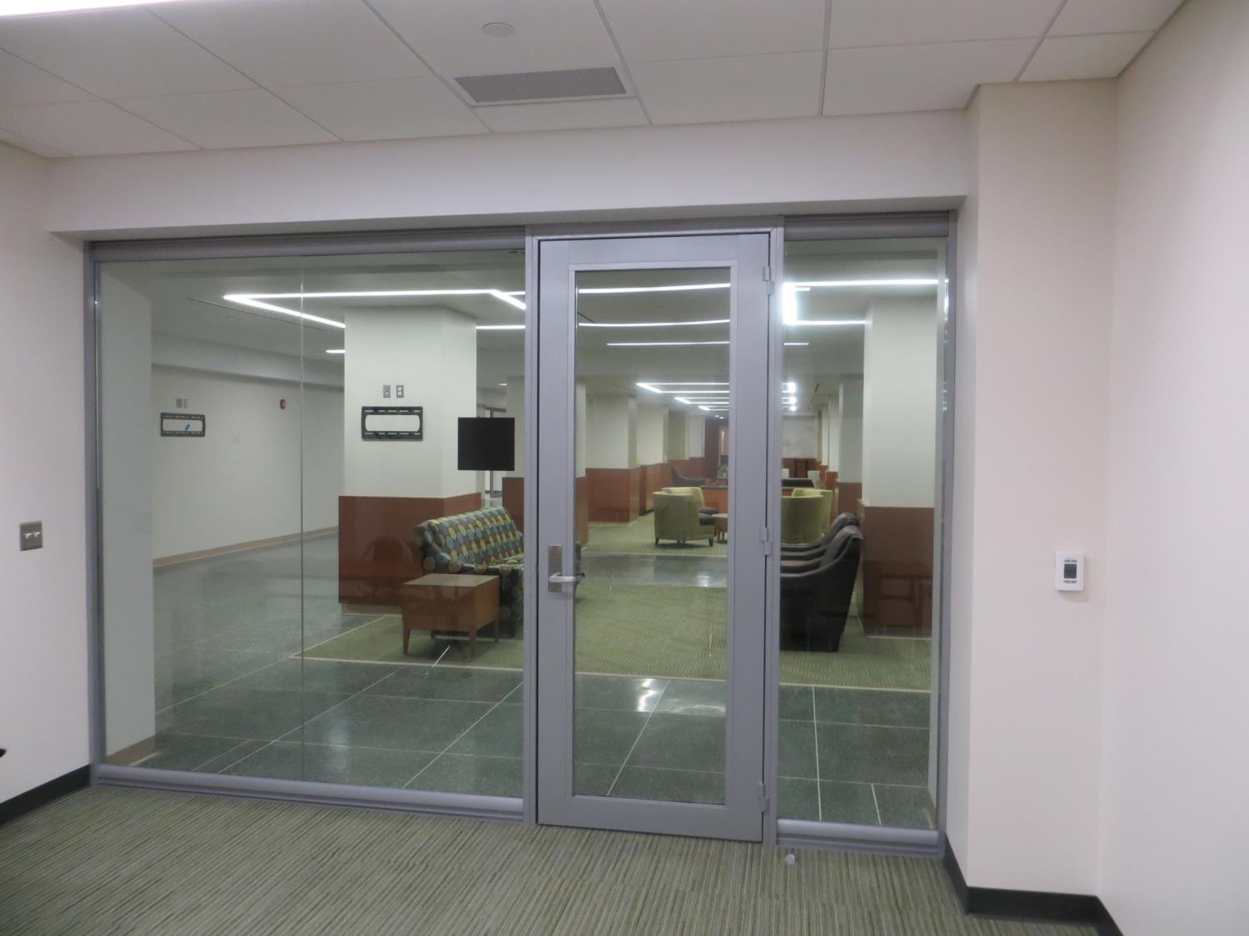
View Series

Slide 36
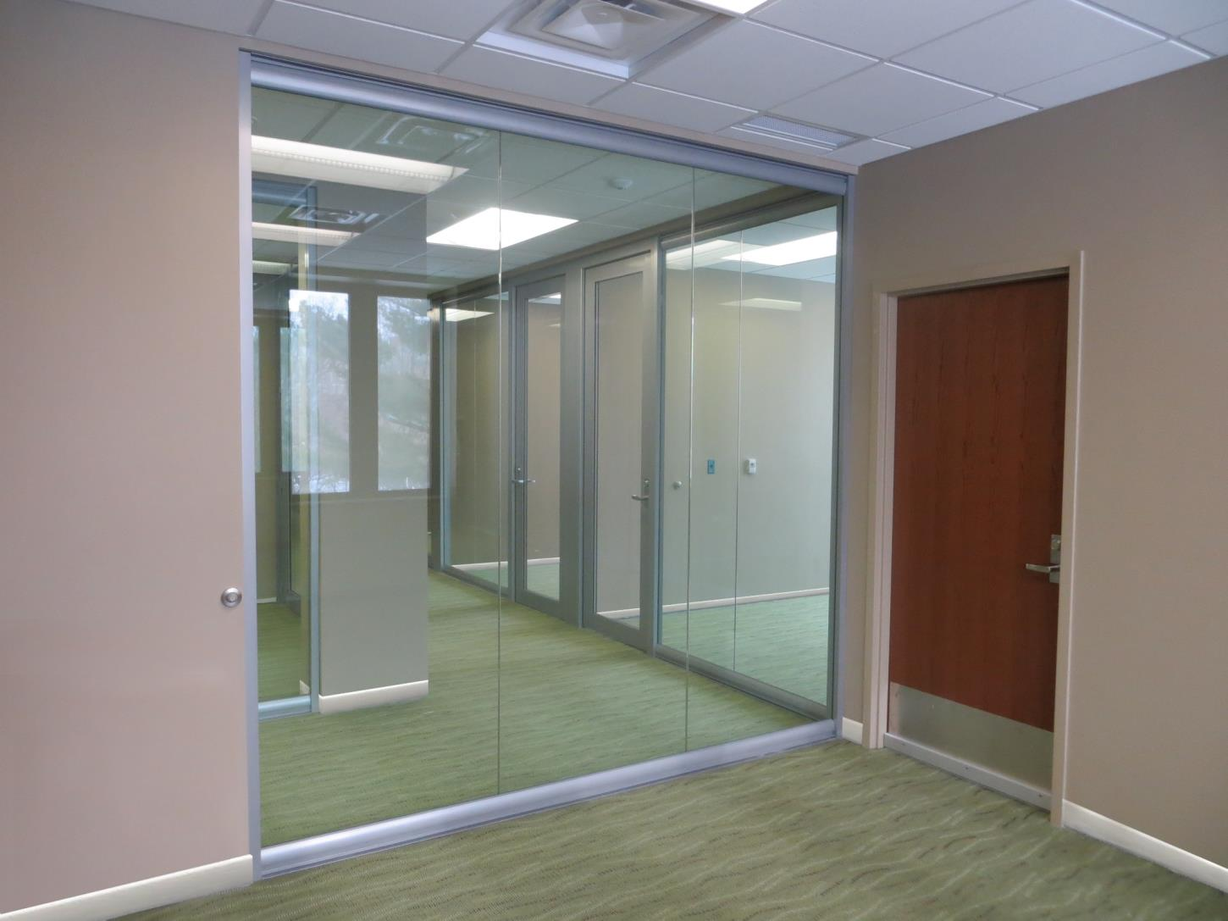
View Series

Slide 37
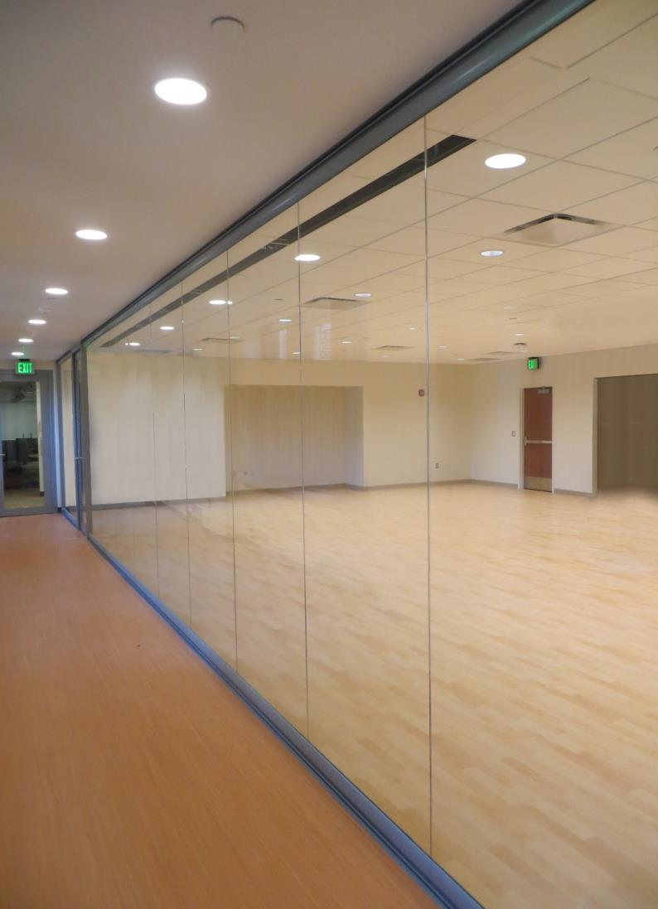
View Series

Slide 38
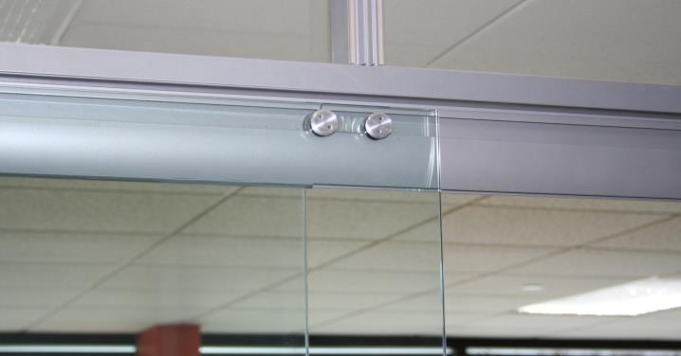
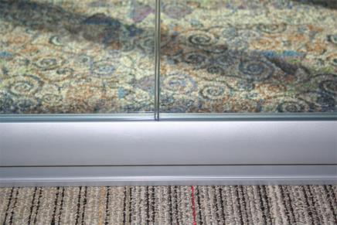
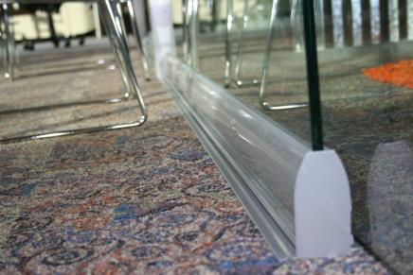
Integrated Sliding Door Hardware
Polycarbonate option between Glass
Low flexible profile

Slide 39
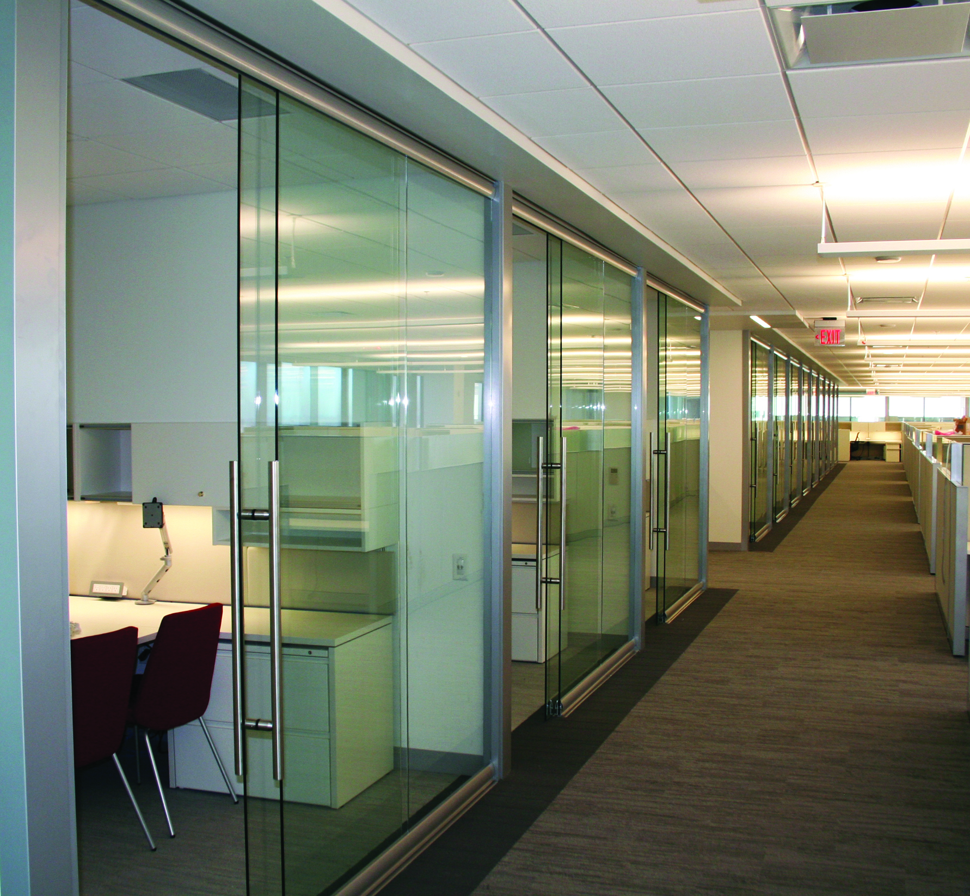
View Series

Slide 40
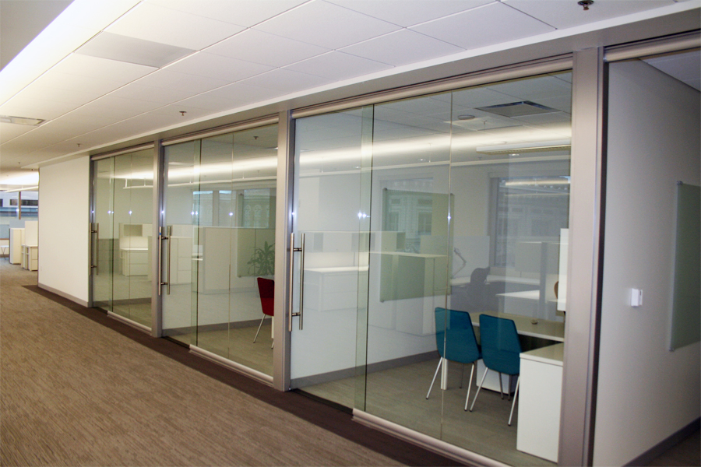
View Series

Slide 41
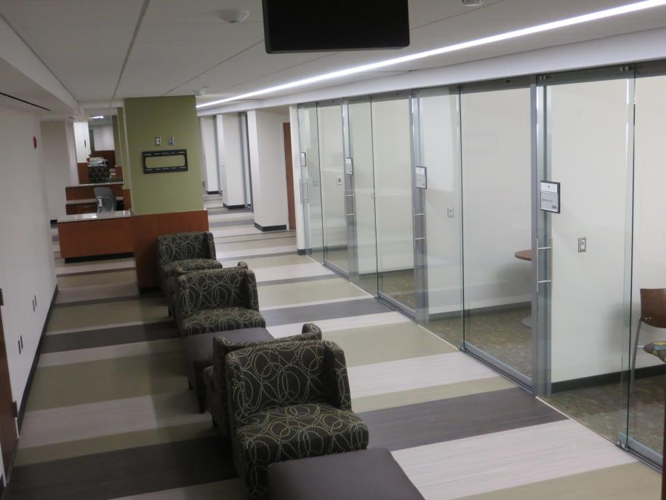
View Series
View Series
View Series

Slide 42


True Sustainability can only be achieved with a NxtWall System that can adapt to all building environments for all generations. LANDFILL
Components used by NxtWall are 100% Recyclable, Reconfigurable and Reusable.
Disassembly is simple and complete without the need for additional Labor to grind, cut and sort.
Minimal Off Site Manufacturing, Local Labor, Condensed Packaging & Freight = REDUCED CARBON FOOTPRINT

Slide 43


































Slide 44
The NxtWall Advantage
Work Flow Clean efficient process, One Trade Group, low impact on operations
Sustainability: Recycle, Reuse, LEED, Worker comfort
Price: Blended price per lineal foot competitive with GC/Trades
Architectural: Glass, Colors, unique shapes, integration
No Permits: Most municipalities do not require a permit to install furniture
Quick lead times: 3-5 Week standard Lead Times
Flexibility: As requirements change so can our Walls
Long Term savings: Reuse/Re-purpose strategy
Tax Advantages: Qualifies as Furniture for accelerated depreciation
Speed of
Construction: No delays as with typical gypsum board construction. Eliminate debris, sanding, finishing, painting and Environmental Impact
Experience: Expertise, experience and the performance to
provide a successful project on time and on budget…….

Slide 45
Demountable Walls
Unitized/Pre Engineered
Constructed largely or entirely on site
Adaptive to building conditions
Easily change Wall Finishes and Functions
Quick access to Wall cavity for Utility maintenance and Blocking requirements
Simple Kit of Parts
Non Progressive
Non Unitized
Speed of Construction
Efficiently deconstructed when relocating
Stores efficiently
Appreciates in Value
100% recyclable with minimal effort
In a factory (usually outside the USA)
Not adaptive on site
Welded frames must be returned to factory for modification.
Access under a Plastic Track
Numerous parts complicated to update
Progressive
Unitized
Bulky
Requires several bins for parts
Requires large area to store and protect
Single use and too expensive to update Panels
Labor intensive to recycle

Slide 46

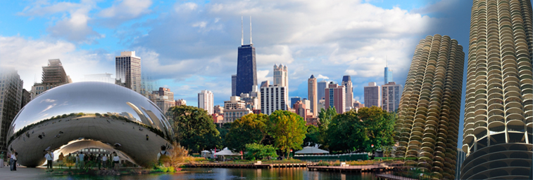
Chicago Showroom
  401 North Franklin, Suite 4E, Chicago, IL 60654
Adjacent to The Merchandise Mart

Slide 47
Partners with
“The Sustainable Solution”
www.nxtwall.com

