Slide 1

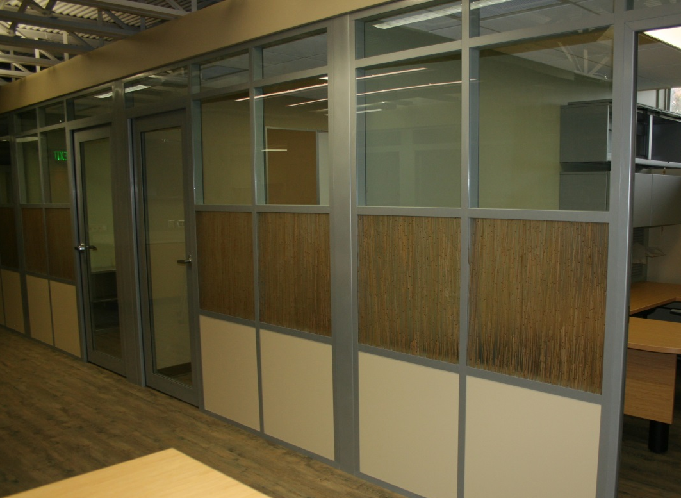
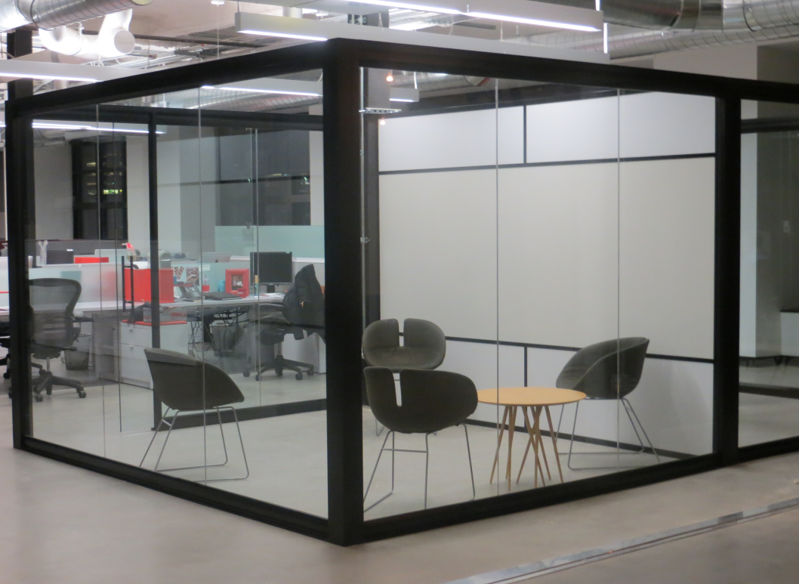
Kalamazoo, MI
Headquarters
Downtown Chicago
Corporate Showroom
The Sustainable Solution

Slide 2

Who is
?
Demountable Wall/Partition company focused on offering great aesthetics, flexible design and sustainable products
100% Made in the USA
Deliver a “real” Demountable Wall solution that supports and promotes change, understands the importance of cost while adapting to the needs of an ever changing workplace.
Installations in 40+ States
Headquarters located in Kalamazoo, MI
Corporate Showroom Downtown Chicago near the Merchandise Mart

Slide 3
Why
Demountable Walls?
      Simple Kit of Parts (Solid to Glass or Glass to Solid)
      Field Fit (Stick Built vs Unitized or Semi-Unitized)
      Non-Progressive
      Ease and Speed of Construction
      2 to 3 Week Standard Lead Time
      The Most Sustainable in the Industry
      LEED Points (Regional Materials, Local Labor)

Slide 4
Installation
Simple single Office Installation using the Flex Series incorporating Glass and Solid Panels performed by a two man crew in four hours.
Click to Start

Slide 5
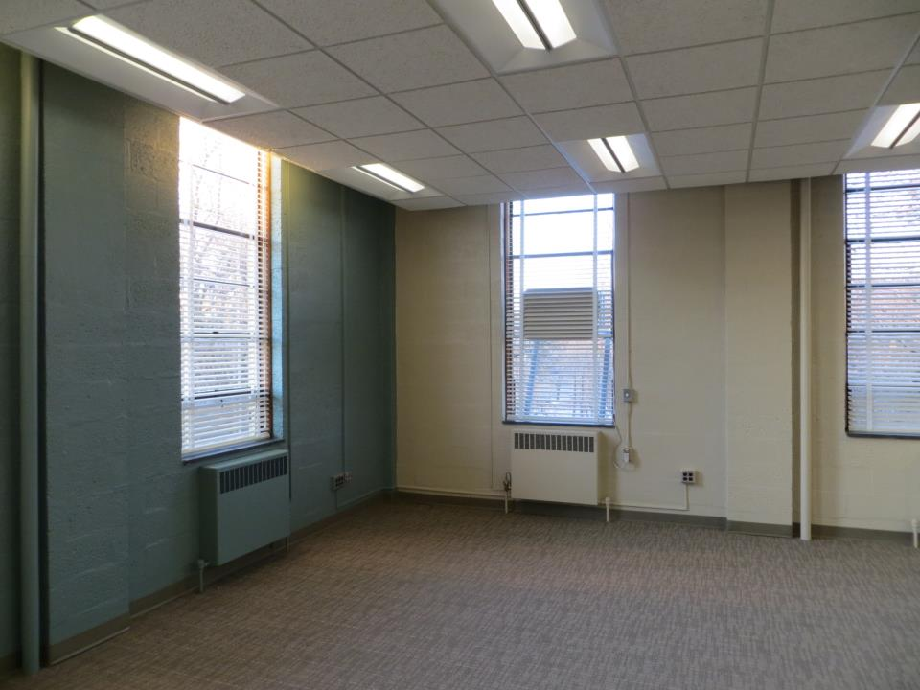

Slide 6
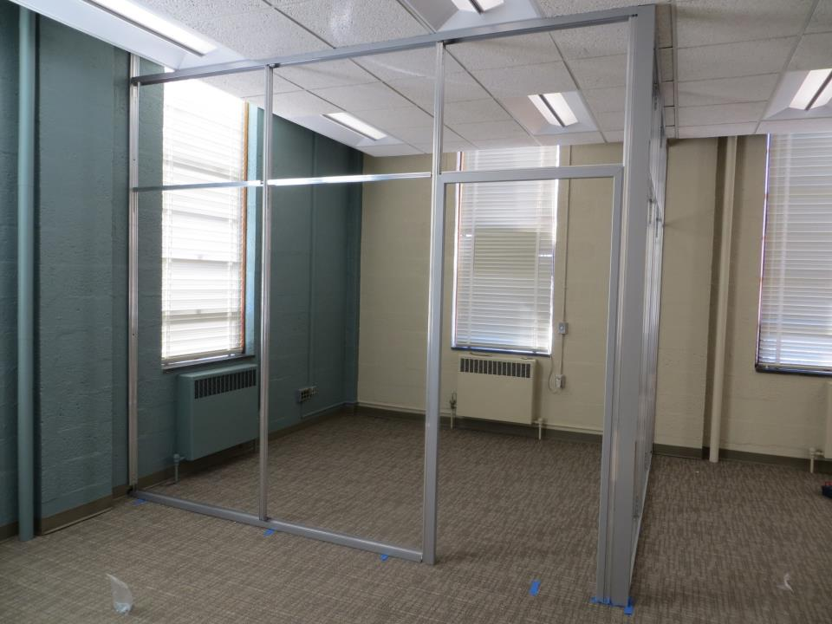

Slide 7
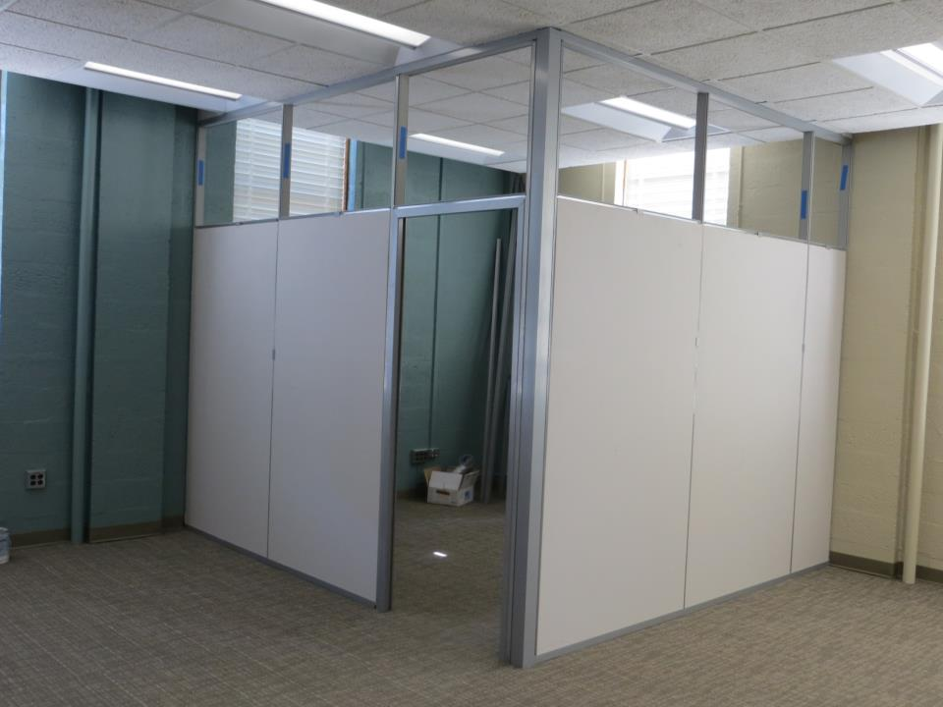

Slide 8
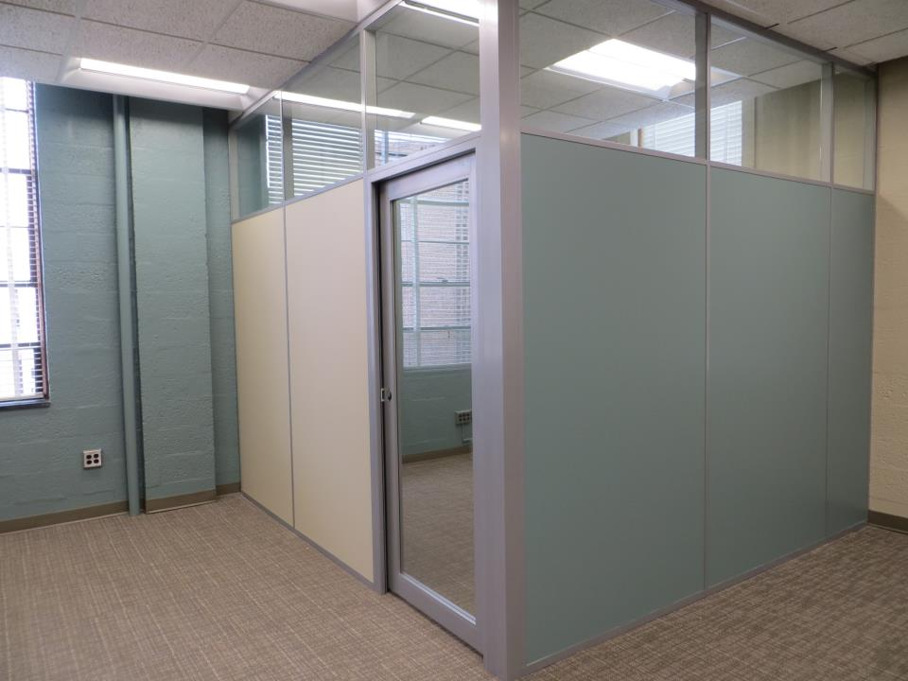
Click to advance

Slide 9
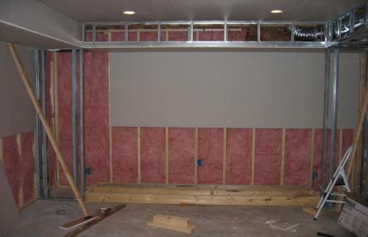
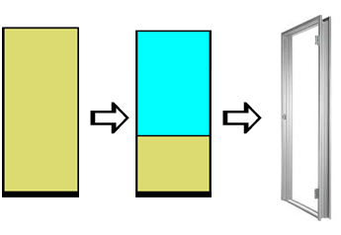
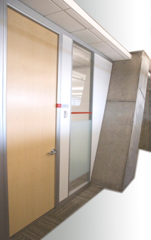

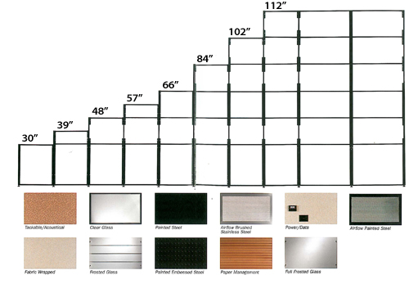
The Evolution of Walls
      Drywall Construction
      Unitized (First Generation)
      Pre-engineered
      (Second Generation)
      Truly Demountable “Field Fit”
      …product fits to building conditions

Slide 10

Unitized vs
Pre-Engineered/Pre-Manufactured vs
NxtWall
Who are they?
The "Unitized" Demountable Wall | Pre-Engineered/Pre-Manufactured Demountable Wall | NxtWall’s "Field Fit" Capability
DIRTT Trendway SMED Transwall Inscape KI Genius Wall Infinium Steelcase Others | DIRTT Teknion Altos Enclose Many of the Italian or European designed products Others | NxtWall - Flex Series - View Series DIRTT

Slide 11
Wall SERIES
Flex Glass/Solid
Genesis Glass/Solid
Extend Solid Only
View Glass Only

Slide 12
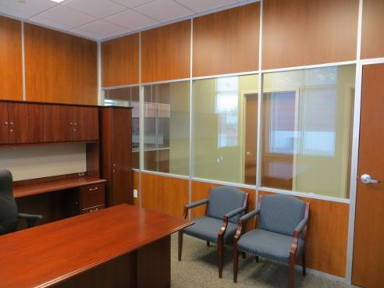
FLEX WALL SERIES
3” Thick Wall
  Floor to Ceiling/Freestanding
Wall board can be any ½” material
Easily Incorporate Glass and Solids
Single or Double pane Glass
Universal Swing Doors
Barn and Pocket Door Options
Great Acoustical Performance
Wide Trim option (Genesis)
Integrated White Board, Tackable Surface, Fabric, Electrical, Electric Privacy Glass, etc.
4” Thick wall (Extend)

Slide 13
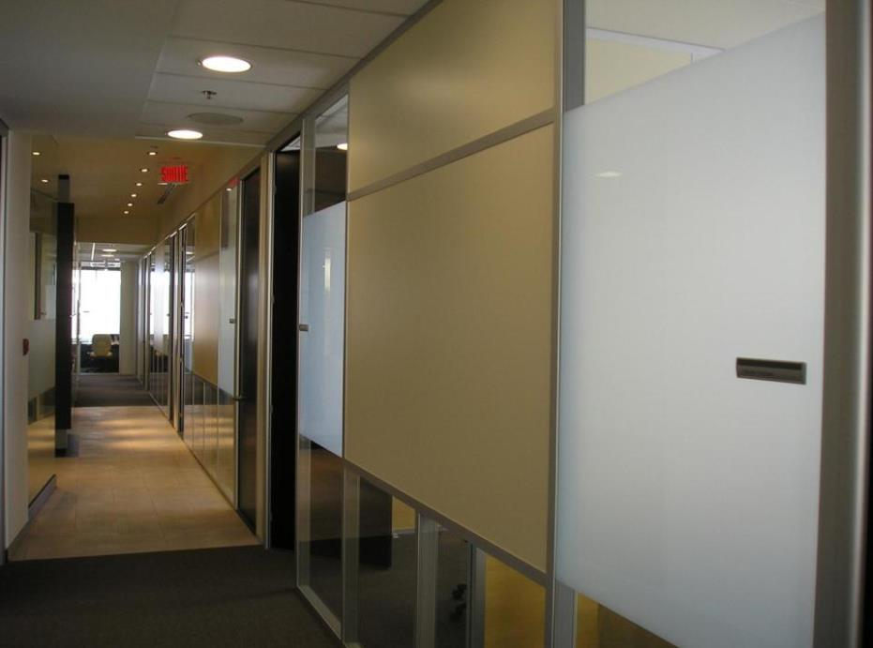
Flex Series

Slide 14
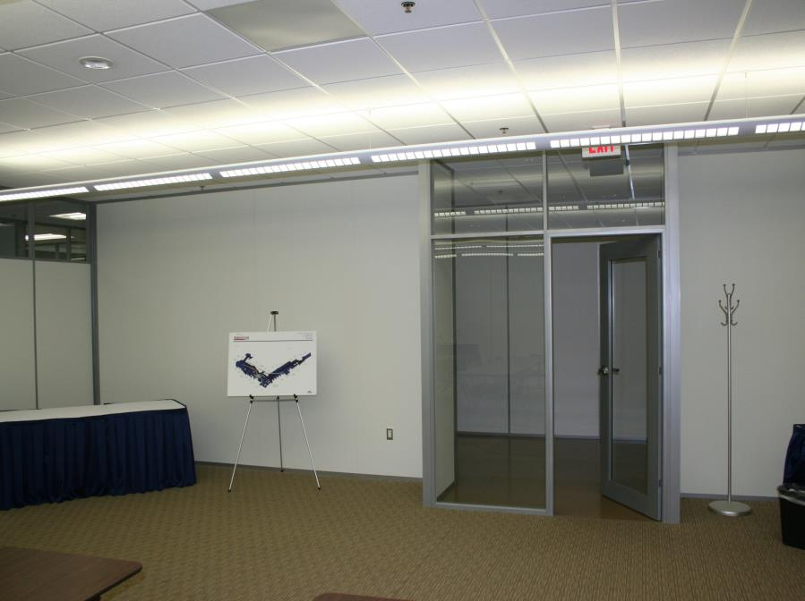
Flex Series

Slide 15
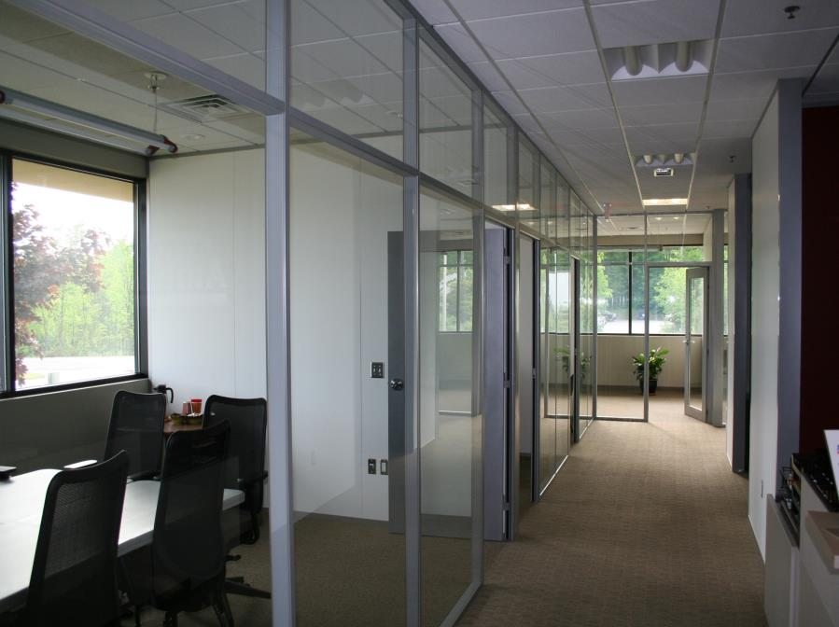
Flex Series

Slide 16
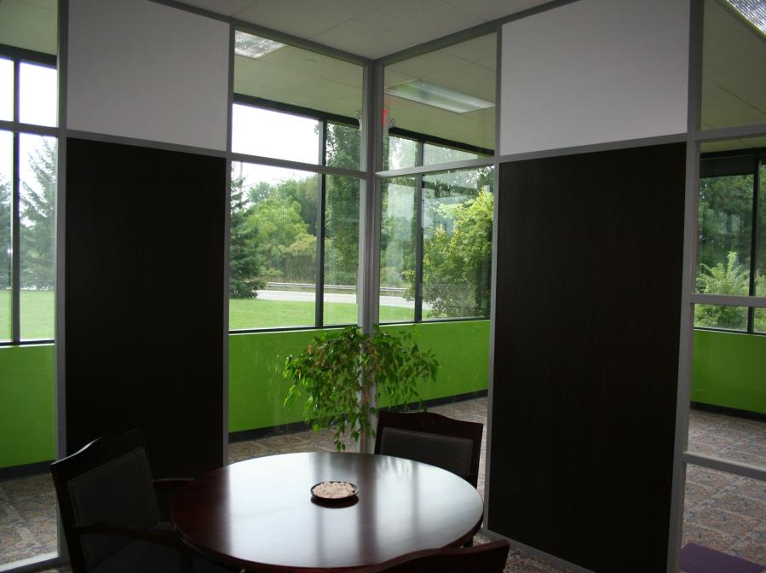
Flex Series

Slide 17
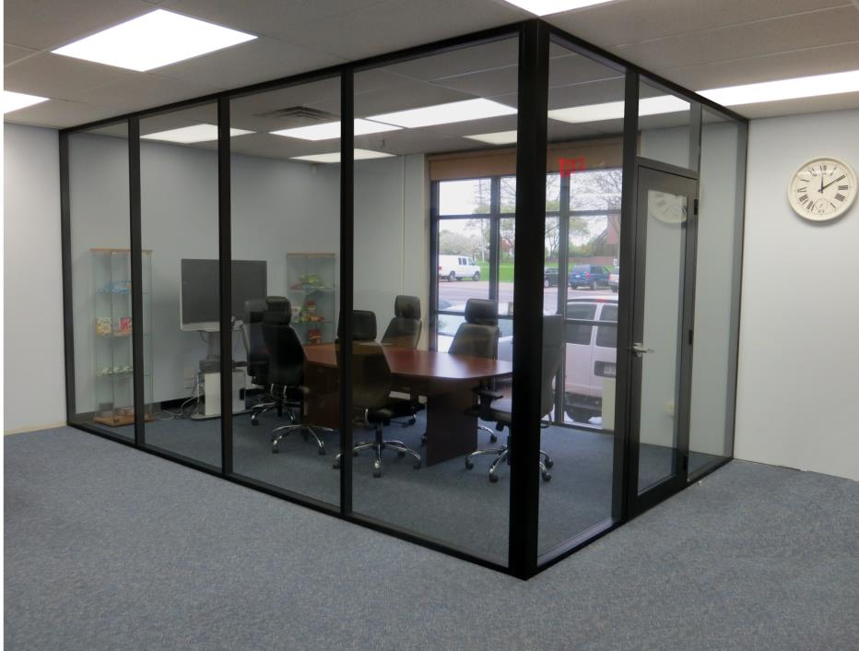
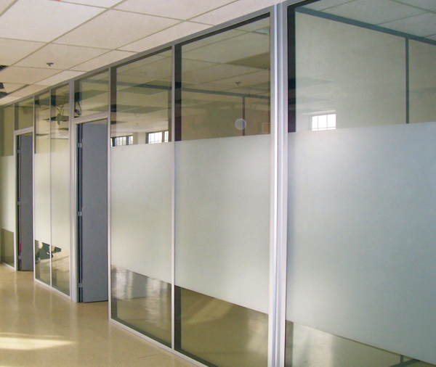
Flex Series

Slide 18
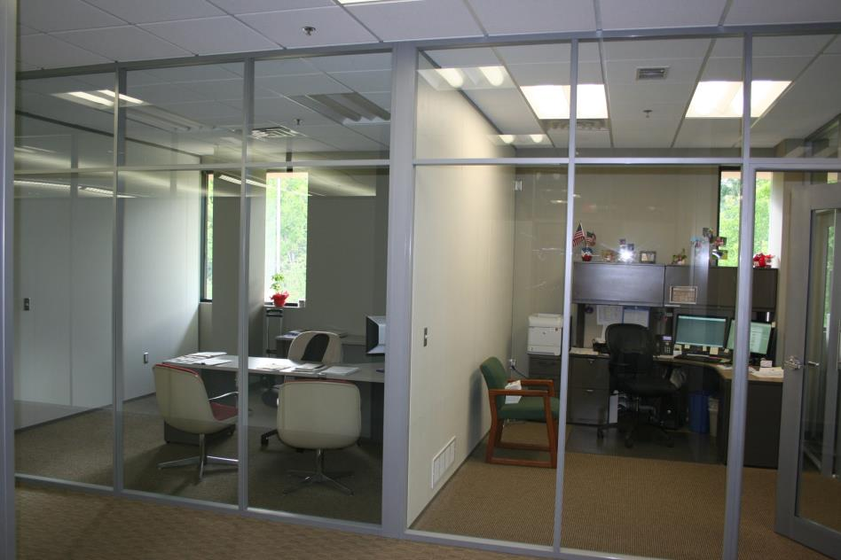
Flex Series
Solid Core Swing Door, Sidelight and Laminate

Slide 19
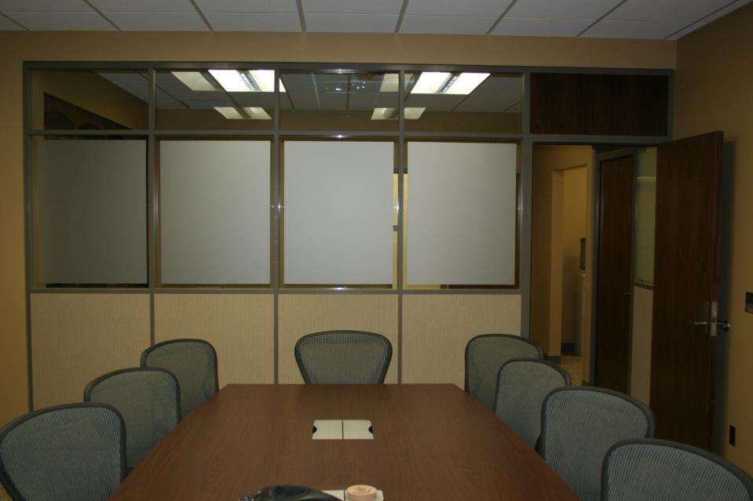
Flex Series
Solid Core Swing Door, Sidelight and Laminate

Slide 20
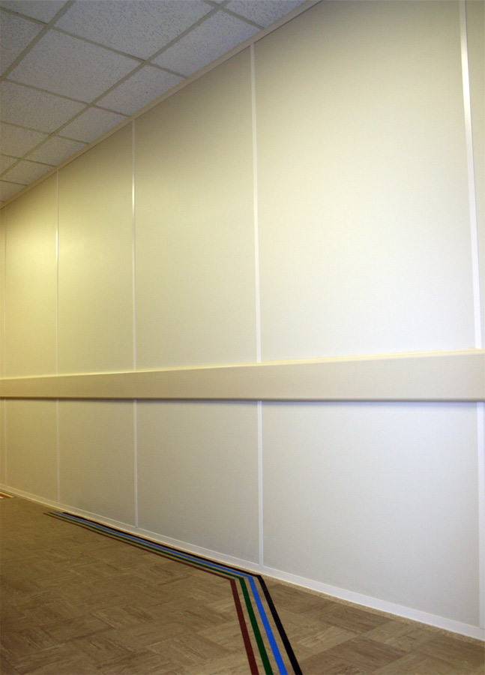
Matching Wall Board and Trim

Slide 21
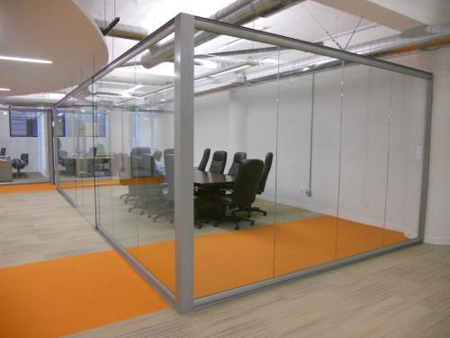
VIEW WALL SERIES
Center Mounted Single Pane Glass 3/8” to 5/8”
Floor to Ceiling or Freestanding
Integrated Sliding Doors
Universal Swing Doors
Designed as a stand alone Storefront or compliments the Flex Series for a total Office solution

Slide 22
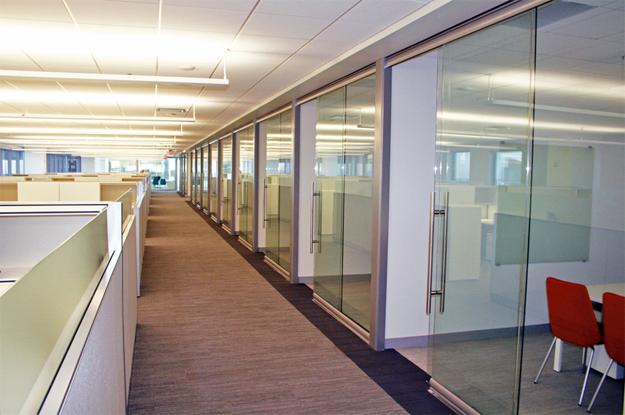
View Series

Slide 23
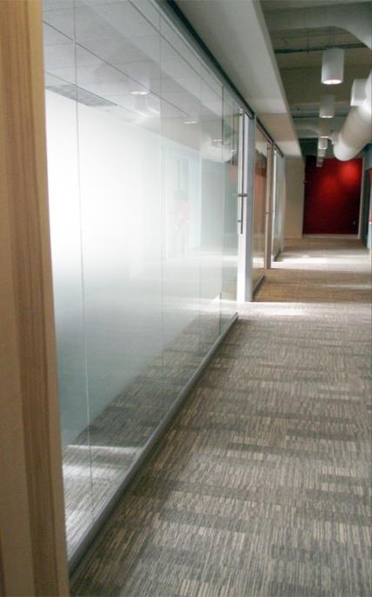
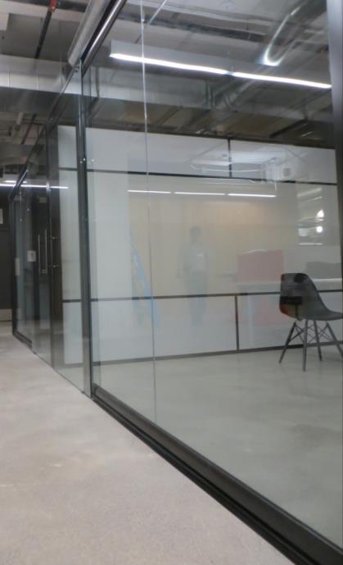
View Series
View Series
View Series

Slide 24
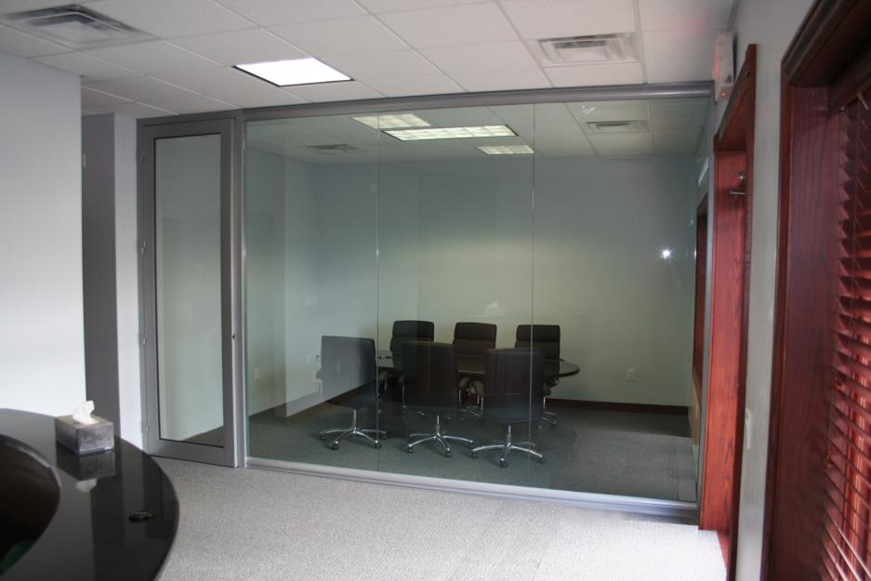
View Series

Slide 25
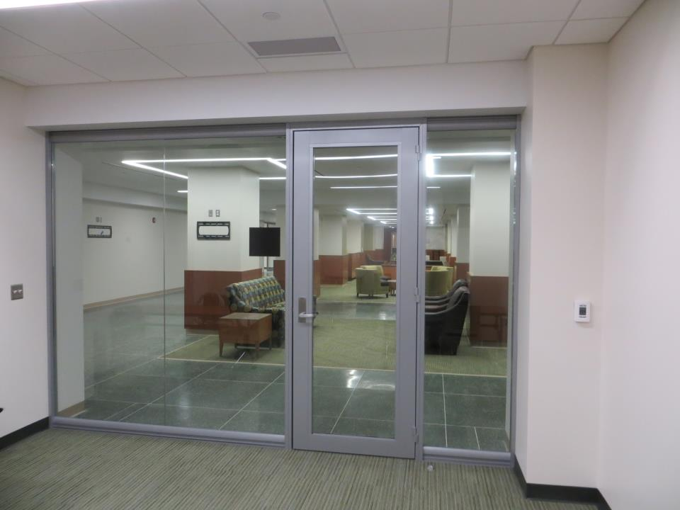
View Series

Slide 26
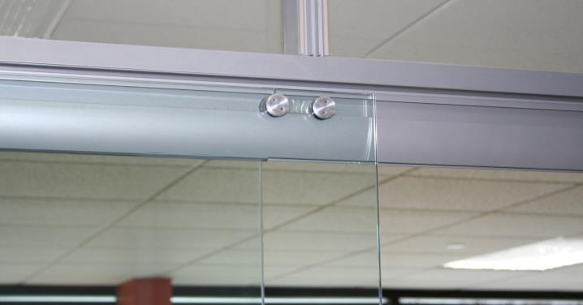
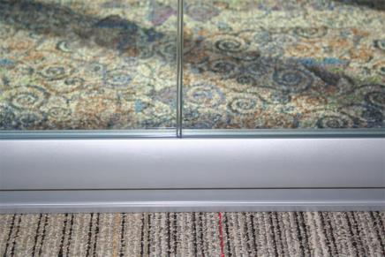
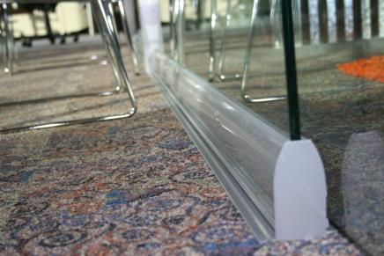

Slide 27
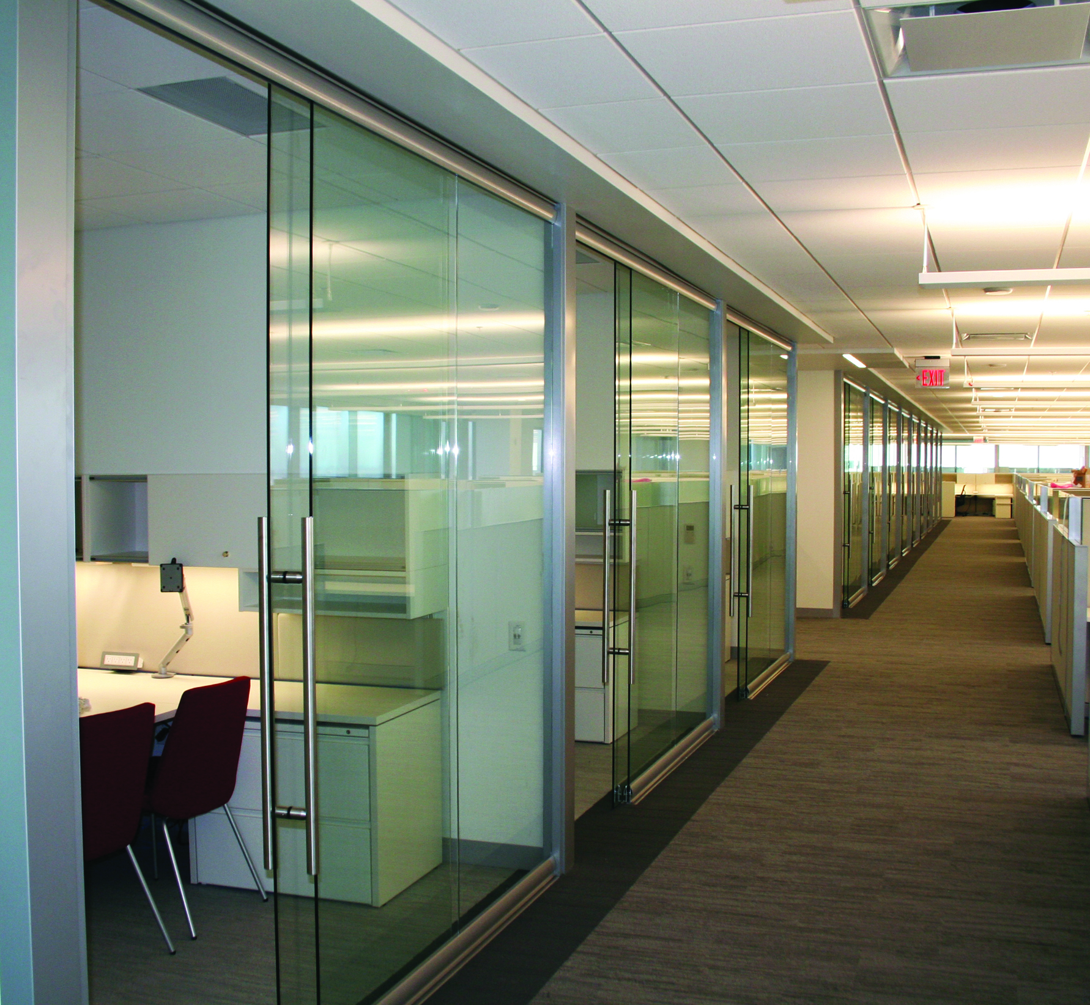
View Series

Slide 28
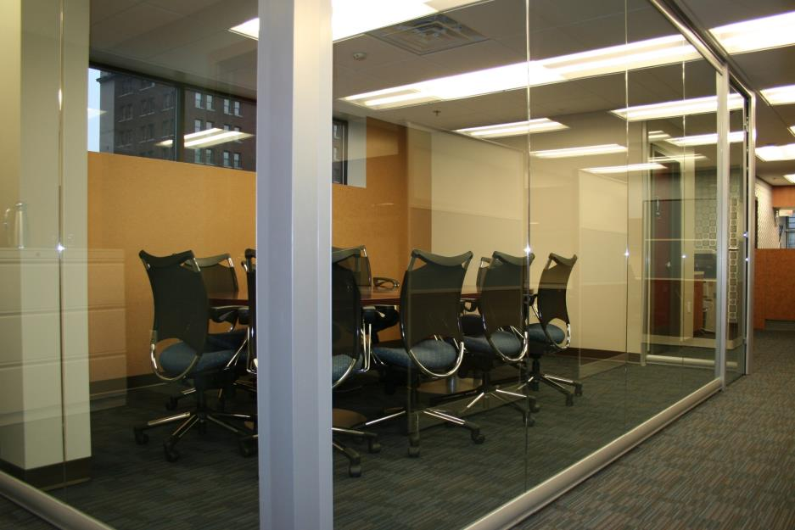
View Series

Slide 29
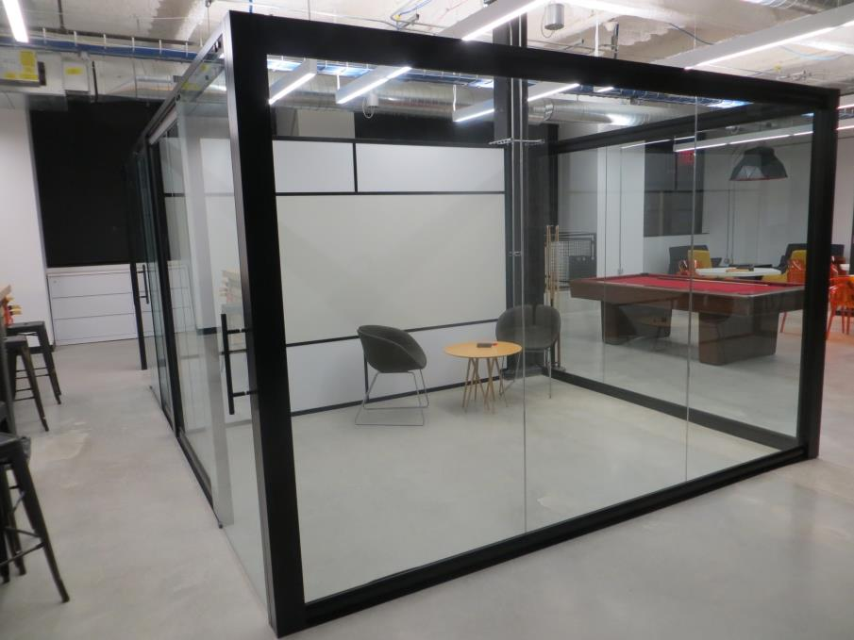
View Series
View Series

Slide 30
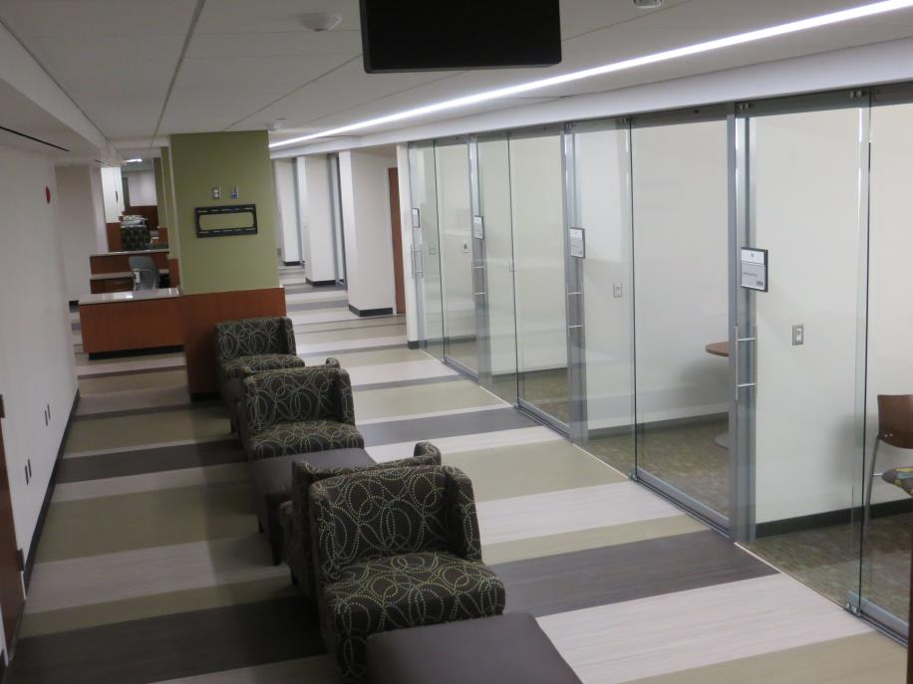
View Series
View Series
View Series

Slide 31
Sustainability
Meet the needs of the present without compromising the ability of future generations to meet their own needs
      Recycled and recyclable content
      Outstanding products reuse strategy
      Regional materials as needed
      Supports worker comfort, safety and health

Slide 32


































Slide 33
THE NXTWALL ADVANTAGE
Work Flow: Clean efficient process, One Trade group, Low impact on operations
Sustainability: Recycle, Reuse, LEED, Worker comfort
Price: Blended price per lineal foot competitive with GC/Trades
Architectural: Glass, Colors, Unique shapes, Integration
No Permits: Most municipalities do not require a permit to install furniture
Quick lead times: 3-5 Week Standard Lead Times
Flexibility: As requirements change so can our walls
Long Term savings: Reuse/Re-purpose strategy
Tax Advantages: Qualifies as Furniture for accelerated depreciation
Speed: No delays as with typical gypsum board construction. Eliminate debris, sanding, finishing and painting
Experience: NxtWall has the expertise, experience and the performance to provide a
successful project on time and on budget…

Slide 34
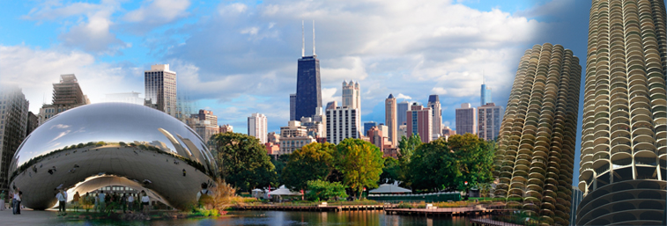
Chicago Showroom
  401 North Franklin, Suite 4E, Chicago, IL 60654
Adjacent to The Merchandise Mart

Slide 35
“The Sustainable Solution”
KEY CONTACTS:
Jerry Sweet President jsweet@nxtwall.com
Chris Palinski VP Operations cpalinski@nxtwall.com
Tim Gunter Lead Designer tgunter@nxtwall.com
Gregg Cullen Marketing gcullen@nxtwall.com
www.nxtwall.com
269-488-2752

