Slide 1

Sustainable Demountable
Wall Design
Meeting the needs of the present without compromising the ability of future generations to meet their own needs

Slide 2
Environmental Statement
“Construction and Manufacturing of any kind places a burden on the environment. Environmental responsibility begins with a product’s ability to support significant change and reuse.”

Slide 3

The Three R’s of Sustainablility
RECYCLE REDESIGN REPURPOSE
NxtWall’s “Field Fit” Simple Kit of Parts approach to building leads the way in the demountable wall industry and proactively supports redesigns, repurpose and recycling. These are the key ingredients of Sustainable Building Design.

Slide 4
What Makes NxtWall so Unique?
Material content
Redesign options post initial installation
Ability to source Regional materials
Creativity for product reuse
Product solution can avoid landfills
Avoid costly recycling process, incentive to recycle
Community-based labor

Slide 5
NxtWall Material Content
All aluminum and steel utilize both recycle and recyclable content.
Insulation option is recycled PET….pop bottles, plastic containers, etc.
Options for recyclable wall board materials
  Skyblend Particleboard
  MAG board
  Gypsum board provides a recycled and recyclable option

Slide 6
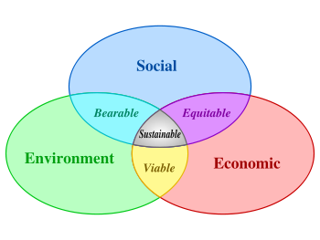
Affordable Adaptability
NxtWall’s Panels are not “Unitized” allowing end- users the opportunity to change configurations, colors and function to adapt to environmental changes as space is reconfigured

Slide 7
Reasons for Changes
Privacy: Ability to add insulation or Double Pane glass for greater sound control
Public: Add Glass to increase visibility
Capacity: Increase or decrease square footage
Image: Color scheme “New Look”
Ergonomics: Increase productivity by introducing natural daylight

Slide 8
www.nxtwall.com
info@nxtwall.com
(269) 488-2752

