Slide 1
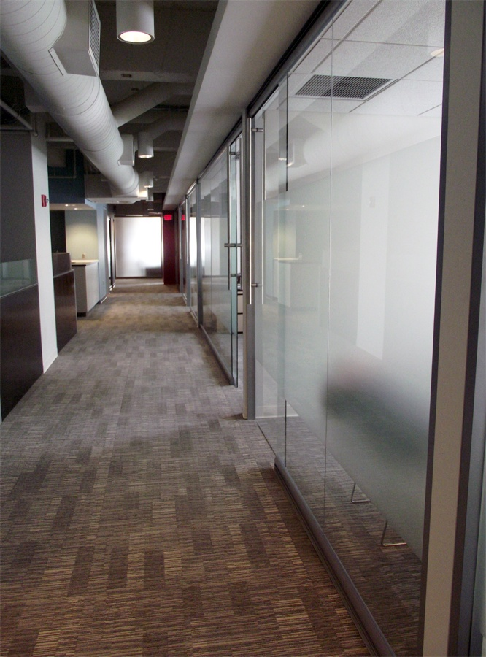

VIEW SERIES
Track Assembly & Installation

Slide 2
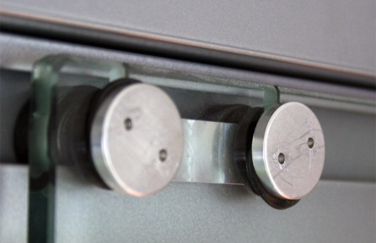
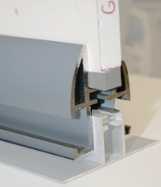
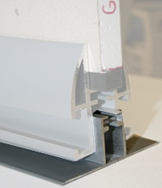
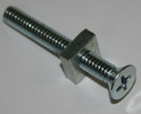
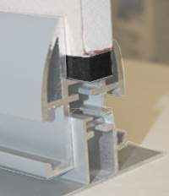
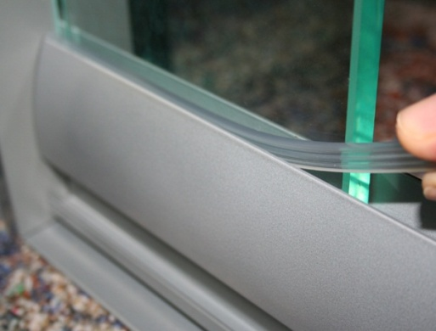
Minimum Parts Using Existing Walls
1) VIEW Top/Bottom Universal Track
2) Track Guide
3) Level Adjusters
4) Glass Shims
5) Glass Caulk/Glazing Spline
6) Sliding Glass Door: (3 Sliding Carriages, 1 Bar Pull, 2 Door Stops)
7) Side Glass
Detail of Sliding Carriage:
1) Top/Bottom Track
2) Track Guide
3) Level Adjusters
4) Glass Shims
6) Sliding Glass Door
INCLUDES: 3 sliding carriages (see detail above), 2 door stops, & 1 bar pull.
5) Glass Caulk / Glazing Spline
7) Side Glass

Slide 3
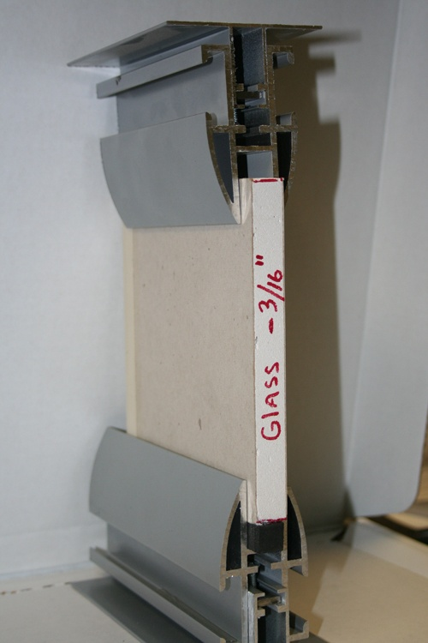
TRACK GUIDE
MINIMUM AIR GAP 3/16TH INCH
VIEW TRACK
FINAL ASSEMBLY
VIEW SERIES
GLASS
GLASS CAULK/Glazing spline
VIEW TRACK
X
GLASS SHIM
MINIMAL AIR GAP 3/16TH INCH
TRACK GUIDE

Slide 4
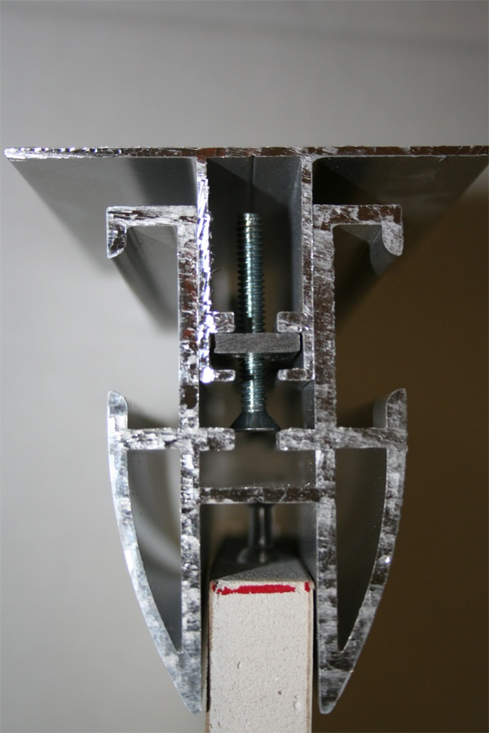
TOP TRACK ASSEMBLY
TRACK GUIDE
MINIMUM AIR GAP 3/16TH INCH
LEVEL ADJUSTER
VIEW TRACK

Slide 5
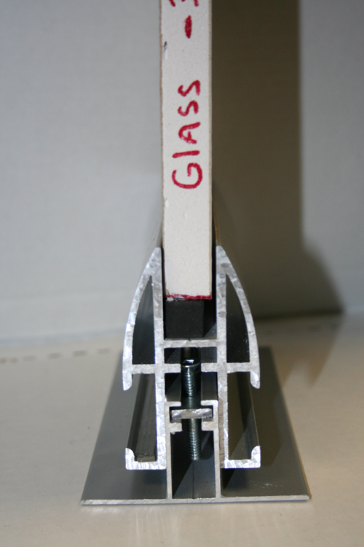
BOTTOM TRACK ASSEMBLY
GLASS CAULK/Glazing spline
X
GLASS SHIM
VIEW TRACK
LEVEL
ADJUSTER
MINIMUM AIR GAP 3/16TH INCH

Slide 6
QUESTIONS
TO ASK:
MINIMUM AIR GAP 3/16TH INCH
1. Are my Tracks Level?
2. Do I have the required Minimum
Air Gap?
NOTE: If flooring is not down you
must compensate for its thickness:
Min air gap 3/16” + flooring thickness
3. Have I secured the Track Area to
the Deck above the Door
opening?
4. Is the Glass properly secured in
Top Track?
VIEW TRACK
GLASS CAULK/Glazing Spline
VIEW TRACK
GLASS SHIM
X
MINIMUM AIR GAP 3/16TH INCH

Slide 7
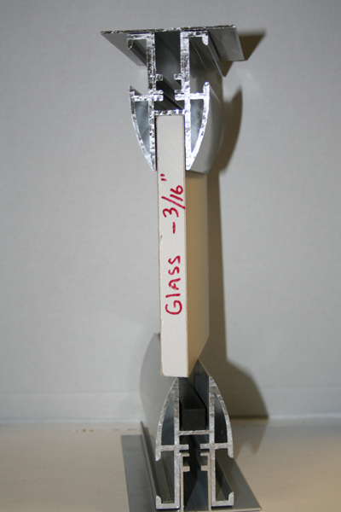
GLASS MEASUREMENT
Measure from the Inside of the Top Track to the Top Edge of the Bottom Track and Subtract 3/16th of an Inch.
Total Distance Minus 3/16”= Glass Length
Total minus 3/16th Of One Inch
X

Slide 8
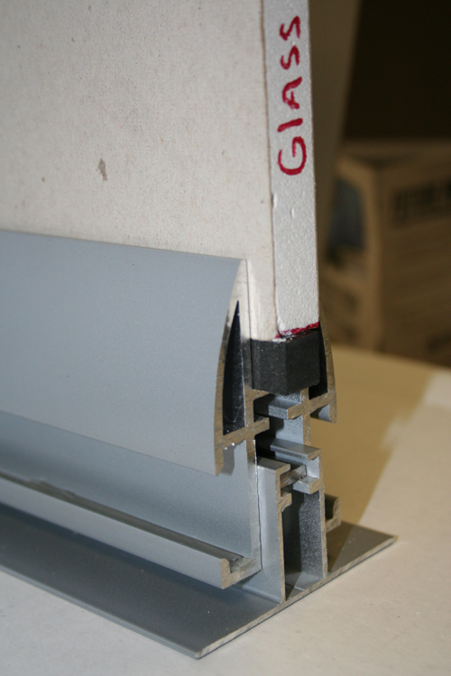

GLASS SPACER DETAIL
GLASS CAULK/
Glazing Spline
GLASS CAULK/Glazing Spline
GLASS SHIM
X
Note: Additional Shims can be installed to achieve proper securement in the Top Track.

Slide 9
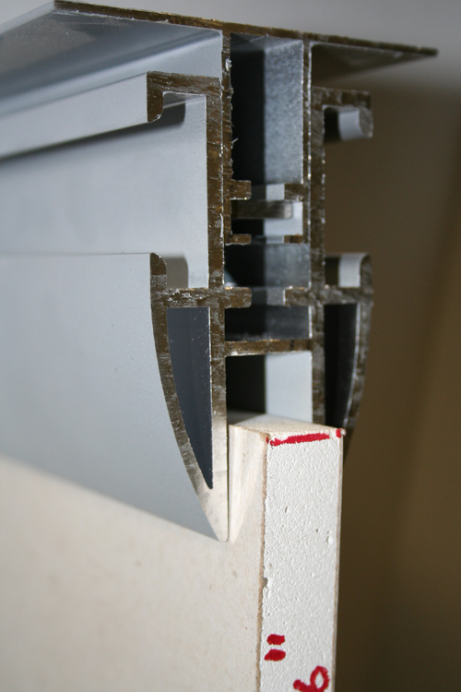
TOP TRACK DETAIL WITH GLASS INSTALLED
AIR GAP AT TOP OF GLASS PANEL
Avoid large air gaps by installing additional shims in the Bottom Track.
GLASS

Slide 10
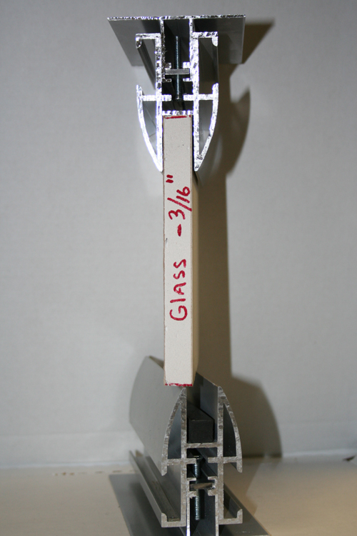
TRACK GUIDE
VIEW TRACK
SLIDING DOOR
GLASS MEASUREMENT
Door Glass is measured between the VIEW Top Track and VIEW Bottom Track minus 1/4“
VIEW TRACK
TRACK BASE TO TRACK CEILING MINUS ¼”
Track Base + Track Base - 1/4 Inch
X
VIEW TRACK
VIEW TRACK
TRACK GUIDE

Slide 11
VIEW SERIES
VIEW TRACK
EXISTING WALL
Side Glass Minimum Width 37”
EXISTING WALL
Glass Door Width 42 ½”
VIEW TRACK
Rough Opening 38 ½”
DIMENSIONS TO ACHIEVE A 33” FINISH OPENING

Slide 12
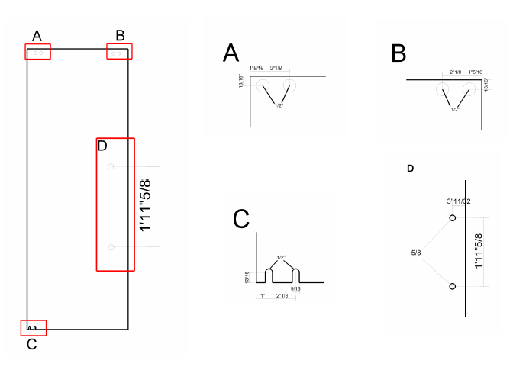
SLIDING DOOR GLASS TEMPLATE
With Standard Bar Pull
TBD
D
TBD

Slide 13
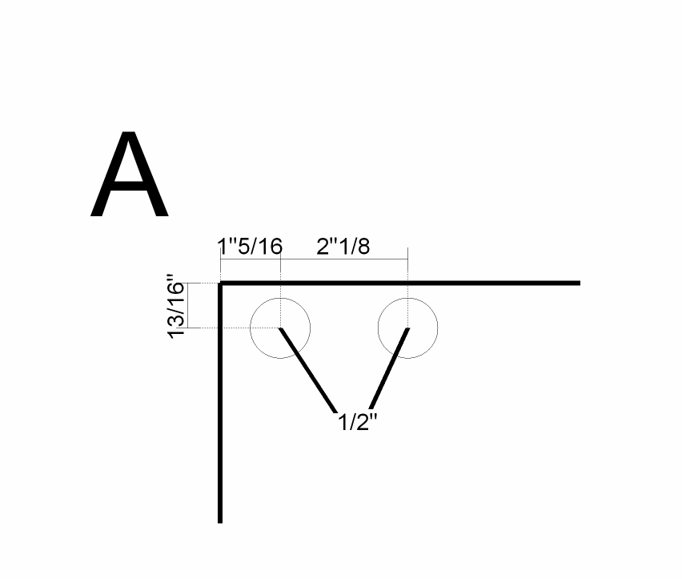
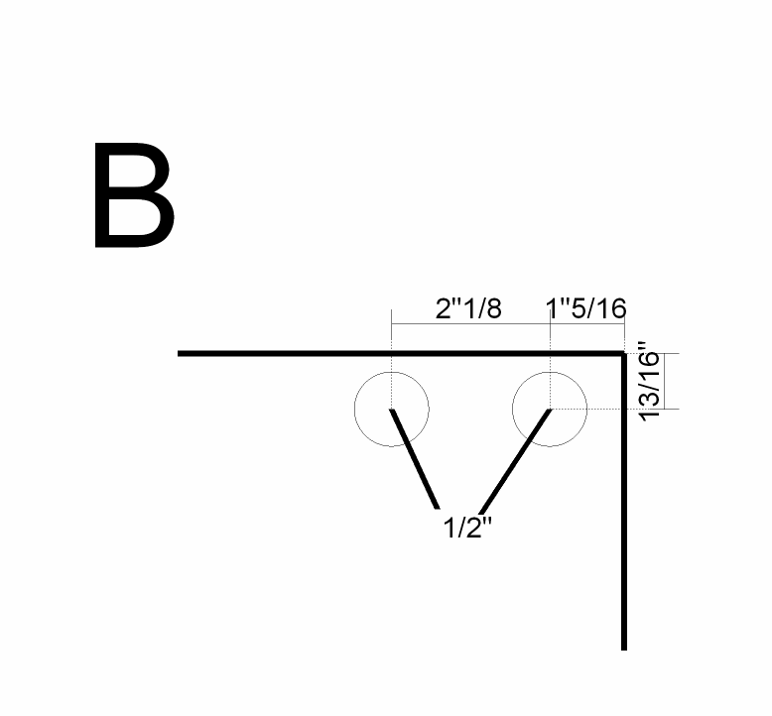
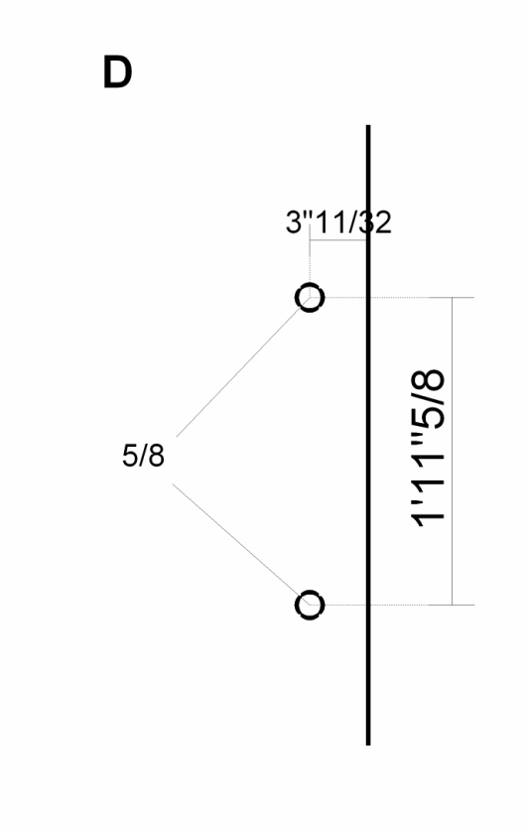
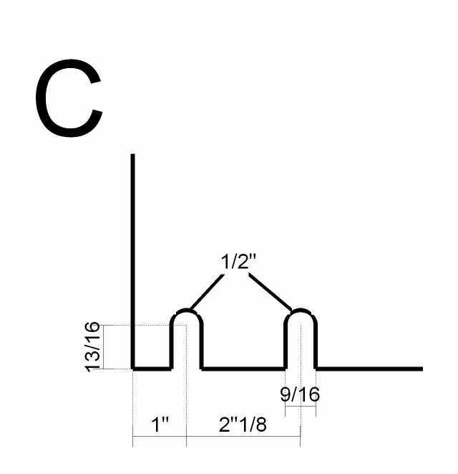
SLIDING DOOR GLASS TEMPLATE
With Standard Bar Pull
A
B
A = Top Left
B = Top Right
C = Bottom Left
D = Door Pull Right
D
C
TBD

Slide 14
VIEW SERIES
VIEW TRACK
EXISTING WALL
EXISTING WALL
VIEW TRACK

Slide 15
FOR MORE INFO
Contact:
info@nxtwall.com
Or call: 269-488-2752

